Slide 1
Small-Sided Soccer
RULE DIFFERENCES

Slide 2
Small-Sided Soccer Rule Modifications
The Soccer Rule Differences contained in this presentation are based upon the latest recommended modifications by US Youth Soccer to the FIFA (USSoccer) Laws of the Game.

Slide 3
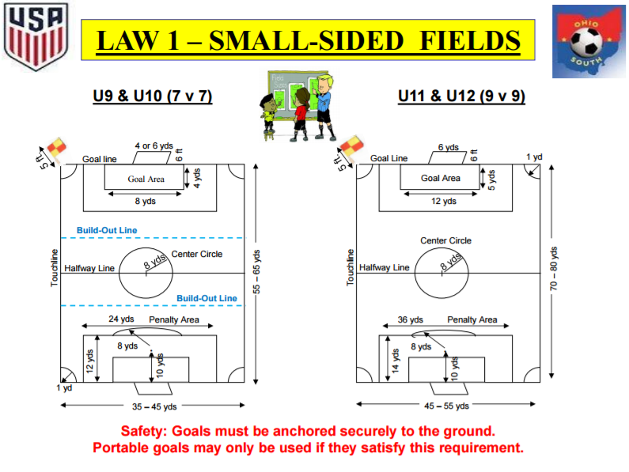

Slide 4
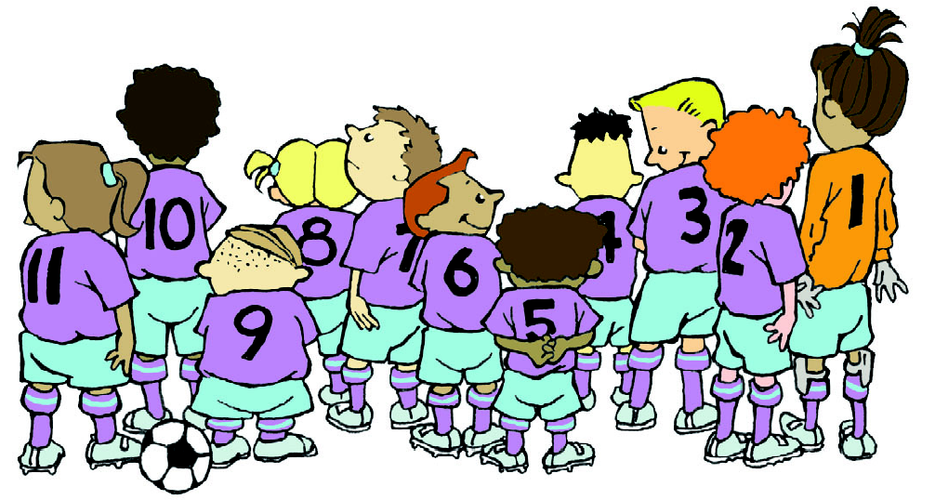
LAW 3 - NUMBER OF PLAYERS
Full-Sided Games
U13 & Older:
11 v 11 players, one of whom must be the goalkeeper … (minimum of 7 players to continue)
Small-Sided Games (Two different levels)
U11 & U12: 9 v 9 players, one of whom must be the goalkeeper … (minimum of 6 players to continue)
U9 & U10: 7 v 7 players, one of whom must be the goalkeeper … (minimum of 5 players to continue)

Slide 5
LAW 8 - START OF PLAY (Small-Sided)
U9 & U10 (7v7) and U11 & U12 (9v9)
As per FIFA / USSoccer
Distance from the Ball (Until ball is in play):
Kick-off U9 & U10 U11 & U12 U13 & Older Opponents 8 yds. 8 yds. 10 yds.

Slide 6
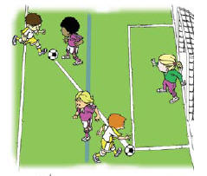
LAW 11 – OFFSIDE
(Small-Sided)
U11 & U12 (9 v 9)
Offside as per FIFA / USSoccer

Slide 7
LAW 11 – OFFSIDE
(Small-Sided)
U9 & U10 – (7 v 7)
Offside as per FIFA / USSoccer
Exception: Attacking players can only be in an offside position when they are between the build-out-line and the goal-line, i.e. within the Build-Out Area.
Offside is not in effect between the half-line and the build-out-line.

Slide 8
LAW 12 – FOULS & MISCONDUCT
(Small-Sided)
U11 & U12 (9 v 9)
All restarts are as per FIFA / USSoccer … DFK & IFK
Any misconduct punished as per the Laws of the Game
U12
NOTE: Heading is allowed in games without limitations.
U11
NOTE: Heading is NOT allowed in games.

Slide 9
LAW 12 – FOULS & MISCONDUCT
(Small-Sided)
U9 & U10 (7 v 7)
EXCEPTION #2: Goalkeepers are not allowed to punt or drop kick the ball.
An IFK is awarded to the opposing team at the spot of the offense.
If the punt occurs within the goal area, the IFK is to be taken on the goal area line parallel to the goal line at the nearest point to where the infringement occurred.

Slide 10
LAW 12 – FOULS & MISCONDUCT
(Small-Sided)
U9 & U10 (7 v 7)
Restarts are as per FIFA / USSoccer … DFK & IFK
Any misconduct punished as per the Laws of the Game
EXCEPTION #1: Deliberate heading is not allowed.

Slide 11
LAW 13 – FREE KICKS (Small-Sided)
The minimum distance that all opposing players must be from the ball at the taking of a free kick is the same as the “radius of the center circle”.
7v7 9v9 11v11
Center Circle Radius 8 yds. 8 yds. 10 yds.

Slide 12
LAW 14 – PENALTY KICK (Small-Sided)
U9 & U10 (7 v 7)
Penalty Spot is 10 yds. from the Goal Line
U11 & U12 (9 v 9)
Penalty Spot is 10 yds. from the Goal Line
Full-Sided U13 & Older (11 v 11)
Penalty Spot is 12 yds. from the Goal Line

Slide 13
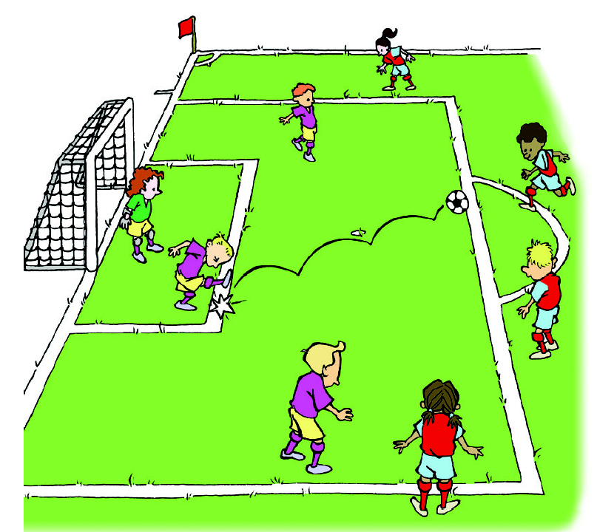
LAW 16 - GOAL KICK (Small-Sided)
U11 & U12 (9 v 9)
As per FIFA / USSoccer:
Opponents must be outside penalty area.
The ball is in play when it is kicked outside the penalty area and into play.

Slide 14
LAW 16 - GOAL KICK (Small-Sided)
U9 & U10 (7 v 7)
As per FIFA / USSoccer:
U9 & U10 EXCEPTION:
Opposing players must retreat to behind the build-out- area until the ball is in play.
The ball is in play when it is kicked outside the penalty area and into play.

Slide 15
LAW 1 – SMALL-SIDED FIELDS (7 v 7)
THE FIELD OF PLAY
Touchline
Goal Line
Build-Out Line
Center Circle
Goal Area
Penalty Area
Build-Out Area
Penalty Area
Penalty Area
Goal Area
Build-Out Area
Halfway Line
Build-Out Line
Goal Line
Touchline

Slide 16
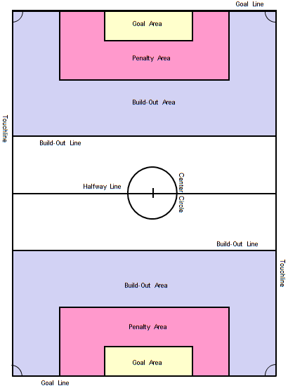
LAW 1 – SMALL-SIDED FIELDS (7 v 7)
U9 & U10 (7 v 7)
The Build-Out-Lines are only used in U9 and U10 (7 v 7) matches.
The Build-Out-Lines are located equidistant between the Halfway line and the Penalty Area line.
The Build-Out Areas at each end of the field are located between the Build-Out-Line and the Goal-Line and bounded by the two touchlines.
Safety: Goals must be anchored securely to the ground.
Portable goals may only be used if they satisfy this requirement.

Slide 17
LAW 1 – SMALL-SIDED FIELDS (7 v 7)
U9 & U10 (7 v 7)
Build-Out Areas
The opposing team must move outside the Build-Out Area:
on all goal kicks
on any defensive free kick taken from within the Build-Out Area (must also be at least 8-yds. from the ball).
whenever the goalkeeper gains possession of the ball with their hands during play.

Slide 18
LAW 1 – SMALL-SIDED FIELDS (7 v 7)
U9 & U10 (7 v 7)
Build-Out Areas
The opposing team must remain outside the Build-Out Area until the ball is put back into play.
On goal kicks the ball is in play when it leaves the penalty area.
On free kicks (DFK or IFK) the ball is in play when it is kicked and clearly moves (and leaves the penalty area).
On goalkeeper possession the ball is in play when:
the ball is placed on the ground and kicked or
the goalkeeper releases the ball by either throwing or rolling it into play.

Slide 19
LAW 1 – SMALL-SIDED FIELDS (7 v 7)
U9 & U10 (7 v 7)
Build-Out Areas
At any time the goalkeeper may pass, throw or roll the ball to a teammate before the opponents have moved outside the Build-Out- Area, but by doing so the goalkeeper accepts the positioning of the opponents and the consequences of how play resumes.
Goalkeepers are not allowed to punt or drop-kick the ball as this would defeat the purpose of the Build-Out-Lne. Restart is IFK at spot of offense (or pull out to goal area line)
After the ball is put back into play, the opposing team can then move into the Build-Out Area and play resumes as normal.

Slide 20
LAW 1 – SMALL-SIDED FIELDS (7 v 7)
U9 & U10 (7 v 7)
Build-Out Areas
Offside
Attacking players are in an offside position only when they are in the opponent’s Build-Out Area.
The Build-Out-Lines are used as the offside lines, therefore no offside offense can occur between the two Build-Out-Lines.
ARs would run the touchline from goal line to Build-Out-Line.

Slide 21
OSSRC
Heading the Ball
Restrictions
If a player in a U11(9v9), U10(7v7) or younger age group match deliberately heads the ball in a game with any portion of their head, an indirect free kick (IFK) is to be awarded to the opposing team from the spot of the infraction.
If the ball makes contact with a player’s head and the player has not deliberately played or attempted to play the ball, then play should continue as no infraction has occurred.

Slide 22
OSSRC
Heading the Ball
Restrictions
A player shall not be cautioned nor sent-off for persistent infringement, as a result of a heading infraction.
A player shall not be cautioned nor sent-off for denying an obvious goal scoring opportunity (DOGSO), as a result of a heading infraction.
It is not a handling offense and it is not an offense committed against an opponent … therefore criteria for committing a DOGSO offense does not exist.

Slide 23
OSSRC
Heading the Ball
Clarifications
Heading of the ball is allowed in U12 and older age group matches (9 v 9) without limitations.
Referees are to enforce the heading restrictions by age group of the team in accordance with these specified rules.
Referees will not be assessing the age of individual players on the field … they will only enforce the rules for the age group.

Slide 24
OSSRC
Heading the Ball
Clarifications
Advantage shall not be implemented when a heading infraction occurs which would allow play to continue. Exception: When a ball goes directly into the goal from a header by a defending player into their own goal (e.g. with no subsequent play on the ball) the goal should be awarded. This is the only time an advantage should be applied.
This rule is primarily a SAFETY issue, which needs to be addressed immediately, such that it does not occur again.
This is not an infraction where the player needs to be punished, i.e. with a caution or send-off. Again, it is a self-inflicted safety issue.

Slide 25
OSSRC
Heading the Ball
Clarifications
It may be acceptable to have the player leave the game (much like an injury) such that the coach can talk to the player.
This is not a mandate … solely at the discretion of the referee.
More likely to implemented, if deliberate heading is repeated.
Player would be allowed back in the game at the team’s next substitution time.
Again, this is not intended to be a punishment, but instead a teaching moment.

Slide 26
OSSRC
Heading the Ball
Explanations
As a referee or an AR you must determine if ball and head contact was a deliberate act by the player.
Ball to head … not deliberate
Head to ball … deliberate
Similar to determining a handling foul … expect to hear “Headball, Ref”, as an added complaint from the sidelines.

