Slide 1

LAW 11
The
Offside
Law
2017
Notes:
When looking at Offside there are four parts we will be considering
The Offside position, what defines it
When does offside position equal offense
When is Offside position NOT an Offside offense
And what is the proper punishment for Offside infraction

Slide 2
LAW 11
How Many Parts to the Offside Law?

Slide 3
LAW 11
4 Parts
What are they??

Slide 4
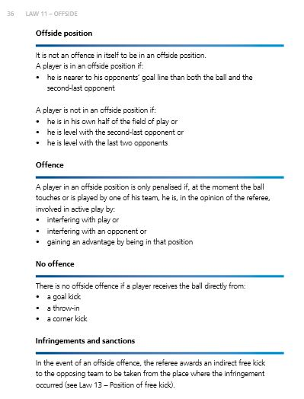
FIFA LAW BOOK
1
2
3
4

Slide 5
FIFA LAW BOOK
1
Offside Position
It is not an offence to be in an offside position.
A player is in an offside position if:
any part of the head, body or feet is in the opponents’ half (excluding the halfway line) and
any part of the head, body or feet is nearer to the opponents’ goal line than both the ball and the second-last opponent
The hands and arms of all players, including the goalkeepers, are not considered.
A player is not in an offside position if level with the:
  second-last opponent or
  last two opponents

Slide 6
FIFA LAW BOOK
2
Offside Offence
A player in an offside position at the moment the ball is played or touched by a team-mate is only penalised on becoming involved in active play by:
  interfering with play by playing or touching a ball passed or touched by a team-mate or
  interfering with an opponent by preventing an opponent from playing or being able to play the ball by clearly obstructing the opponent’s line of vision or
    challenging an opponent for the ball or
    clearly attempting to play a ball which is close to him when this action impacts on an opponent or
    making an obvious action which clearly impacts on the ability of an opponent to play the ball
    preventing an opponent from playing or being able to play the ball by clearly obstructing the opponent’s line of vision
  gaining an advantage by playing the ball or interfering with an opponent when it has:
    rebounded or been deflected off the goalpost, crossbar or an opponent
    been deliberately saved by any opponent

Slide 7
FIFA LAW BOOK
3
No Offence
There is no offside offence if a player receives the ball directly from:
  a goal kick
  a throw-in
  a corner kick
4
Infringements and Sanctions
If an offside offence occurs, the referee awards an indirect free kick where the offence occurred, including if it is in the player’s own half of the field of play.

Slide 8




LAWS OF THE GAME MADE EASY
1
(Top Page 24)
2
(Top Page 25)
3
(Top Page 26)
4
(Bottom Page 25)

Slide 9
WHAT DOES LAW 11 SAY ?
There are just 4 parts to the Offside Law
Position - Was the player in an offside position?
Involvement - Was the player involved in play?
Exceptions - Was the play one of the offside exceptions?
Restart – What’s the restart?

Slide 10
PART 1
OFFSIDE POSITION
How Many Ways ?

Slide 11
PART 1
OFFSIDE POSITION
3 Ways
What are they??
Special Conditions?

Slide 12
PART 1 - Offside Position
A player is in an offside position ONLY if they are:
ahead of the ball and
in their attacking half of the field
and
ahead of the second to last defender
If any of the 3 conditions is missing then the player is NOT in an offside position

Slide 13
PART 2
OFFSIDE OFFENSE
Involved in Active Play
How Many Ways ?

Slide 14
PART 2
OFFSIDE OFFENSE
Involved in Active Play
3 Ways
What are they??

Slide 15
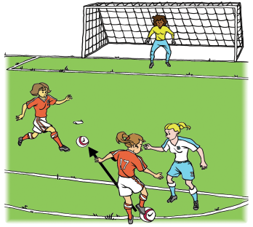
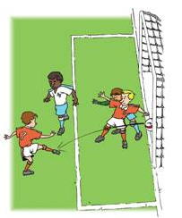
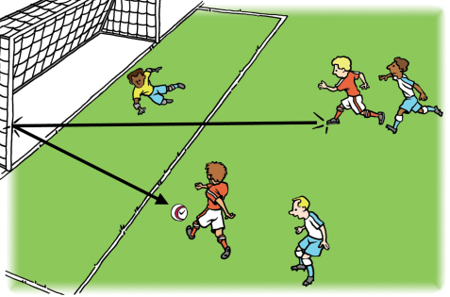
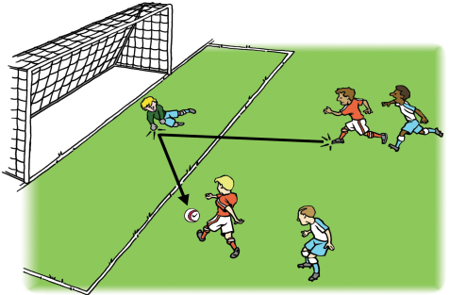
Involved in Active Play by ...
Interfering with Play
Interfering with an Opponent
Gaining an Advantage

Slide 16
Interfering With Play
Most Common Way
Having the ball played or touched (deflected) to you by a teammate
NOT “Interfering With Play” until you actually “touch” the ball.
TOUCH = Interfering with Play
NO TOUCH = NOT Offside …… YET

Slide 17
Laws of the Game Made Easy – Page 25
Interfering With Play
(Having the ball passed to you, running toward the ball, or a combination of these.)
ADD THIS NOTE:
You are NOT guilty of interfering with play until you actually touch the ball.

Slide 18
Interfering With An Opponent
Blocking movement or line of sight of the defending goalkeeper (most common way)
– just being near the goalkeeper is not enough to “interfere” with goalkeeper.
Being in the way of an opponent – forcing the opponent to stop, swerve, or slow down
Last Opponent

Slide 19
Interfering With An Opponent
AND
that movement causes an opponent to move or react
Moving to play a ball from an offside position

Slide 20
Interfering With An Opponent
Attacker moves to play a ball from an offside position AND that movement causes an opponent to react.
Guilty of Interfering with an Opponent
Attacker does not have to “touch the ball” to be Guilty

Slide 21
Interfering With An Opponent
Remember!!!
Just being in an offside position anywhere on the field is not necessarily interfering with an opponent.
A Distraction? …. YES
Direct Interference? ... NO
Direct Interference? …. YES

Slide 22
Gaining An Advantage
Touching a ball
Touching a ball deflected off the goalpost, crossbar, referee, goalkeeper, or an opponent
Must have been in an offside position when teammate played or touched the ball ……..
NOT when the ball was deflected (or merely touched) by an opponent

Slide 23
NOT Involved in
Active Play
How Shown??

Slide 24
Involved In Active Play ??
Maybe not..
An attacker in an offside position who is in the area of active play can attempt to avoid being called for offside by:
Backing away
Standing still
Moving in the opposite direction
Stepping off the field

Slide 25
PART 3
OFFSIDE EXCEPTIONS
How Many ?

Slide 26
PART 3
OFFSIDE EXCEPTIONS
3 Exceptions
What are they??

Slide 27
PART 3 – Offside Exceptions
An attacker can never be guilty of the offside offense if they receive the ball directly (first touch) from a:
Goal Kick
Corner Kick
Throw-In

Slide 28
PART 4
OFFSIDE PUNISHMENT
How Many Parts ?

Slide 29
PART 4
OFFSIDE PUNISHMENT
3 Parts
What are they ??

Slide 30
PART 4
OFFSIDE PUNISHMENT
Whistle the offside offense and stop play
Restart play with an IFK for the opposing team
IFK taken where the offside offense occurred, …. at the spot where the offside player became involved in active play (even if in the player’s own half of the field).

Slide 31
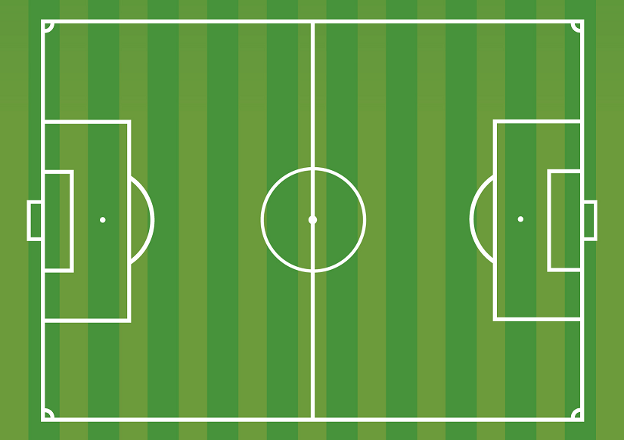
LAW 11
Restart – where A₂ touches the ball, since no defender reacted.
Where is the Restart?
A₁
K
D₁
A₁ plays the ball forward, A₂ from an offside position runs up to the ball. None of the defenders react.
A₂
X

Slide 32
LAW 11
Restart – where A₂ touches the ball, since no defender reacted.
Where is the Restart?
A₁
K
D₁
A₁ makes a square pass across the field. A₂ from an offside position runs up to the ball. None of the defenders react.
X
A₂

Slide 33
LAW 11
Restart – where A₂ was when Keeper reacted
Where is the Restart?
A₁
K
D₁
A₁ plays the ball forward, A₂ from an offside position runs up to play the ball. The keeper reacts to A₂ attempting to play the ball.
X
A₂

Slide 34
Remember
Offside Law 11 = 4 Parts
Position – 3 Ways (All at the Same Time)
Involvement – 3 Different Ways
Not Offside – 3 Exceptions
Punishment – 3 Steps

Slide 35
Also Remember
+
Position (1)
Involvement (2)
=
Offside Offense (3)

Slide 36
THE OFFSIDE CALL
ALWAYS
A Slow Whistle
Take Your Time
And Be Sure
  Slide 36

Slide 37
THE OFFSIDE CALL
If in doubt
(Not 100% Sure)
No Offside!
  Slide 37

Slide 38
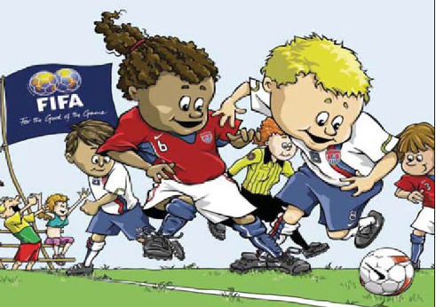
Review of the Test and Law 11

Slide 39
According to the Laws of the Game, a player in an offside position is only penalized if:
A. she is involved in active play.
B. she is closer to the ball than the defender.
C. she has an obvious chance to score.
D. none of the above
LAW 11

Slide 40
An attacking player, in an offside position, receives the ball directly from an opponent’s pass.
A. Guilty of offside B. The player is NOT guilty
LAW 11

Slide 41
For the purpose of determining if an attacker is in an offside position, the position of the attacker’s head or feet matter, but not the position of the attacker’s arms.
A. True B. False
LAW 11

Slide 42
A player cannot be punished for being offside if he receives the ball directly from a
A. direct free kick. C. corner kick.
B. indirect free kick. D. both B and C
LAW 11

Slide 43
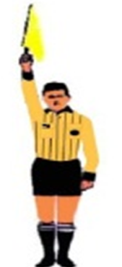
ANY time an attacker is in an offside position, but not involved with active play, the AR should signal as follows:
A. True B. False
LAW 11

Slide 44
An attacking player, in an offside position, receives the ball from a teammate’s pass, which was originally intended for another teammate, who was not in an offside position. But the ball was deflected off the outstretched leg of a defender.
A. The player is guilty B. The player is NOT of offside guilty of offside
LAW 11

Slide 45
An attacking player, in an offside position, receives the ball directly from a teammate’s goal kick.
A. The player is guilty B. The player is NOT of offside guilty of offside
LAW 11

Slide 46
Players A and B are attackers; Players X and Y are defenders. Player B plays the ball by X and then runs onto it to play the ball again. Meanwhile Player A does not move.
A. Player guilty of offside B. Player NOT guilty of offside
LAW 11

Slide 47
Defender X leaves the field of play in attempt to put player A into an offside position. Player B passes the ball to player A, who heads the ball, past the goalkeeper GK, into the net.
A. Player guilty of offside B. Player NOT guilty of offside
LAW 11

