Slide 1

ENTRY LEVEL REFEREE TRAINING COURSE
2017
Notes:
First and foremost, you are going to be in a position of authority. Nobody, not player, not coaches, and certainly not fans are in charge, YOU are. You need to wrap your mind around this and learn what it takes for you to be comfortable with this reality. You must adapt and learn not to let it bother you one way or the other, just do your job as referee.
Second, numbers tracked over the last few years tell us that nearly half of you may become an statistic of attrition if you’re not properly mentally prepared.
To help you avoid the Second, we want to give you some knowledge to cope with stress.
Help you to know what to expect.
Give you some suggested skills to deal with situations, and
Help you to anticipate, plan for and manage conflict.

Slide 2
ENTRY LEVEL REFEREE TRAINING COURSE
On-Line Training is Mandatory
Equivalent to 6-hours in-class training
You must complete all the on-line training prior to attending the first classroom session.
On-line work not completed? Go home and come back when you’ve finished it.

Slide 3
HOUSE RULES
Mute your cellphone – don’t text
LISTEN
FOLLOW DIRECTIONS
PARTICIPATE
HAVE FUN

Slide 4
ENTRY LEVEL REFEREE TRAINING COURSE
Soccer officiating is the only position in which
Perfect Judgement
is expected from the start
with Steady Improvement thereafter.

Slide 5
ENTRY LEVEL REFEREE TRAINING COURSE
MURPHY’S LAW
Anything that can go wrong
Will go wrong

Slide 6

ENTRY LEVEL REFEREE TRAINING COURSE
WE TEACH “FIFA” ONLY
We teach according to the directives of the
U.S. Soccer Federation
NOT city leagues…
NOT high school
NOT college

Slide 7
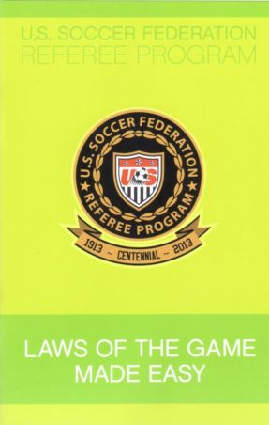
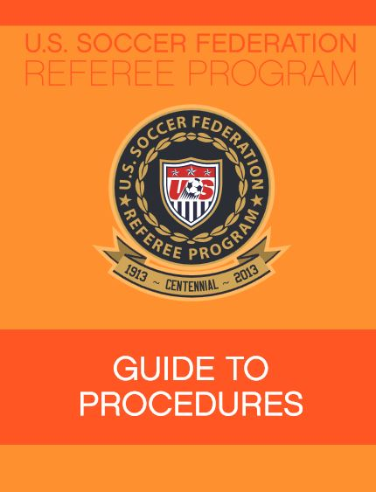
ENTRY LEVEL REFEREE TRAINING COURSE

Slide 8
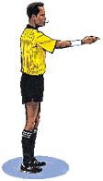

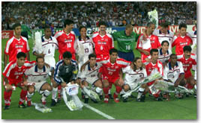

ENTRY LEVEL REFEREE TRAINING COURSE
Basis of Laws of the Game
Safety
Sportsmanship
Spirit of the Laws
Respect for Tradition

Slide 9
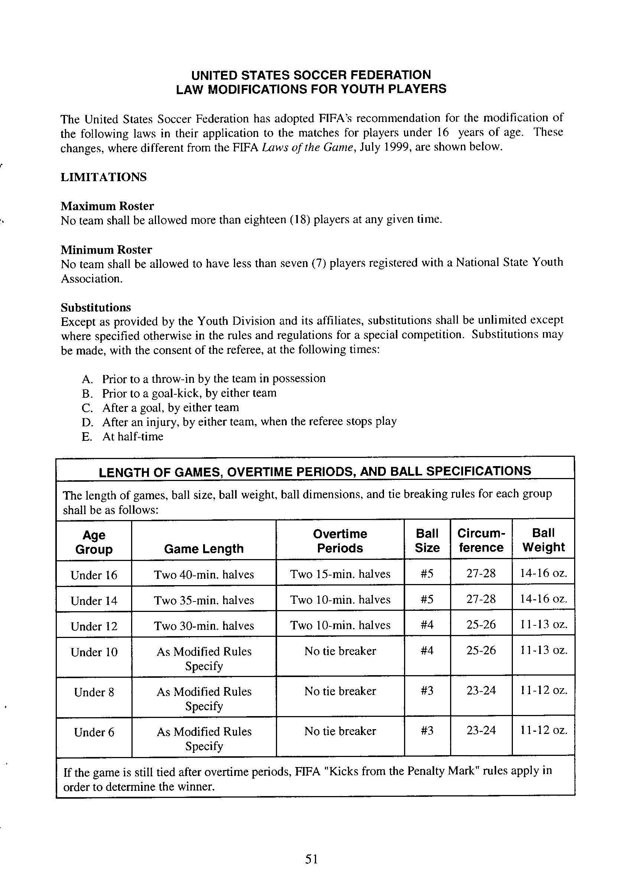
ENTRY LEVEL REFEREE TRAINING COURSE
AMENDMENTS TO LAWS FOR YOUTH PLAY
What is modified?
Size of field
Size of the ball
Size of goals
Duration of periods of play
Number of substitutions
Number of players

Slide 10
ENTRY LEVEL REFEREE TRAINING COURSE
USSF Soccer Referee Course
Breakdown of the Laws – on-line
What's Needed to Play
  The Field, Ball, Players, Substitutes and Players' Equipment - Laws 1, 2, 3 and 4
How to Play the Game
  Length of the Game, How the Game is started, stopped and re-started - Laws 7, 9, 10, 8, 13, 14, 15, 16 and 17
Dynamic Play
Offside, Fouls and Misconduct – Laws 11 and 12
You’re in Charge Now
The Referee and Assistant Referee – Laws 5 and 6

Slide 11
ENTRY LEVEL REFEREE TRAINING COURSE
USSF Soccer Referee Course
3 - 3 hour class-room & field instruction
Offside
  All about Offside - Law 11
Things Players Do….
  Fouls and Punishment - Law 12
You're In Charge Now
  Referee and Assistant Referee - Laws 5 and 6
  Game Management & Restarts
Field Session
  Touchline, goal line, offside activities, Mechanics and Signals

Slide 12
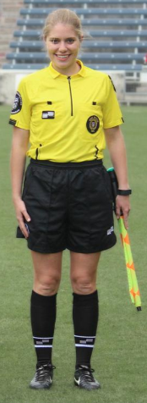
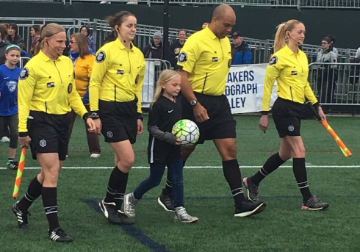
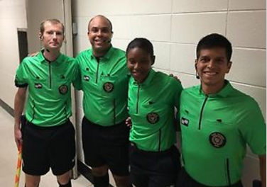
ENTRY LEVEL REFEREE TRAINING COURSE
Uniforms ……
Jersey, black shorts, black socks (pulled up) and black shoes.
And note, everyone is wearing the same color jersey

Slide 13
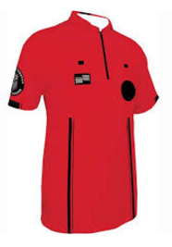
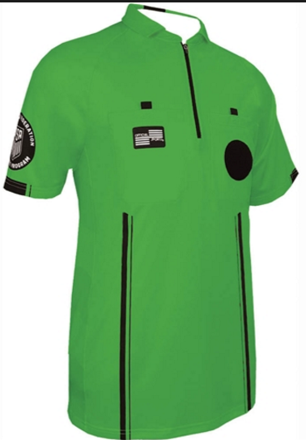
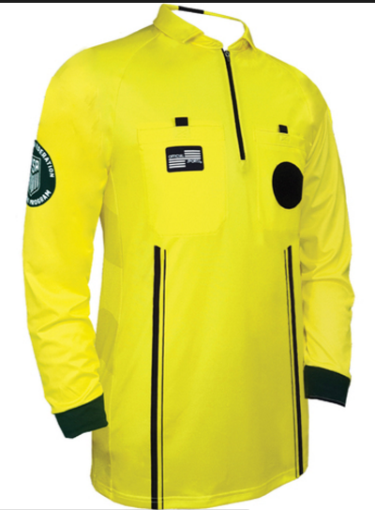
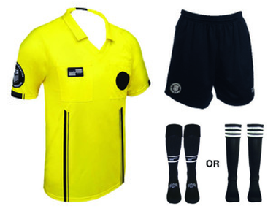
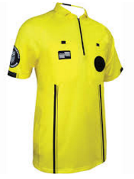
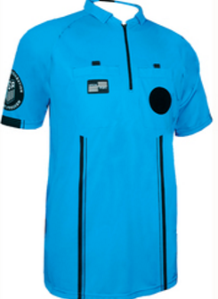
ENTRY LEVEL REFEREE TRAINING COURSE
Which uniform should I buy?
Mandated Jerseys - 2019

Slide 14
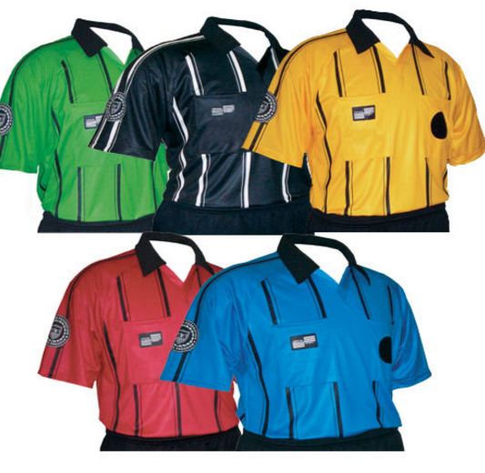
ENTRY LEVEL REFEREE TRAINING COURSE
Which uniform should I buy?
The older style pinstripe jersey is acceptable thru 2018 – but don’t go out and buy it.

Slide 15
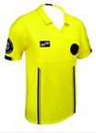
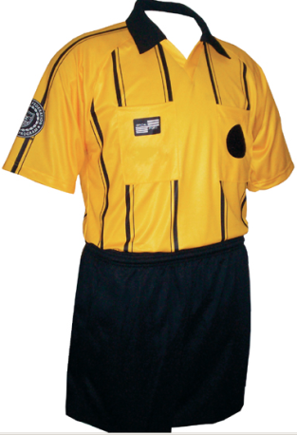
ENTRY LEVEL REFEREE TRAINING COURSE
Which uniform should I buy?
BUT … Different jersey styles of the same color may be worn by the game officials until 2019 season.

Slide 16
ENTRY LEVEL REFEREE TRAINING COURSE
Laws 5 & 6 -
The Referee & The Assistant Referees
Uniforms ……DO NOT COME TO A GAME OUT OF UNIFORM

Slide 17
ENTRY LEVEL REFEREE TRAINING COURSE
WARNING:
Participants should check the OSSRC website immediately prior to attending any classroom session for any last-minute changes or cancellations.

