Slide 1
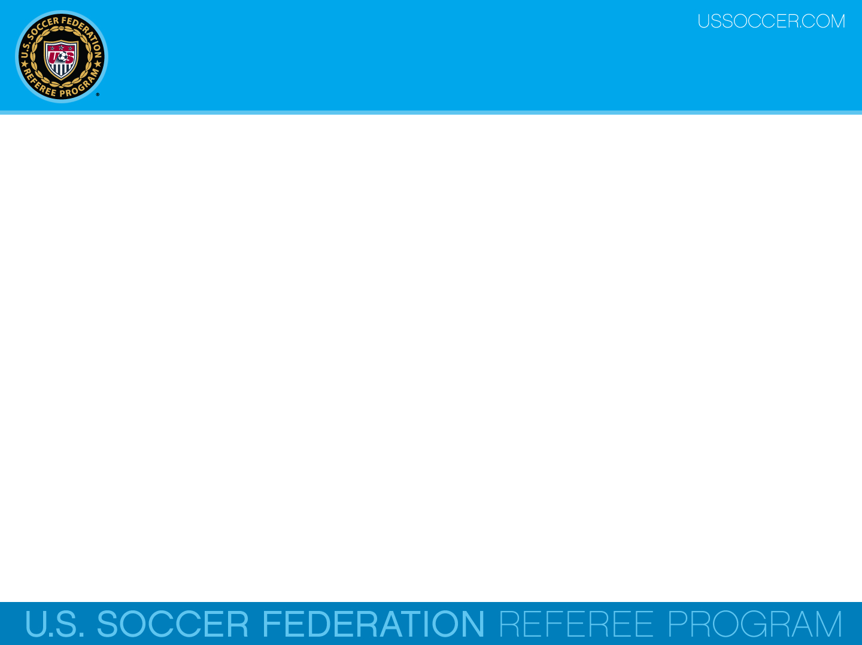



Law 9 - Ball In and Out of Play
U.S. Soccer Federation Referee Program
Entry Level Referee Course
Competitive Youth Training
Small Sided and Recreational Youth Training
2016-17
Notes:
Online Training Script:
Welcome to U.S. Soccer’s online training for the Grade 8 & 9 Referee Course.
Grade 8 training is specific to preparing officials for the competitive youth game.
Grade 9 training is specific to preparing officials for the small sided and recreational youth game.
This presentation focuses on Law 9 – The Ball In and Out of Play.

Slide 2
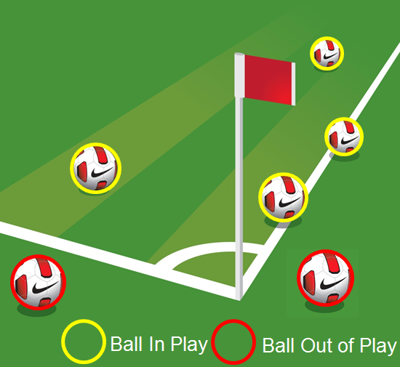
Boundary Lines
The ball only leaves the field-of-play when it completely crosses the whole of the goal line or touch line, whether on the ground or in the air.
Officials should understand that the outside edge of each boundary line has an invisible plane that extends up from the ground into the air.

Slide 3
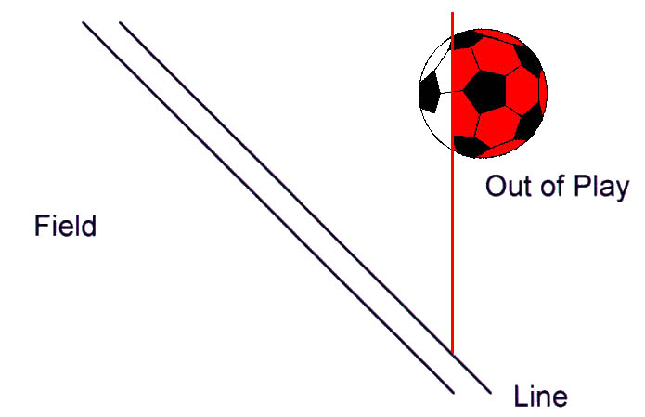
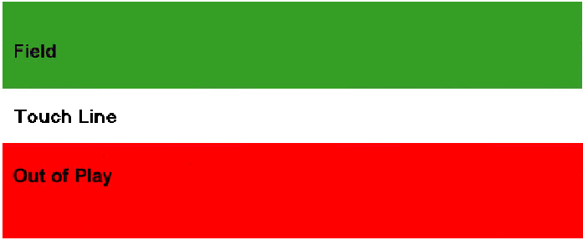
Boundary Lines
A ball may cross a boundary line on the ground or in the air
Out
IN
This ball is not out of play because part of it is still above the outside edge of the line

Slide 4

Boundary Lines
When in the air, the ball is “out-of-play” when it completely crosses this invisible plane.
The positioning of the AR is very important in order to make this determination.

Slide 5
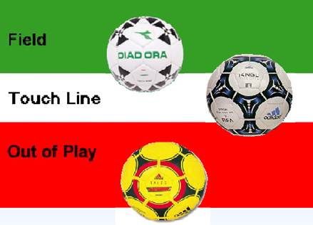
Boundary Lines
Remember that the entire ball must cross the entire boundary line before it is considered off the field of play.
In Play
In Play
Out of Play
This applies to when the ball is on the ground or in the air.

Slide 6
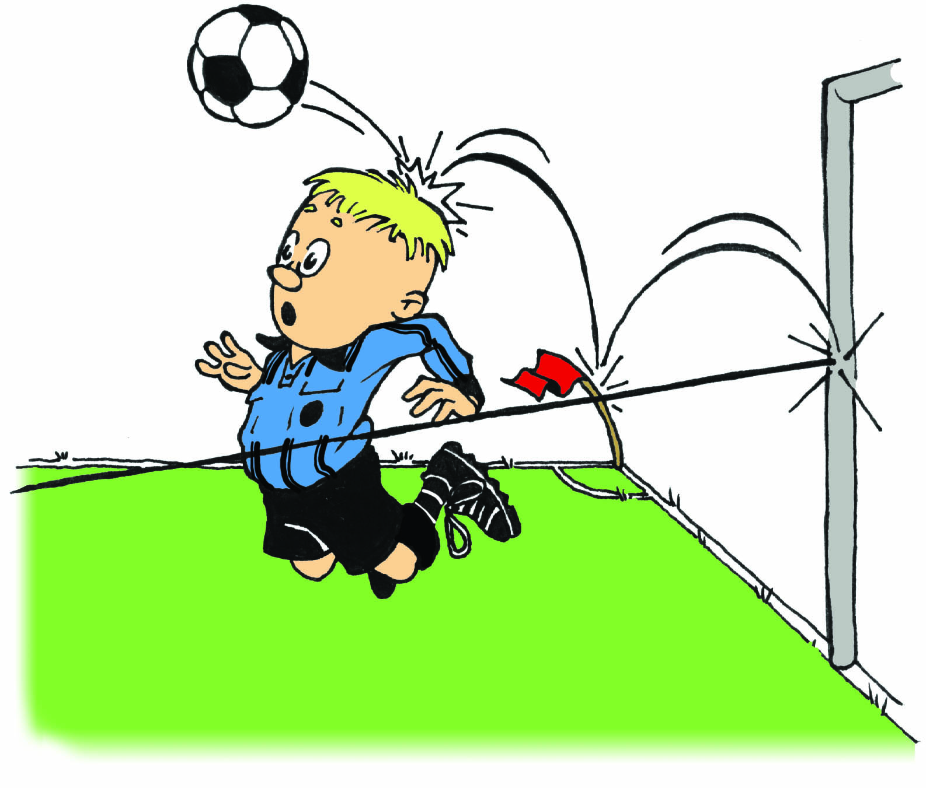
Rebounds
Note that a ball is still considered to be in play even if it rebounds off a goalpost, crossbar, corner flag, referee or assistant referee and having never left the field-of-play.

Slide 7
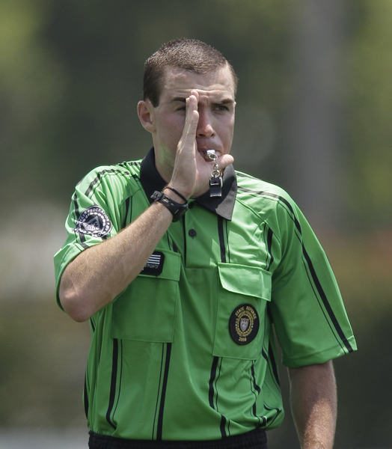
Stoppage
The ball is also “out-of-play” when play has been stopped by the referee, for any reason, such as when a foul or misconduct has occurred.
Note that the ball is deemed to be out-of-play when the decision is made by the referee, not at the time the whistle is blown.
The ball is also considered to be out-of-play if the whistle is blown accidentally.

Slide 8

Boundary Lines
In summary, once the game starts from the kick-off, the ball remains in play:
until it wholly crosses over a goal line or a touch line
… or …
until the referee stops play.

Slide 9
Review Question
48. Does the entire ball or just part of the ball have to cross a boundary line in order for it to be considered out-of-play?
      Entire ball
      Part of the ball

Slide 10
Review Question
49. Is the ball still considered in-play when the referee blows his or her whistle?
        Yes
        No
Notes:
Online Training Script:
Classroom Instructor Talking Points:

Slide 11
Review Question
50. What should the referee do if the ball completely crosses the touchline in the air and blows back onto the field?
  Allow play to continue since the ball never touched the ground outside the field of play
  Stop play and restart with a throw-in

