Slide 1
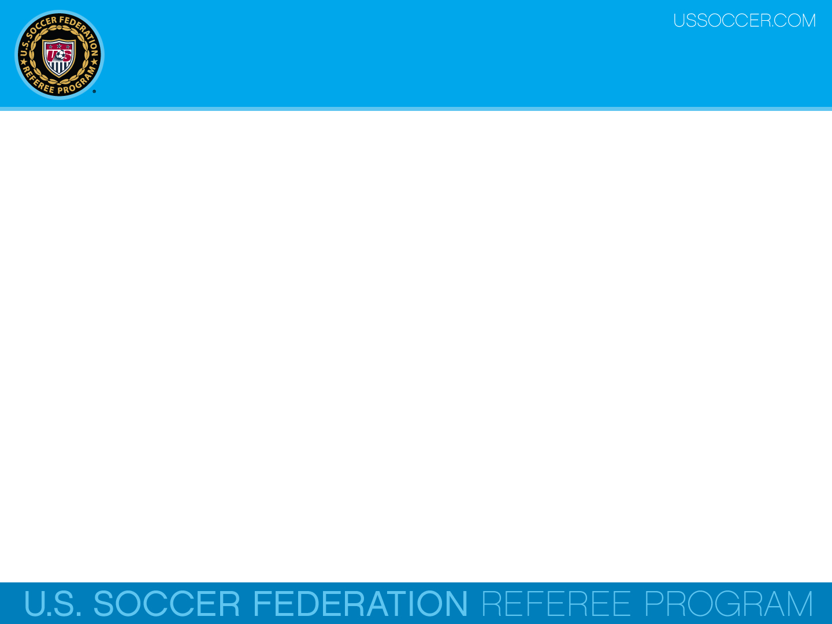

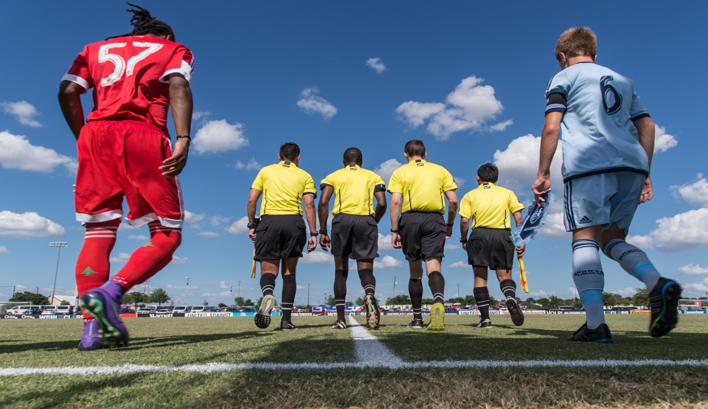
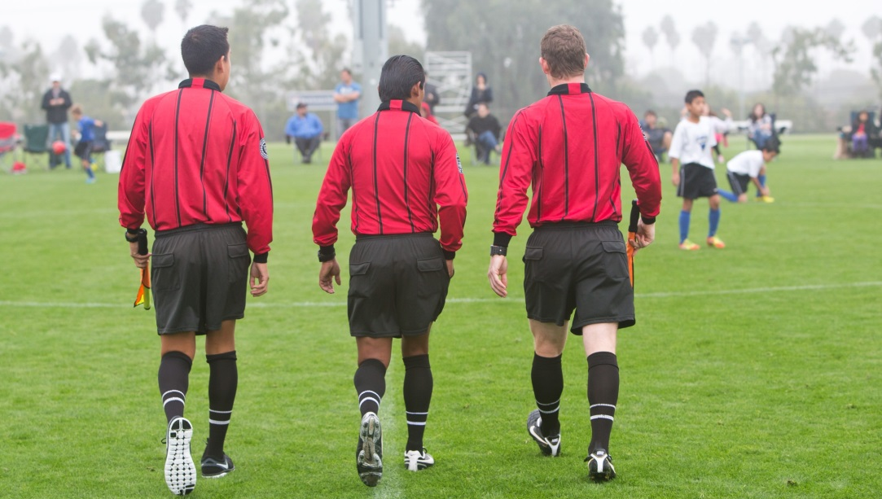
Law 8 - Start & Restart of Play
U.S. Soccer Federation Referee Program
Entry Level Referee Course
Competitive Youth Training
Small Sided and Recreational Youth Training
2016-17
Notes:
Online Training Script:
Welcome to U.S. Soccer’s online training for the Grade 8 & 9 Referee Course.
Grade 8 training is specific to preparing officials for the competitive youth game.
Grade 9 training is specific to preparing officials for the small sided and recreational youth game.
This presentation focuses on Law 8 – The Start and Restart of Play.

Slide 2
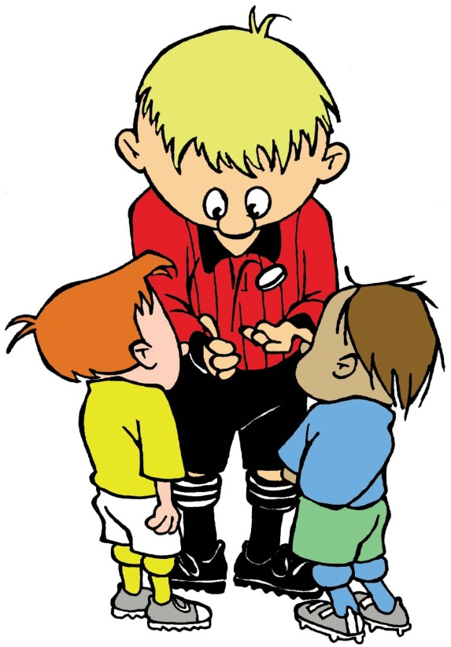
Coin Toss
The game starts with a kick-off and that’s decided by the coin toss.
The coin toss usually takes place with the designated team captains.
The visiting captain usually gets to select heads or tails before the coin is tossed by the referee.

Slide 3
Coin Toss
The winner of the coin toss selects which goal they will attack in the first half (or period).
The other team must then take the kick-off to start the game.
In the second half (or period) of the game, the teams change ends and attack the opposite goals.
The team that won the coin toss takes the kick-off to start the second half (or period).

Slide 4
Kick-off
The kick-off is used to start the game and to start any other period of play as dictated by the local rules of competition.
  First half
  Second half
  Any add’l periods of play
A kick-off is also used to restart the game after a goal has been scored.
Notes:
Online Training Script:

Slide 5
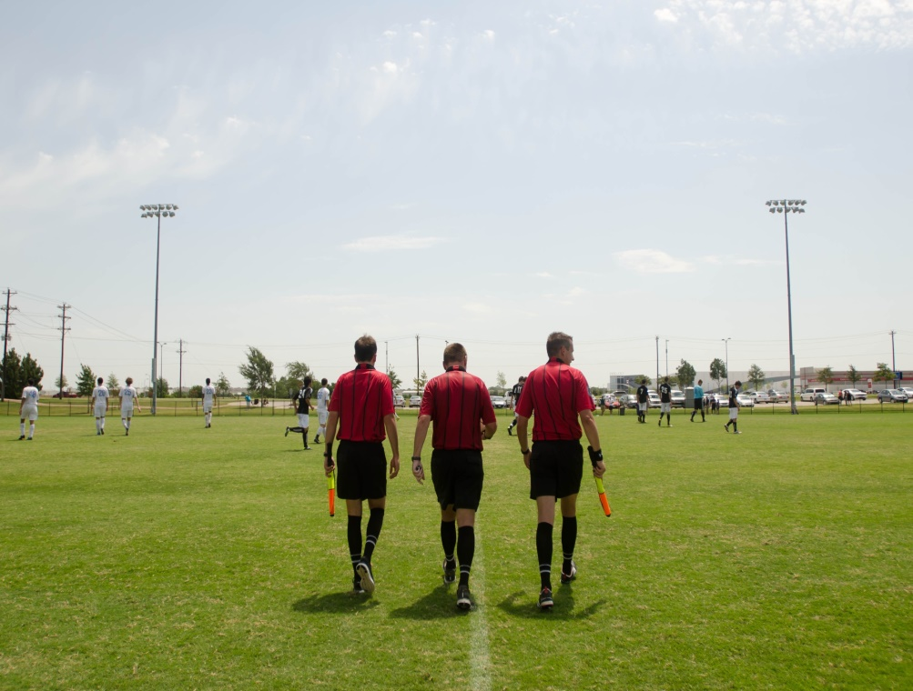
Kick-off Mechanics
The referee crew enters the field together prior to the opening kick-off.
They move to the center mark, the referee carries the ball.
Following final instructions and a handshake, the ARs go to their respective goals lines, do a final check of the goals/nets and then move to their positions on the touch lines.

Slide 6
Kick-off Mechanics
Before kick-off, the referee looks over the field & players and makes eye contact with both ARs.
The ARs, in line with second to last defenders, unfurl their flag and hold it straight down to show the referee – we are all set and ready.
All set and ready by the ARs means:
  The number of players is correct,
  The goalkeepers are clearly identified and ready,
  The bench areas are ready, and
  There are no outside agents on the field.

Slide 7
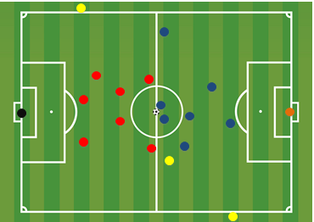
Kick-off Requirements
There are a number of requirements that the referee must ensure are met at the taking of a kick-off.
All players on both teams must be in their own defensive half of the field of play.
The team not taking the kick-off must also remain outside of the center circle until the ball is kicked into play.

Slide 8
Kick-off Requirements
Opponents of the team taking the kick-off must remain at least 10 yards from the ball and outside of the center circle until it is is kicked into play.
This distance may be modified for small-sided games.

Slide 9
Kick-off Requirements
The U.S. Soccer Player Development Initiative recommends that small-sided youth games use a modified center circle of 8 yards, depending on the age of the game.

Slide 10
Kick-off Requirements
The ball must be stationary on the center mark
The referee gives a signal with a whistle
The ball is in play when it is kicked and clearly moves.
The ball may be kicked in any direction, this includes backwards.

Slide 11
Kick-off Requirements
Please be aware, that a goal CAN be scored directly against an opponent from the kick-off.
The referee starts time when the ball is kicked into play.

Slide 12
Kick-off Requirements
The kicker may not touch the ball again until it has touched another player.
If the kicker does touch the ball again before it has touched another player, an IFK is awarded to the opposing team from where the infringement occurred (at location of 2nd touch).
Any other infringement of the kick-off procedure, like any player being on the others team’s half of the field, the kick-off is retaken.

Slide 13
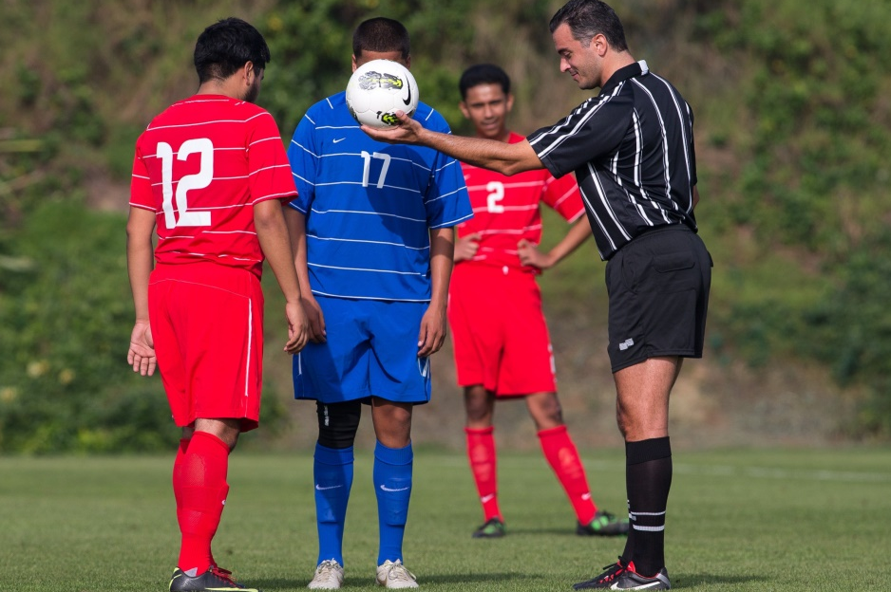
Dropped Ball
A dropped ball is a method of restarting play when, while the ball is still in play, the referee stops play temporarily for any reason not mentioned elsewhere in the Laws of the Game.
Some common examples include:
when the referee stops play due to an injury,
interference from an outside agent,
weather issues or
a referee accidentally blowing the whistle

Slide 14
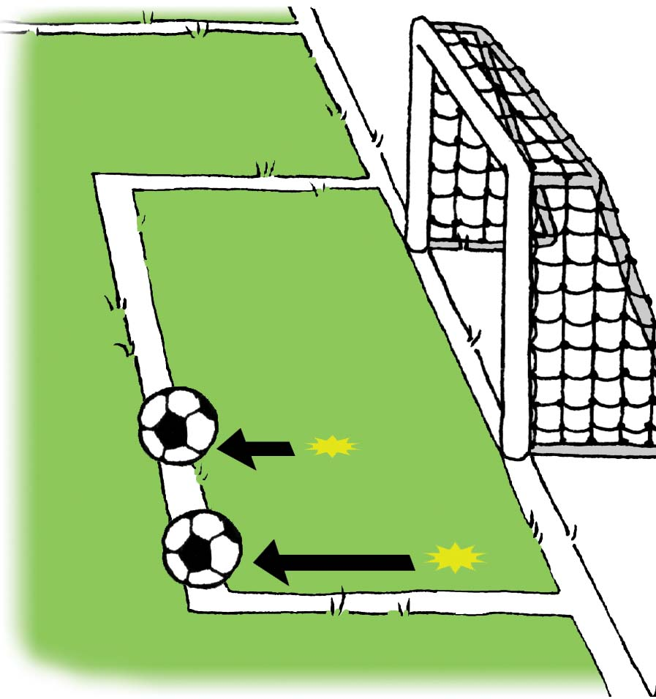
Dropped Ball
The referee drops the ball at the position where it was when play was stopped, unless play was stopped inside the goal area, in which case the ball is dropped on the goal area line parallel to the goal line at the point nearest to where the ball was when play was stopped.

Slide 15
Dropped Ball
The ball is in play once it touches the ground.
Also note that the goalkeeper may use their hands to play the ball once it touches the ground, provided they are within their own penalty area at the time.

Slide 16
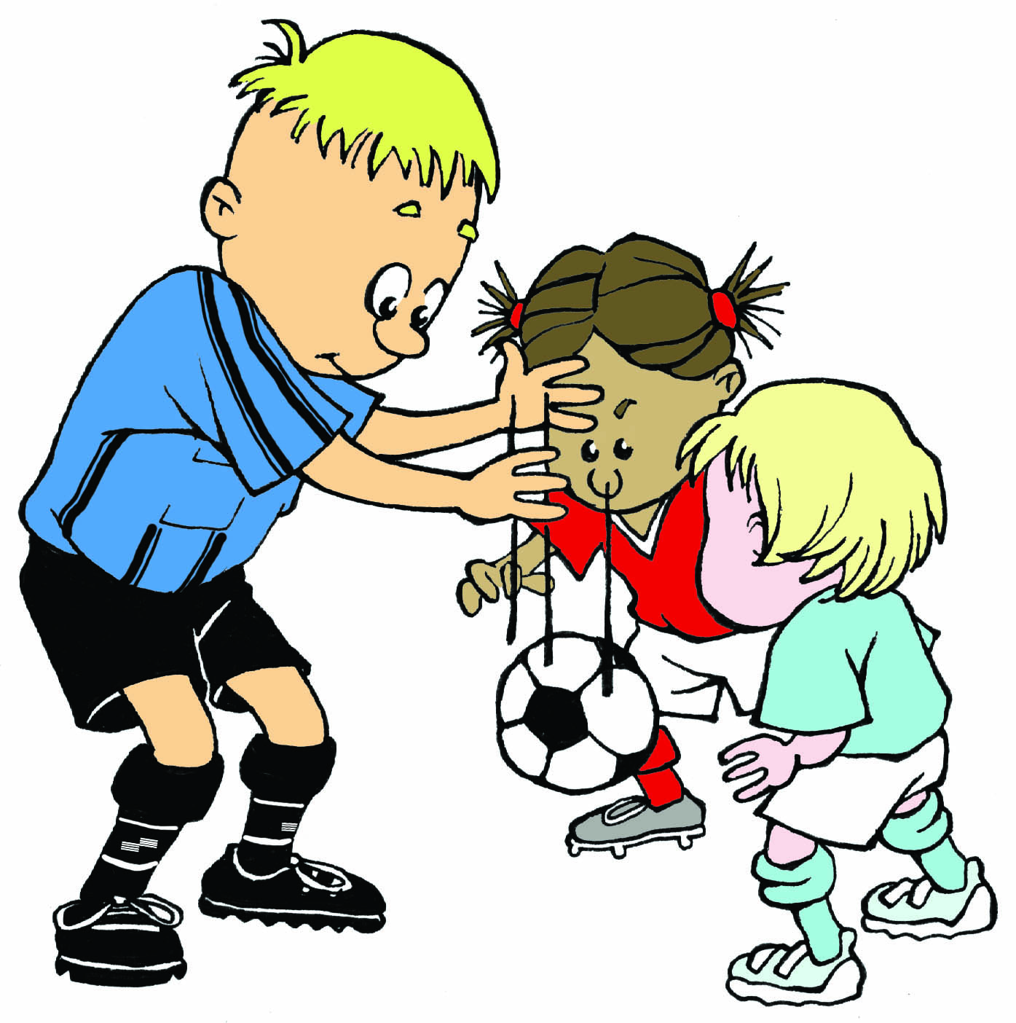
Dropped Ball
The Laws of the Game do not specifically require any particular number of players at the taking of a dropped ball, but there is typically one player from each team that participates.

Slide 17
Dropped Ball
The referee may not decide who may or may not contest a dropped ball.
Any player may challenge for the ball, including the goalkeeper and there is no minimum or maximum number of players required to contest a dropped ball.

Slide 18
Dropped Ball
When referees use a dropped ball to restart play, they should use the following procedure:
Let both teams know that play is going to be restarted with a dropped ball.
Allow for players to get into position. A player from each team usually participates but it is not required.
Hold the ball at waist height of players and then just let it freely drop to the ground.

Slide 19
Dropped Ball
Since the ball is put back into play by the referee, it is in play once it makes contact with the ground.
The ball must be dropped again if :
it is touched by a player before it makes contact with the ground or
if the ball leaves the field of play after it makes contact with the ground, without any player touching it.

Slide 20
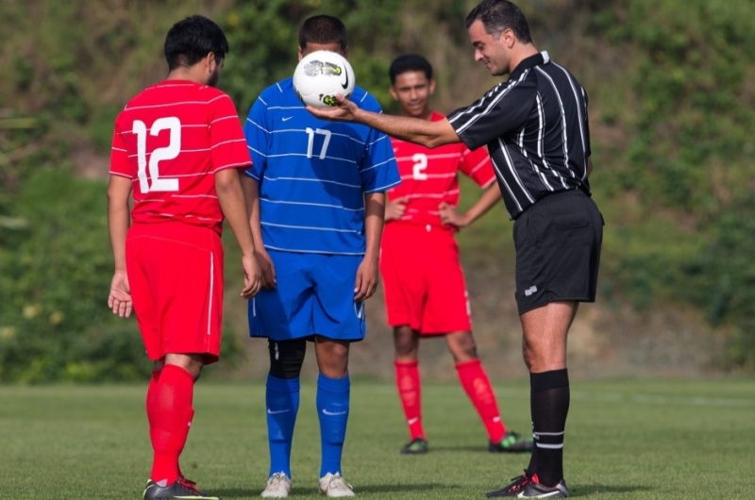
Infringements
Note that if a dropped ball enters the goal without touching at least two players play is restarted with:
a goal kick, if the ball is touched into the opponents’ goal
a corner kick, if the ball is touched into a player’s own goal.

Slide 21

Concussion Initiative
As part of the U.S. Soccer Concussion Initiative, it is recommended that players 10 years old and younger not head the ball.
If a player 10 years old or younger deliberately heads the ball during a match, an indirect free kick (IFK) should be awarded to the opposing team from the spot of the heading.
If the heading occurs within the goal area, the indirect free kick (IFK) should be taken on the goal area line parallel to the goal line at the point nearest to where the heading occurred.

Slide 22
Review Question
41. How should the referee restart the game if play is stopped for an injured goalkeeper who is in possession of the ball in his own goal area?
      Corner kick
      Goal kick
      Indirect free kick
      Dropped ball

Slide 23
Review Question
42. How should the referee restart the game if a player kicks the ball directly into the opponent’s goal from a dropped ball?
      Corner kick
      Goal kick
      Repeat the dropped ball
      Kick-off

Slide 24
Review Question
43. When is the ball in play at the taking of a kick-off?
    When it is kicked forward
    When it leaves the center circle
    When it is kicked and touched by a second player
    When it is kicked and moves

Slide 25
Review Question
44. When is the ball in play from a dropped ball?
    When the ball touches the ground
    When the referee releases the ball
    When a player first touches the ball
    When the ball stops bouncing

Slide 26
Review Question
45. The winner of the coin toss gets to choose which of the following?
    The choice of which goal to attack in the first half
    The choice between kicking off in the first half or the second half
    Choice of either A or B

Slide 27
Review Question
46. During the kick-off, players on the attacking team may straddle the halfway line until the ball is kicked into play.
      True
      False

Slide 28
Review Question
47. What restart should the referee use when no other restart applies to the situation?
      Indirect free kick
      Dropped ball

