Slide 1
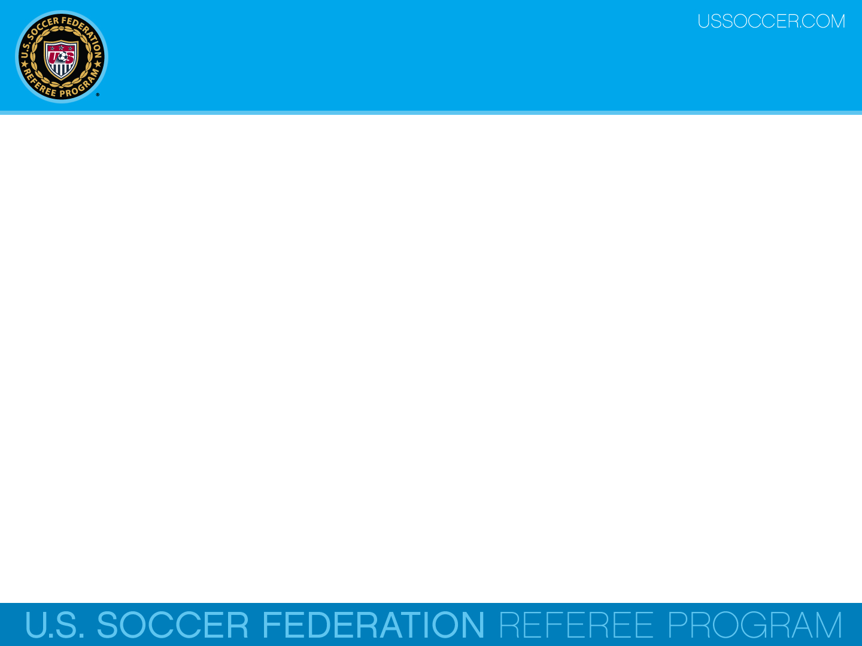

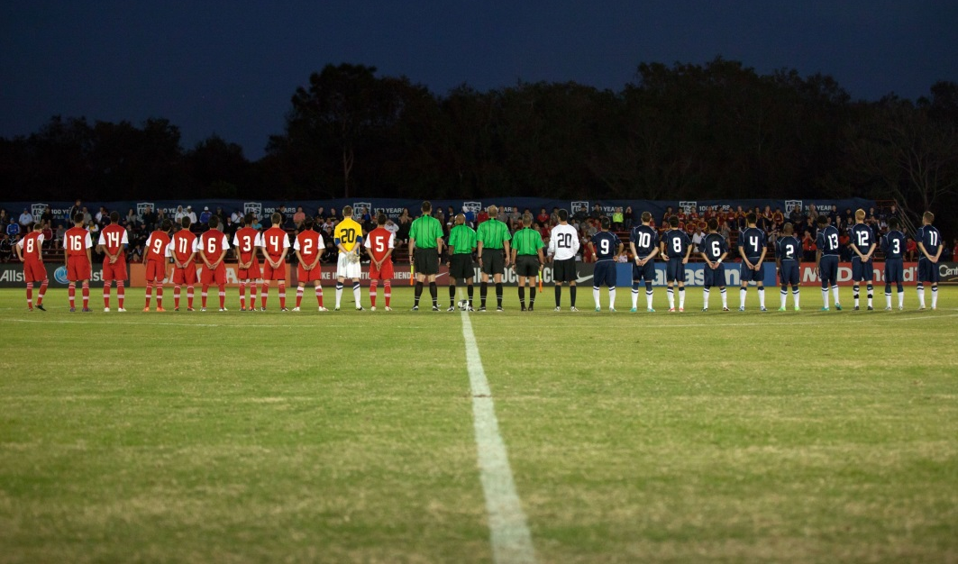
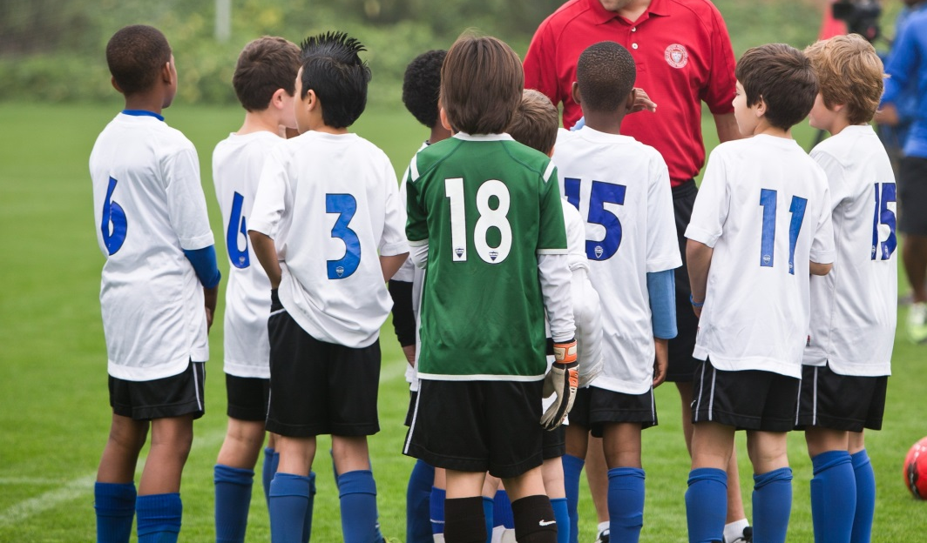
Law 3 - The Players
U.S. Soccer Federation Referee Program
Entry Level Referee Course
Competitive Youth Training
Small Sided and Recreational Youth Training
2016-17
Notes:
Online Training Script:
Welcome to U.S. Soccer’s online training for the Grade 8 & 9 Referee Course.
Grade 8 training is specific to preparing officials for the competitive youth game.
Grade 9 training is specific to preparing officials for the small sided and recreational youth game.
This presentation focuses on Law 3 – The Number of Players.

Slide 2
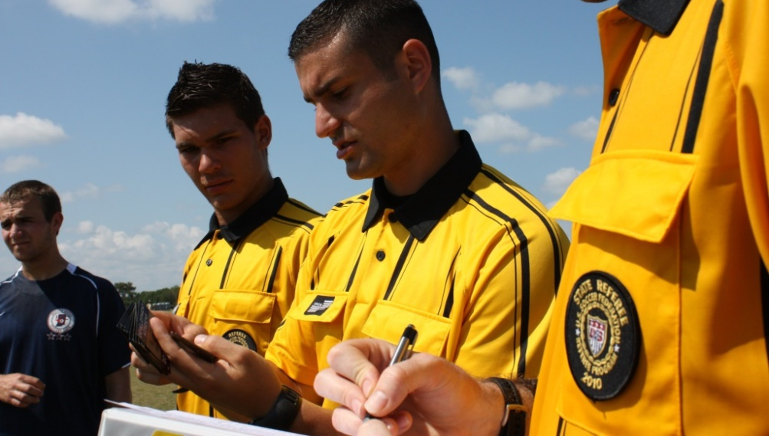
Checking in Teams
Most teams in competitive youth games will have team rosters and player passes issued by the league or state association.
Depending on the local rules of competition the referee team may have to inspect the roster and/or player passes to insure only eligible players compete in the match.

Slide 3
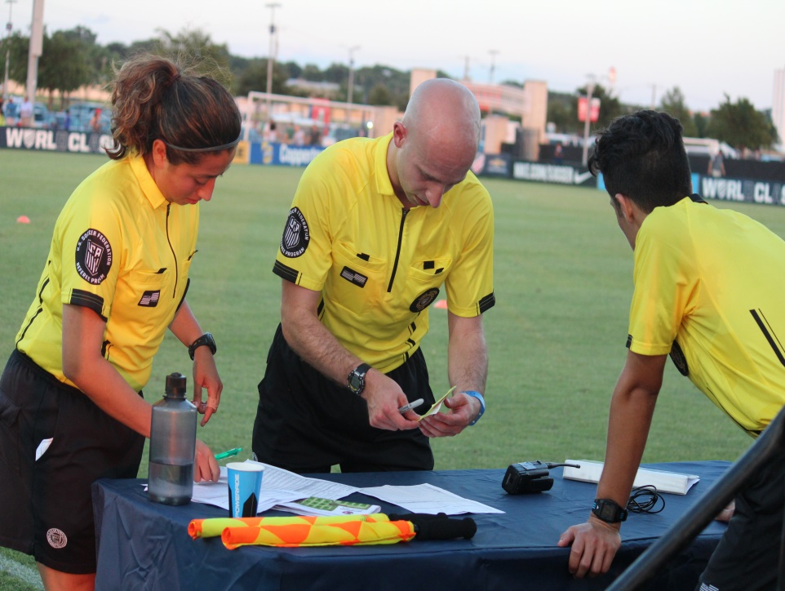
Checking in Teams
Depending on the local rules of competition the referee team may have to inspect the roster and/or player passes to insure only eligible players compete in the match.
The general rule is that a player can’t play without a pass, but this must be verified by the local rules of competition.

Slide 4
Number of Players
The maximum number of players a team may put on the field is dependent upon the age level of the competition:
  U13 & Older - 11v11 (minimum 7 players)
  U11 & U12 - 9v9 (minimum 6 players)
  U9 & U10 - 7v7 (minimum 5 players)
One of the players on each team must be the goalkeeper, and each team must have a goalkeeper at all times.

Slide 5
Number of Players
A game can not begin if a team has fewer than the minimum required number of players, and a game cannot continue if a team drops below that minimum.
Exceptions should be made when a player temporarily leaves the field:
for quick treatment of an injury,
for correcting blood on the uniform, or
to correct illegal equipment.

Slide 6
Number of Players
If a game cannot continue due to a team having fewer than minimum required number of players, the referee must terminate the match and report this to the local competition authorities.

Slide 7
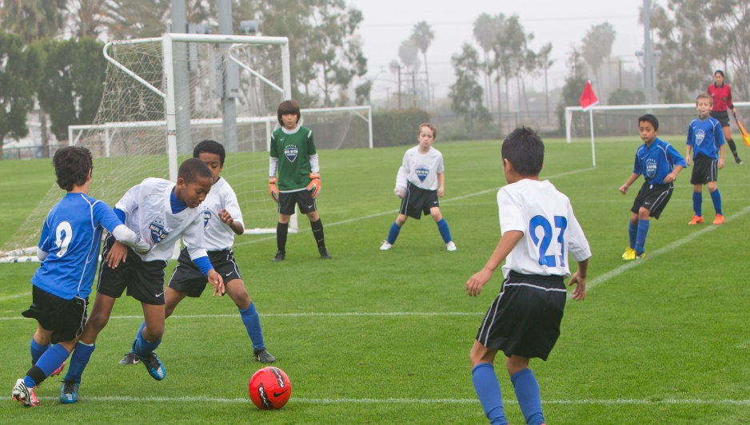
Players & Substitutes
Players are defined as rostered team members who are on the field and participating in game.
Substitutes are defined as rostered team members who are not in the game, but who may replace players. Substitutes must obey the rules just like players.

Slide 8

Players
The number of players allowed can vary significantly – so it’s very important to know the local rules of competition.
For example, U6 & U8 leagues may play with only 3 or 4 players and no goalkeeper, while some U10 leagues may play with 5 field players and a goalkeeper.

Slide 9
Late Arrivals
Late arriving team members may play in the game. They should report to the AR (or fourth official) with their player pass for inspection.
Once the player’s pass and equipment are inspected and deemed safe for play, they may enter the field during play, but only if they have been received permission from the referee.

Slide 10

Checking in Players
The general rule is that a player can’t play without a pass, but this must be verified by the local rules of competition.
Also, according to the local rules of competition, referees should check the player passes against the team roster to verify identity and eligibility.

Slide 11
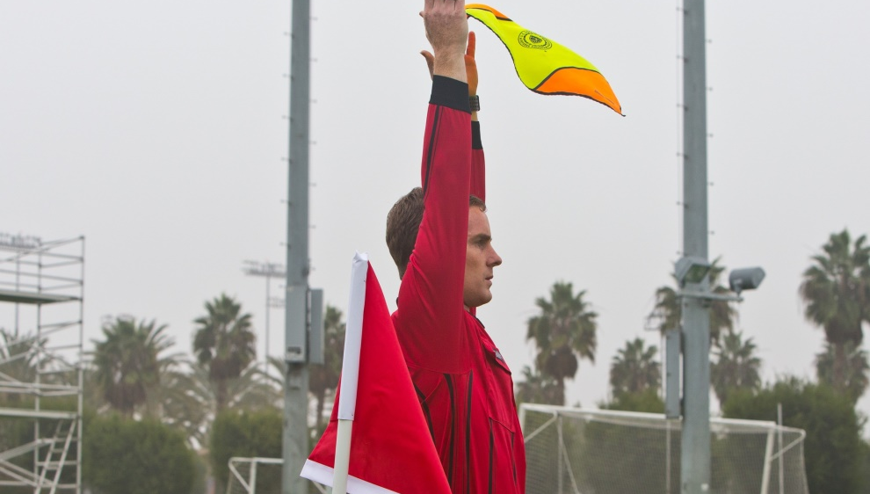
Substitution
The rules of play with regard to substitutions often vary significantly from league to league and from one age group to another. The rules of the competition for each league and age group should outline how many and when substitutions are allowed.
Officials need to make sure that they know and understand the substitution rules for each game they officiate.

Slide 12
Substitution
Typically all small-sided and recreational youth games allow unlimited substitution.
Most U14 and younger competitive games also allow unlimited substitution.
Older and higher level competitive youth matches are more likely to have some form of limited substitution rules.

Slide 13
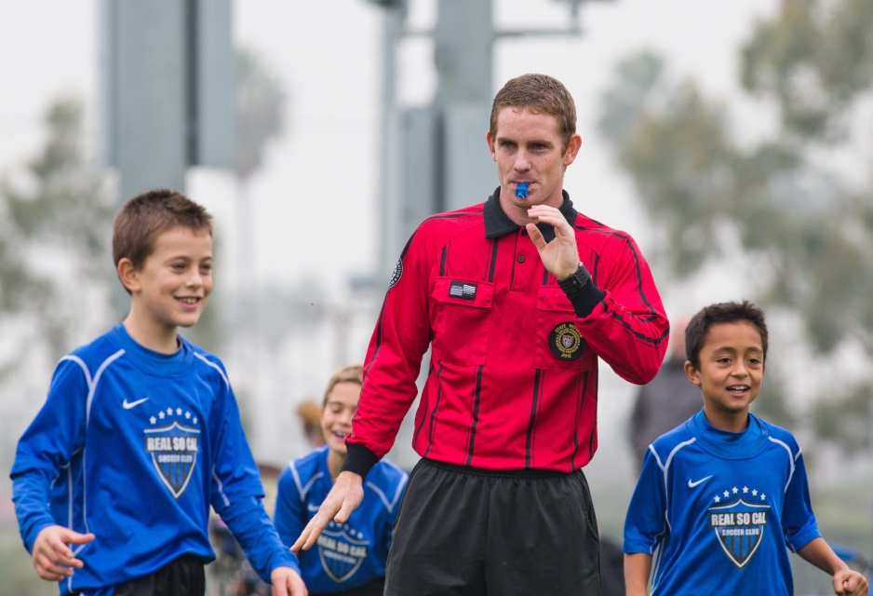
Responsibility
It is the referee’s responsibility to control the substitution process and ensure that a equal number of players leave and enter the field.
Officials should make a habit of counting the number of players after all substitutions are completed to ensure that each team has the correct number of players on the field.

Slide 14

Responsibility
Referees should not restart the game until the substitution process has been done properly and the players are ready for play to resume.

Slide 15
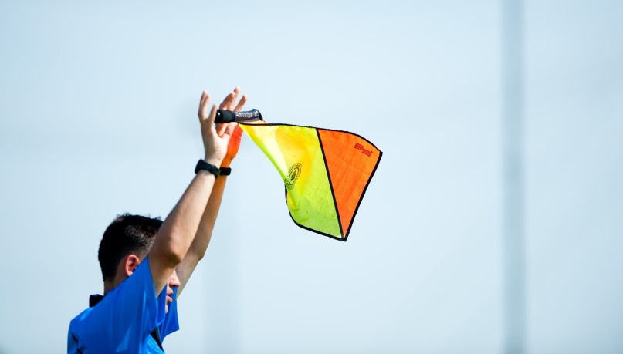
Substitutions
The local rules of competition should dictate which stoppages of play permit substitutions.
Many competitive youth games will allow for unlimited re-entry.
It is common that substitutions may only be allowed during certain stoppages, such as throw-ins, goal kicks, injuries, after halftime, and following goals.

Slide 16
Procedure
The procedure to replace a player with a substitute begins with a stoppage of play.
Substitutes will typically report to the assistant referee on the team-side touch line, or a fourth official if the game has one assigned.

Slide 17
Procedure
That AR or fourth official will then notify the referee at the next appropriate stoppage of play.
The player being replaced usually leaves at the halfway line, but they can leave the field from anywhere.
The substitute may only enter the field after the player leaves and the substitute receives a signal from the referee.

Slide 18
Procedure
The substitute is required to enter the field at the halfway line.
This process remains the same regardless of how many players are being substituted for at the same time.
The substitution procedure is over when the substitute enters the field with the referee’s permission, thus becoming a player.

Slide 19
Procedure Summary
Substitute reports to official
Referee is informed of the substitution
Referee approves the change
Player leaves the field
    Typically at the halfway line, but they can leave the field from anywhere

Slide 20

Procedure Summary
Substitute only enters the field:
  during a stoppage in play
  at the halfway line
  after the player being replaced leaves the field
  after receiving a signal from the referee
  … thus becoming a player.
Substitutes may take a restart, provided they have first stepped onto the field prior to taking any restart.

Slide 21
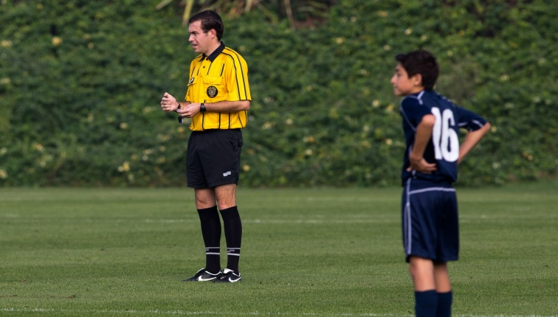
Too Many Players
When multiple substitutions are being made, it is very important that referees follow the substitution procedures and not allow substitutes to enter the field prematurely.
Following the proper procedure allows officials to reduce the risk that the game would restart with too many players.

Slide 22
Too Many Players
If the referee realizes that there are too many players during play, the game should be stopped right away.
The referee should then caution and remove the extra player.
The game would be restarted with an indirect free kick (IFK) for the opposing team.

Slide 23
Too Many Players
If the referee realizes that there are too many players during a stoppage of play, they should caution and then remove the extra player.
The game is then restarted with the appropriate restart that led to the stoppage of play.

Slide 24
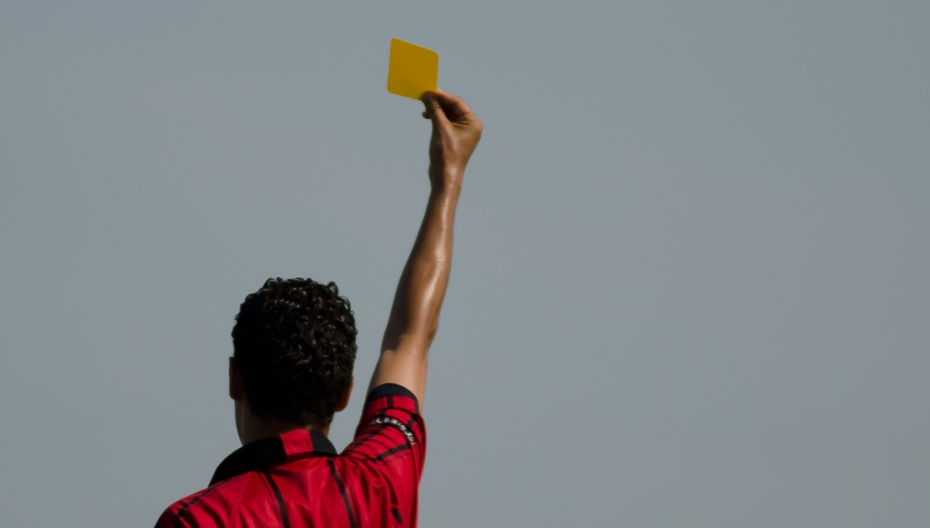
Too Many Players
If a team with too many players scores a goal, the referee must disallow the goal, caution and then remove the extra player.
Play is then restarted with a goal kick.
If the referee does not realize that a goal was scored by a team with too many players until after the subsequent kick-off, the goal will stand.

Slide 25

Too Many Players
If a team with too many players is scored against by a team without extra players, the referee must allow the goal.
The referee must also caution the extra player and have them leave the field.
The restart would be a kick-off since the goal was awarded.

Slide 26

Too Many Players
This reinforces the importance of following proper substitution procedures and that referees and ARs should always count the number of players before allowing play to resume.

Slide 27
Goalkeepers
Any player may change places with the goalkeeper (not a substitution), provided that the referee is informed before the change is made and that the change is made during a stoppage of play.
In competitive youth games with unlimited substitutions, a new goalkeeper in place at the start of the second half is considered to be appropriate notification of a change.

Slide 28
Goalkeepers
If the change is made without the referee’s permission, the referee must allow play to continue and then caution both players at the next stoppage of play.
Regardless, after any change has been made the player wearing the goalkeeper’s jersey is considered to be the goalkeeper of record.
Note that when a change is made without the referee’s permission and cautions are issued, the change of player and goalkeeper is still upheld.

Slide 29
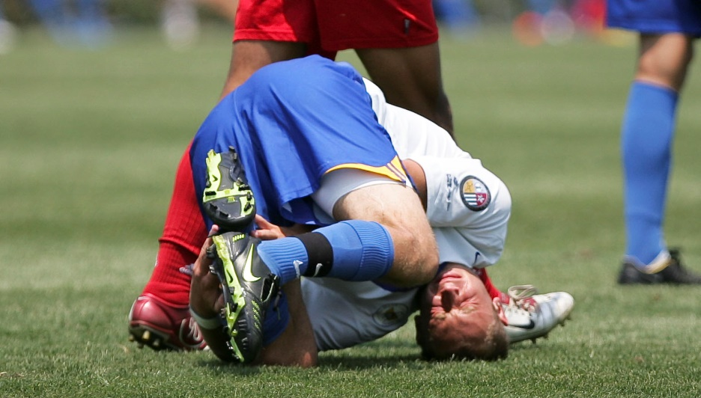
Leaving the Field
There are times during the normal course of play when a player may need to leave the field, such as for an injury or to repair equipment.
Technically, this requires the referee’s permission, however, common sense should be applied, since players may sometimes leave without thinking to ask for permission.

Slide 30
Leaving the Field
In all cases, players must receive the referee’s permission when re-entering the field.
If play is going on, the player must enter from a touch line.
If there is a stoppage, the player may return from anywhere.

Slide 31
Team Officials
Team officials are the coach and any other officials named on the team list.
A player who has received a red card and been sent-off is still considered as a member of the team.

Slide 32
Outside Agents
Outside agents would include anyone, or anything, not listed on the team roster as a player, substitute, or team official.
At the competitive youth level, outside agents are typically family dogs or little siblings who run out on to the field.
A game ball from an adjoining field would also be considered as an outside agent.

Slide 33
Extra Persons
If a substitute, substituted player, sent-off player, team official or outside agent enters the field of play the referee must:
  only stop play if there is interference with play
  have the person or object removed
  take appropriate disciplinary action.
Note: if they do not interfere and are quickly removed, there is no need to stop the game.

Slide 34
Extra Persons
When a substitute or a substituted player enters the field of play without the referee’s permission, and there is no interference with play, the referee shall caution them for unsporting behavior and order them to leave the field-of-play at the next stoppage.
If this is a second caution for either a substitute or substituted player, they shall be shown a red card and are no longer permitted to participate in the match.

Slide 35
Extra Persons
If an outside agent enters the field-of-play and interferes with play, the referee must:
  stop play
  have the person or object removed
  restart play with a dropped ball where the interference occurred.

Slide 36
Extra Persons
If a substitute, substituted player, sent-off player or team official enters the field-of-play without the referee’s permission, the referee stops play, although not immediately if the individual does not interfere with play.
The referee then issues a caution for unsporting behavior and orders the individual to leave the field-of-play.

Slide 37
Extra Persons
If a substitute, substituted player, sent-off player or team official enters the field-of-play and interferes with play, the referee must:
  stop play
  have the person removed
  restart play with a direct free kick (DFK) or penalty kick (PK) for the opposing team at the location where the interference occurred.

Slide 38
Extra Persons
When a substitute, substituted player, sent-off player, team official or outside agent interferes with play … and …
  the ball is going into the goal … and ...
  the interference does not prevent a defending player from playing the ball … and ...
  the ball continues and enters the goal (even if contact is made with the ball)
a goal shall be awarded (unless the ball enters the opponents’ goal).

Slide 39
Extra Persons
NOTE:
A goal cannot be awarded:
  if the interference prevents a defending player from being able to make a play on the ball … or …
  if the interference creates a change in direction of the ball into the goal … or …
  if the ball never crosses completely over the goal-line into the goal

Slide 40
Sent-Off Players
If a rostered player is sent off before the game, the player can be replaced by someone else on the team roster, and the team still starts with 11 players.
Note that this does not count as a substitution, but unless otherwise indicated by the local rules of competition, designating a replacement substitute is not permitted.

Slide 41
Sent-Off Players
If a player is sent-off during the game, they may not be replaced and the team must play with one fewer player.
If a player is sent off after the game, the referee should still show the red card, if the player is still on field of play. The referee must then include this information in their game report.

Slide 42
Sent-Off Substitutes
If a named substitute is sent-off before or during the game, they may not be replaced and the team must play with one fewer substitute.

Slide 43
Management
Communication before the game
  Referee and ARs
When multiple substitutions are being made by one or both teams, it is important that the referee team has discussed how they will communicate that all substitutions have been successfully completed and play can be restarted.

Slide 44
Management
Don’t be influenced or pressured
  Players
  Coaches
  Spectators
There may also be pressure in competitive youth games for the referee to speed up the restart of play at a substitution time by allowing steps in the substitution procedure to be ignored or combined.

Slide 45
Management
Always follow the correct procedure
Referees should resist this pressure and recognize that deviations from the proper substitution procedure can produce problems if there is misconduct by players or substitutes.

Slide 46
Review Question
10. What should the referee do before restarting play after each substitution?
  Signal with his or her hand that the substitution process has ended
  Count to make the sure the correct number of players are on the field

Slide 47
Review Question
11. Can the checking of player passes and the players’ equipment be skipped if the game is running behind schedule?
  No, it’s important to check and inspect all players even if the game is running late
  Yes, this process can be skipped so long as both coaches agree

Slide 48
Review Question
12. If the rules of competition specify teams play with a goalkeeper, can the referee allow a team to play without a goalkeeper?
  Yes, a team is allowed to play without a goalkeeper if they so choose
  No, each team must have a designated goalkeeper

