Slide 1
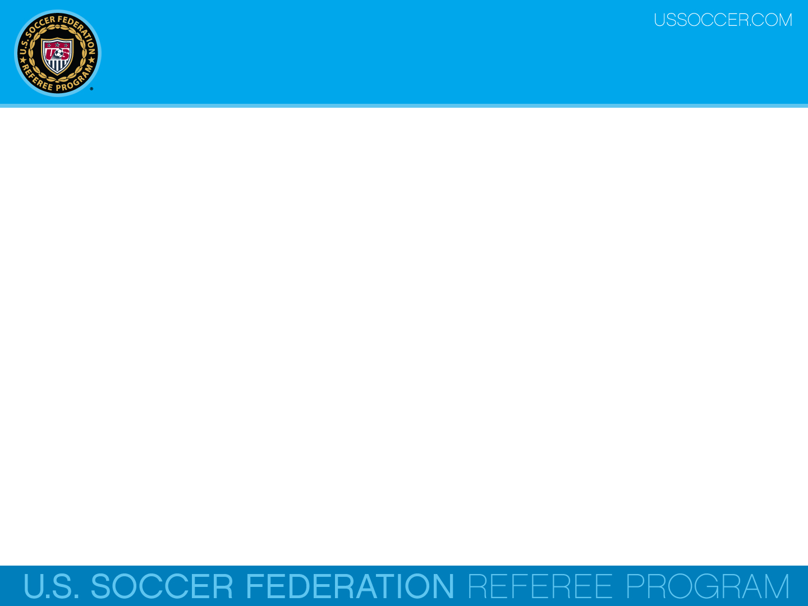

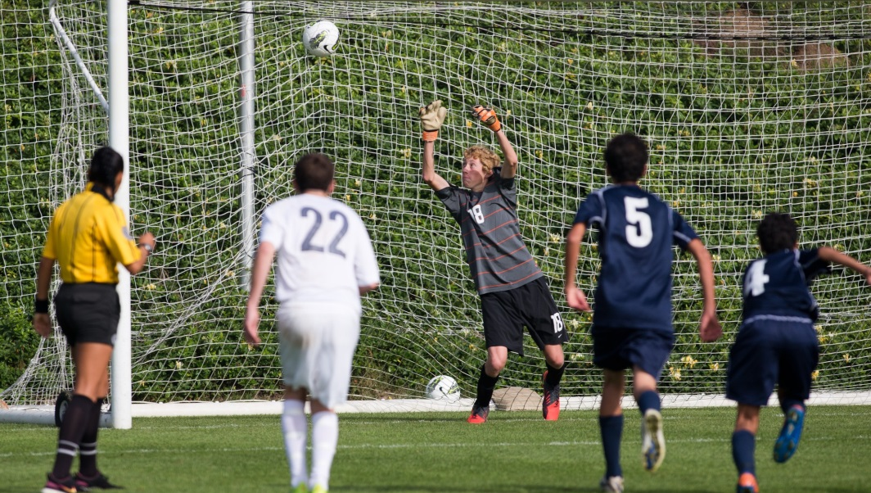
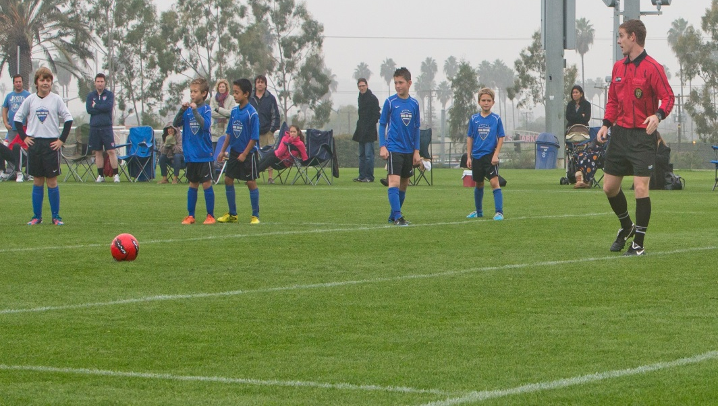
Law 14 - The Penalty Kick
U.S. Soccer Federation Referee Program
Entry Level Referee Course
Competitive Youth Training
Small Sided and Recreational Youth Training
2016-17
Notes:
Online Training Script:
Welcome to U.S. Soccer’s online training for the Grade 8 & 9 Referee Course.
Grade 8 training is specific to preparing officials for the competitive youth game.
Grade 9 training is specific to preparing officials for the small sided and recreational youth game.
This presentation focuses on Law 14 – The Penalty Kick.

Slide 2
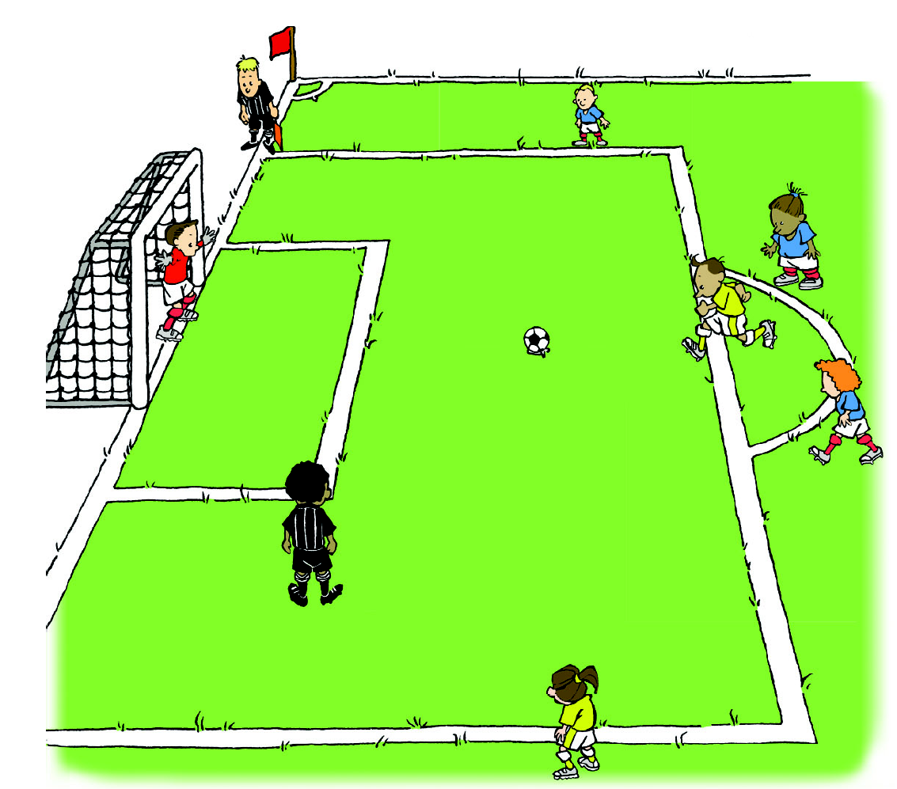
Overview
A penalty kick is awarded when a defending player commits, within their own Penalty Area, one of the ten fouls punishable by a direct free kick (DFK).
A goal can be directly scored from the taking of the penalty kick.

Slide 3
Overview
Awarding a penalty kick is based on the location of where the foul was originally committed, not the position of the ball when the foul took place.

Slide 4
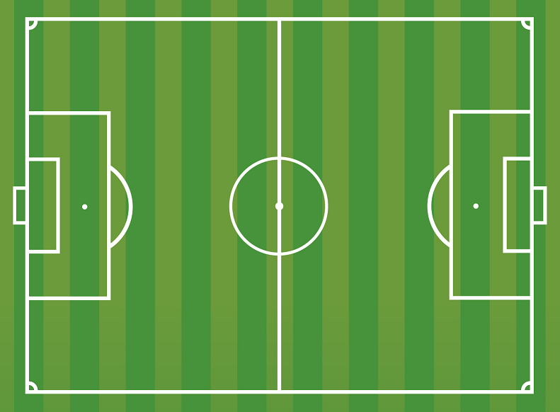
Overview
Goal Line
A penalty kick is also awarded when a player running along the goal line leaves the field as part of the play and commits a DFK offense against an opponent while off the field and within the width of the offender’s own Penalty Area.

Slide 5
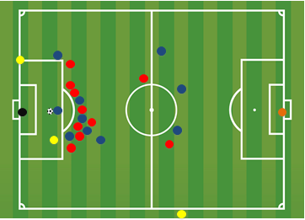
Overview
Understanding how to properly enforce Law 14 is important for officials working competitive youth games.
From the moment the penalty kick is awarded, the referee must begin thinking about how to implement all the requirements for the most ceremonial restart there is in the Laws of the Game.

Slide 6
Positioning
The ball must be placed and be stationary on the penalty mark.
The penalty kick taker must be clearly identified to both the referee and the goalkeeper.
This can often be accomplished by the referee asking who will take the kick and then letting that player place the ball on the mark.

Slide 7
Positioning
The defending goalkeeper must remain on the goal line, between the goalposts, while facing the penalty taker until the ball has been kicked.

Slide 8
Positioning
Penalty kick taker
Ball is on the penalty mark
Goalkeeper is on the goal line

Slide 9
Positioning
All players other than the defending goalkeeper and the penalty kicker must be:
on the field of play
outside the penalty area
behind the penalty mark
outside the penalty arc
until the ball is kicked into play.

Slide 10
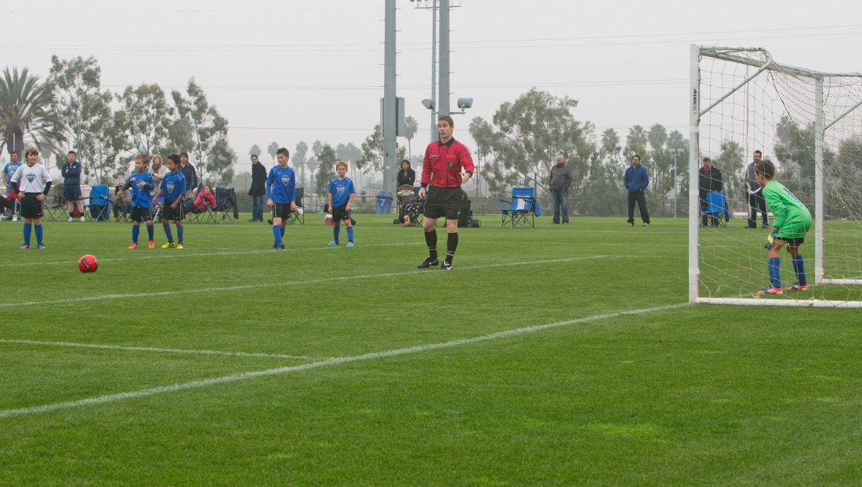
Procedure
After confirming that all players are in the correct position, the referee blows their whistle to signal the taking of the kick.
The ball is in play once it has been kicked and clearly moves forward.
Once the ball is in play, players from both teams may enter the penalty arc and the penalty area.
Notes:
Like all free kicks, the penalty kick taker may not play the ball a second time until it has been touched by another player.
This means the kicker may play the ball a second time if the ball rebounds off the goalkeeper, but not if the ball rebounds directly off the goal post or crossbar without having touched another player.

Slide 11
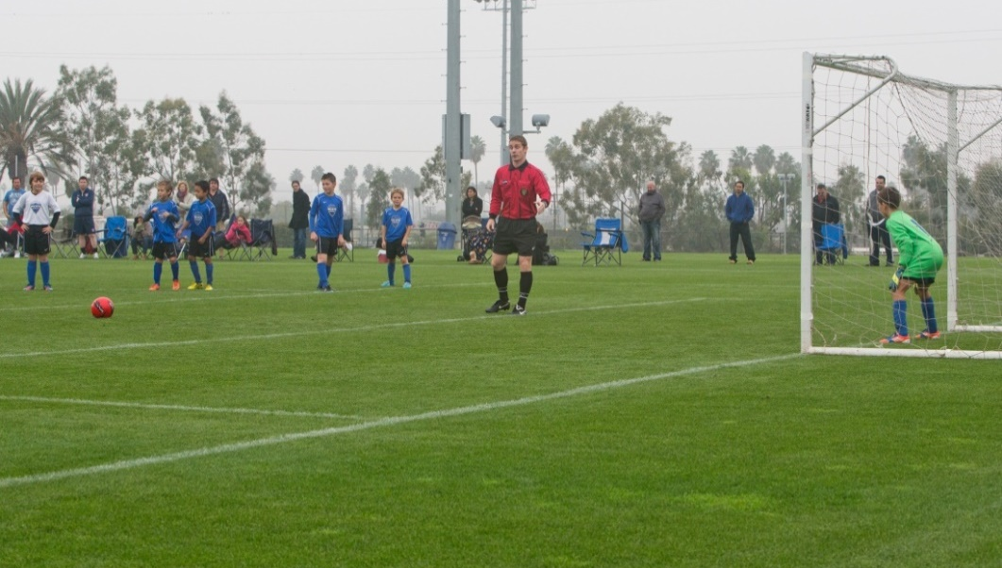
Procedure
The goalkeeper is allowed to move from side to side on the goal line before the kick is taken.
The goalkeeper is not allowed to move off the goal line before the kick is taken.

Slide 12
Procedure
Like all free kicks, the penalty kick taker may not play the ball a second time until it has been touched by another player.
This means that the kicker may play the ball a second time if the ball rebounds off the goalkeeper, but not if the ball rebounds directly off the goal post or crossbar without having touched another player.

Slide 13
Infringements
If, after the penalty kick has been taken and the kicker does touch the ball again before it has touched another player (e.g. rebounds off the goal frame), an indirect free kick (IFK) is awarded to the opposing team at the point of the infringement (where 2nd touch occurs).
However, if the kicker plays the ball with their hands, then a direct free kick (DFK) will be awarded to the opposing team.

Slide 14
Interference
If the ball is touched by an outside agent (e.g. extra ball, an animal, etc.) as it moves forward (i.e. prior to any other player touching the ball or the ball rebounding off the goal frame), the penalty kick is retaken.
If the ball is touched by an outside agent after rebounding off the goal frame or touching another player, play is stopped and restarted with a dropped ball.

Slide 15
Interference
EXCEPTION:
  If a ball touched by an outside agent, whether before or after rebounding or touching another player, that is going to go into the goal and this outside interference does not prevent a player from playing the ball, a goal is awarded if (and only if) the ball enters the goal (even if contact is made with the ball).

Slide 16
Infringements
There are a number of infringements that can take place at the taking of a PK after the whistle and before the ball is in play.
Once the referee has whistled for the PK to be taken, the kick must be taken.
Referees must be able to properly identify who infringed on Law 14 to know whether or not to award a goal and how to restart the game.

Slide 17
Infringements
Law 14 outlines specific restarts should an infringement, like encroachment, take place during the taking of a penalty kick.
Encroachment refers to players moving into prohibited areas prior to the taking of the penalty kick.
Encroachment also refers to when the goalkeeper moves forward from off the goal line before the ball is kicked.

Slide 18
Infringements
If the kicker or the teammate of the kicker commits an infringement during the penalty kick and
a goal is scored - the goal is disallowed and the penalty kick is retaken.
a goal is not scored - the referee stops play and restarts with an indirect free kick (IFK) to the opposing team at the spot of the violation.

Slide 19
Infringements
Play will be restarted with an indirect free kick (IFK) regardless of whether or not a goal is scored, if the kicker or the teammate of the kicker commits one of the following:
a penalty kick is kicked backwards
a teammate of the identified kicker takes the kick – caution player taking the kick
feinting the kick once the kicker has completed the run-up (feinting during the run-up is permitted) – caution the kicker
The IFK restart is to be taken at the penalty mark.

Slide 20
Infringements
If the goalkeeper or the teammate of the goalkeeper commits an infringement during the penalty kick and
1) a goal is scored - the goal stands.
2) a goal is not scored - then the referee awards a retake of the penalty kick.
The goalkeeper is cautioned if responsible for committing an infringement that causes a penalty kick to be retaken.

Slide 21
Infringements
If both teams commit an infringement during the penalty kick, the penalty kick is retaken
Unless a player commits a more serious offense (e.g. illegal feinting).

Slide 22
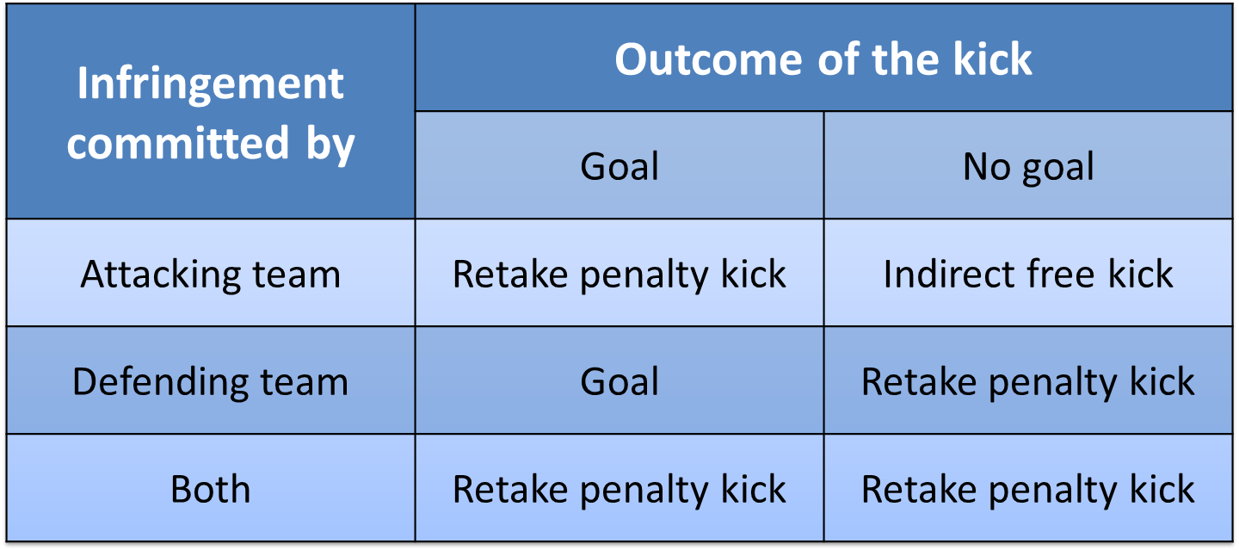
Infringements
RESTART SUMMARY
Encroachment

Slide 23
Defective Ball
If the ball bursts or becomes defective during a penalty kick before it touches any player or the goalposts or crossbar, then the penalty kick should be retaken.
If the ball bursts or becomes defective during a penalty kick after it touches any player or the goal frame, then a dropped ball should be used to restart play.
If the ball becomes defective after making contact with the goal frame and then crosses the goal line, the goal counts.

Slide 24
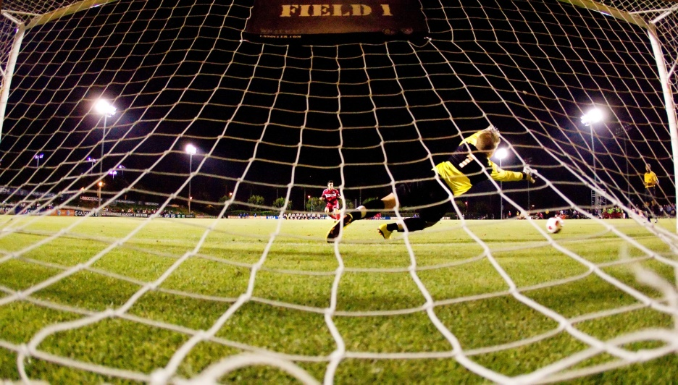
Extending Time
A penalty kick, once awarded, shall be taken regardless of the amount of time or added time remaining in any period of play.
If time will expire before the PK can occur, the referee must extend time as needed for the taking of the PK and indicate clearly that the PK is now being taken in extended time.

Slide 25
Extended Time PK
In the case of an extended time PK, the goalkeeper may be replaced, if necessary, by a substitute if the maximum number of substitutions has not been exceeded, or by an eligible player on the field.

Slide 26

Extended Time PK
Only the kicker and the goalkeeper may participate in an extended time PK.
All other players must still remain on the field until
the PK has been completed.
After the kick has been taken in an extended time PK then only the goalkeeper may participate in play.

Slide 27
Extending Time
The penalty kick is completed when the ball stops moving, goes out of play or the referee stops play for any infringements of the Laws.
Only the referee decides when the penalty kick procedure has been completed.
Once completed the referee should then signal the end of the game with a whistle.

Slide 28
Review Question
82. Is a penalty kick awarded when a defending player commits a foul punishable by a direct free kick against an opponent in the defending player’s penalty area?
      Yes
      No

Slide 29
Review Question
83. What is the correct restart if the penalty kick taker kicks the ball into the goal after the ball has rebounded off the goalkeeper?
    Kick-off
    Indirect free kick
    Goal kick
    Retake the penalty kick

Slide 30
Review Question
84. What is the correct restart if the goalkeeper moves from side to side on the goal line before the penalty kick is taken and then deflects the kick over the crossbar?
      Corner kick
      Goal kick
      Indirect free kick
      Retake the penalty kick

Slide 31
Review Question
85. What is the correct restart if a teammate of the penalty kick taker enters the penalty area before the penalty kick is taken and then the goalkeeper deflects the ball over the crossbar?
    Corner kick
    Indirect free kick
    Retake the penalty kick
    Goal kick

Slide 32
Review Question
86. Can any player, including the goalkeeper, from the team that was fouled take the penalty kick?
        Yes
        No

