Slide 1
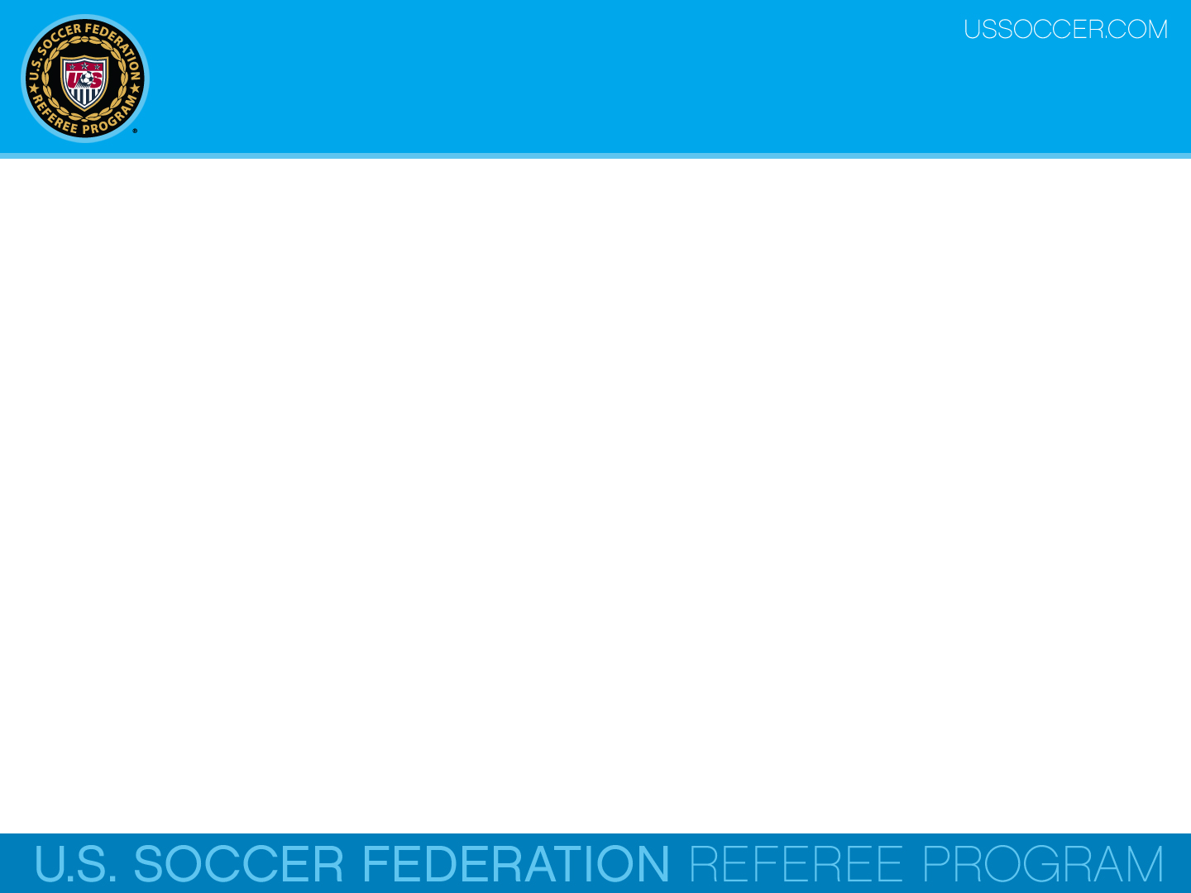

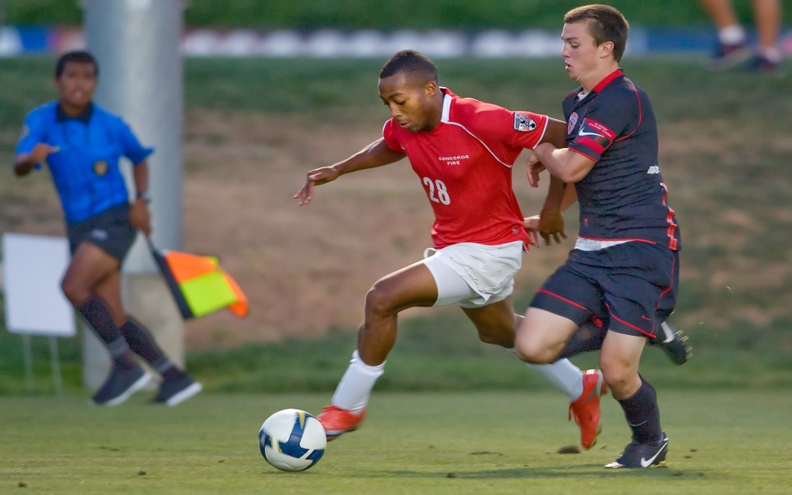
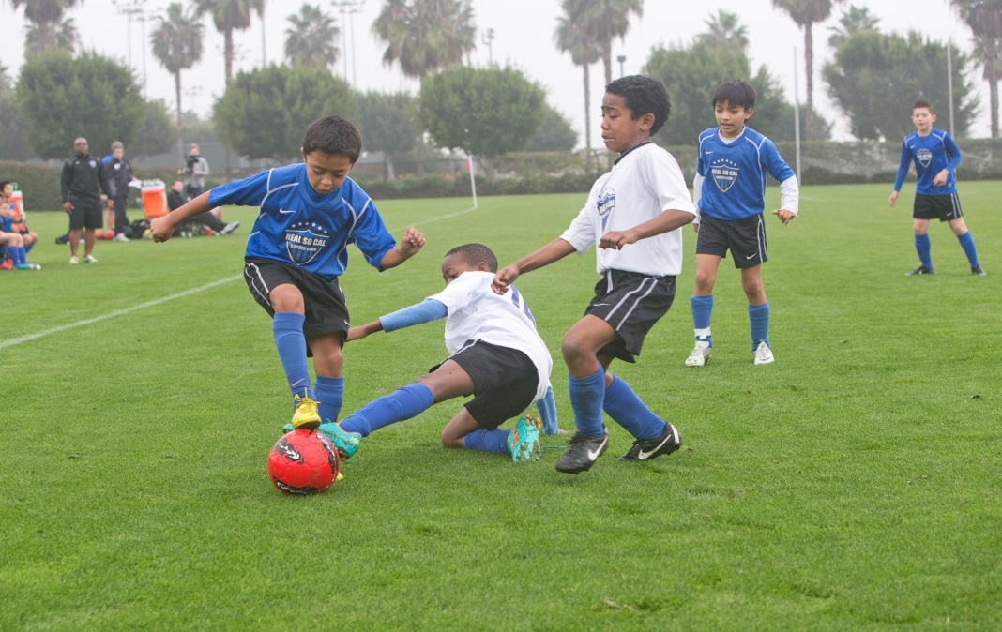
Law 12 - Fouls & Misconduct
U.S. Soccer Federation Referee Program
Enter Level Referee Course
Competitive Youth Training
Small Sided and Recreational Youth Training
2016-17
Notes:
Online Training Script:
Welcome to U.S. Soccer’s online training for the Grade 8 & 9 Referee Course.
Grade 8 training is specific to preparing officials for the competitive youth game.
Grade 9 training is specific to preparing officials for the small sided and recreational youth game.
This presentation focuses on Law 12 – Fouls and Misconduct.

Slide 2
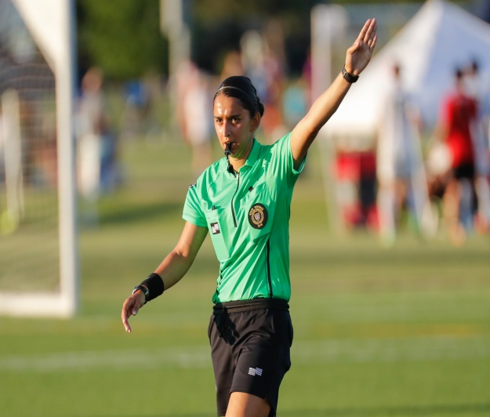
Law 12 Overview
The Law 12 is separated into two parts. The first part is about fouls and the second part deals with misconduct.
Fouls
  Direct free kick fouls (DFK)
  Indirect free kick fouls (IFK)
Misconduct
  Cautionable offenses
  Sending-off offenses

Slide 3

Part 1 – Fouls

Slide 4
Offenses
If the ball is in-play and a player commits an offense inside the field-of-play against:
an opponent – restart is an IFK, DFK or PK,
a team-mate, a substitute, a substituted player or any team official – restart is a DFK or PK,
a match official (Referee or AR) – restart is a DFK or PK,
any other person – restart is a dropped ball

Slide 5
Fouls
A foul is an unfair or unsafe action that meets the following criteria:
Committed by a player
Against an opponent or the opposing team
On the field of play
While the ball is in play
If these four (4) requirements are not met, the unfair or unsafe action cannot be a foul, but it may still be misconduct.

Slide 6
Types of Fouls
In most matches, there are usually two types of fouls.
However, the local rules of competition may specify different types of fouls to be called and their respective restarts.
The referee must know the rules of competition for the match they are officiating.

Slide 7
Types of Fouls
In competitive youth matches, there are two types of fouls. Each type reflects the kind of restart used.
Direct free kick fouls (DFK)
A DFK is awarded if one of the ten (10) direct free kick fouls are committed.
Any fouls that in involve contact are penalized with a DFK or a PK, if the offence occurred within the offending teams own penalty area.
A goal can be scored directly (one touch) from the taking of the restart.

Slide 8
Types of Fouls
In competitive youth matches, there are two types of fouls. Each type reflects the kind of restart used.
Indirect free kick fouls (IFK)
An IFK is awarded if a player commits one of the eight (8) indirect free kick fouls.
The ball must be touched by another player (from either team) before a goal can be scored from an IFK.

Slide 9
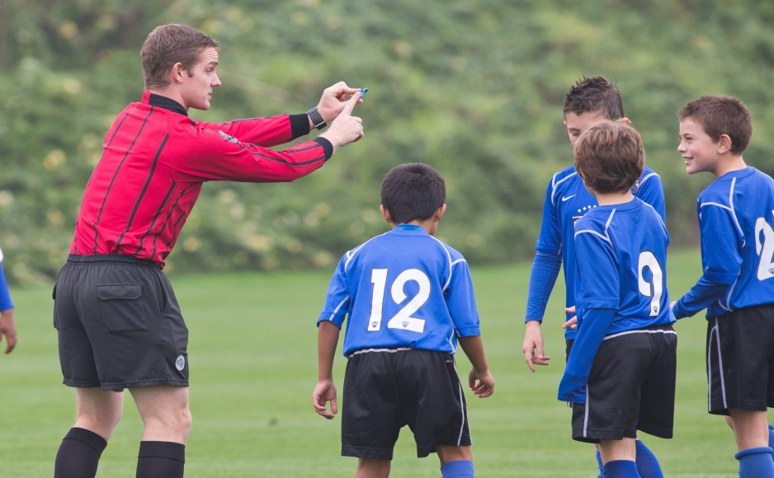
Direct Free Kick
The ten (10) direct free kick (DFK) fouls are separated into a group of seven (7) actions and a group of three (3) actions.
For the first seven (7) of the ten (10) direct free kick (DFK) fouls, the referee must determine if the action has been committed carelessly or
Recklessly
or with
Excessive Force.

Slide 10
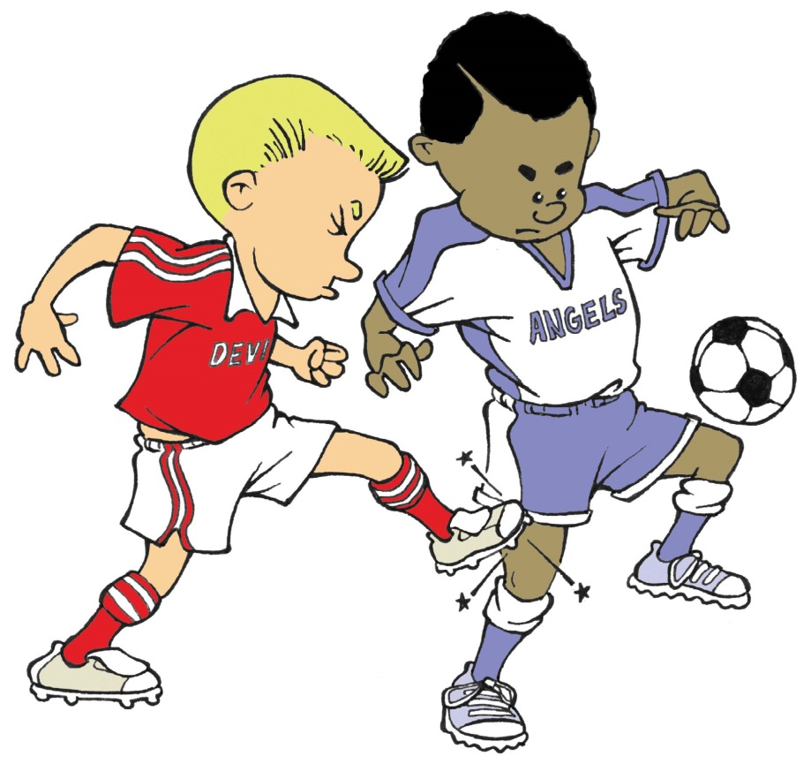
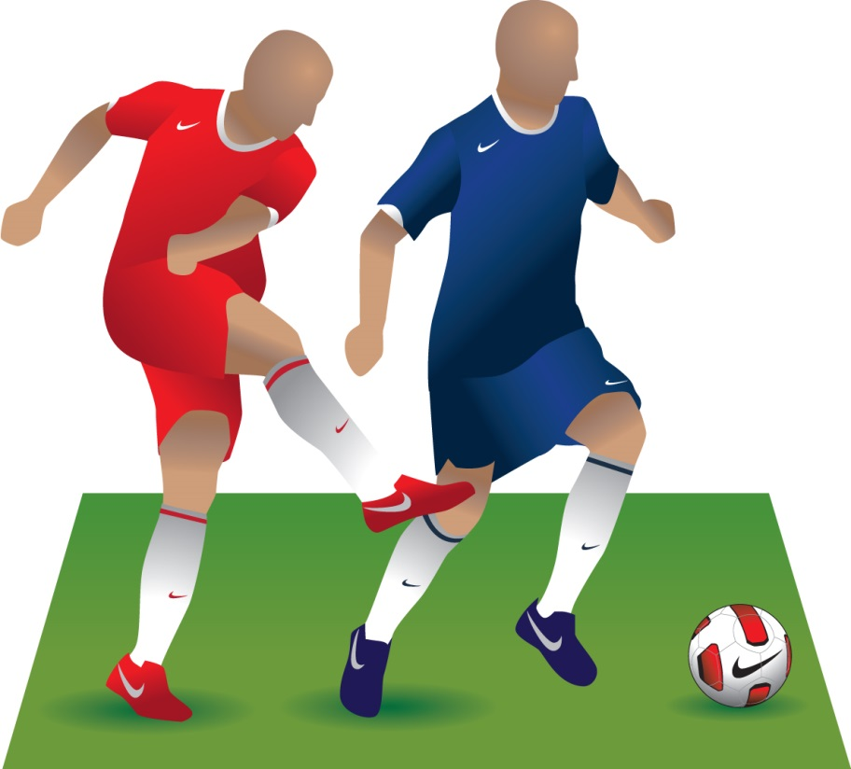
(1) Kicking
Kicking or Attempting to Kick.
Notes:
Online Training Script:
Kicking or attempting to kick.
Classroom Instructor Talking Points:

Slide 11
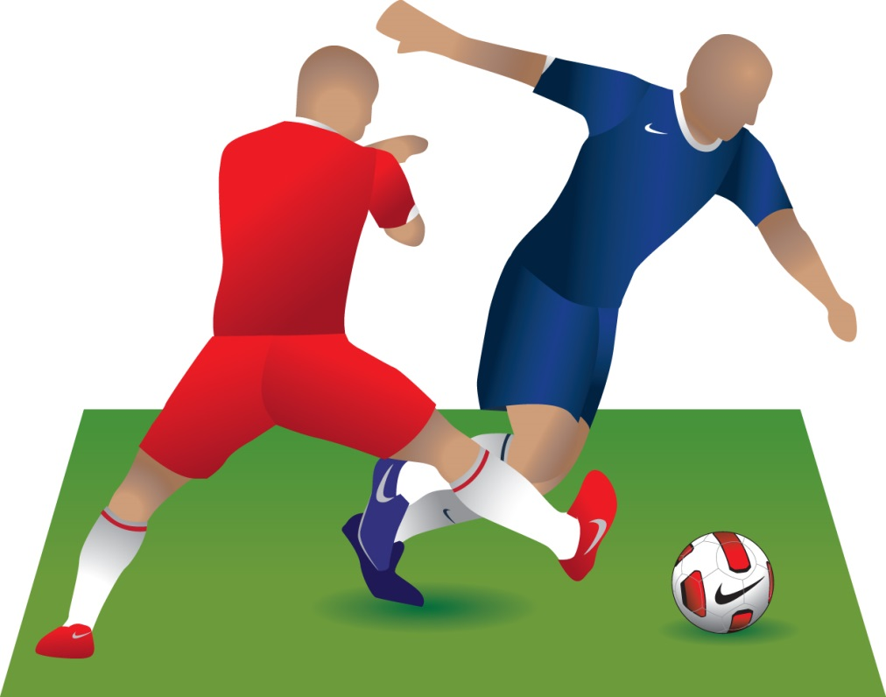
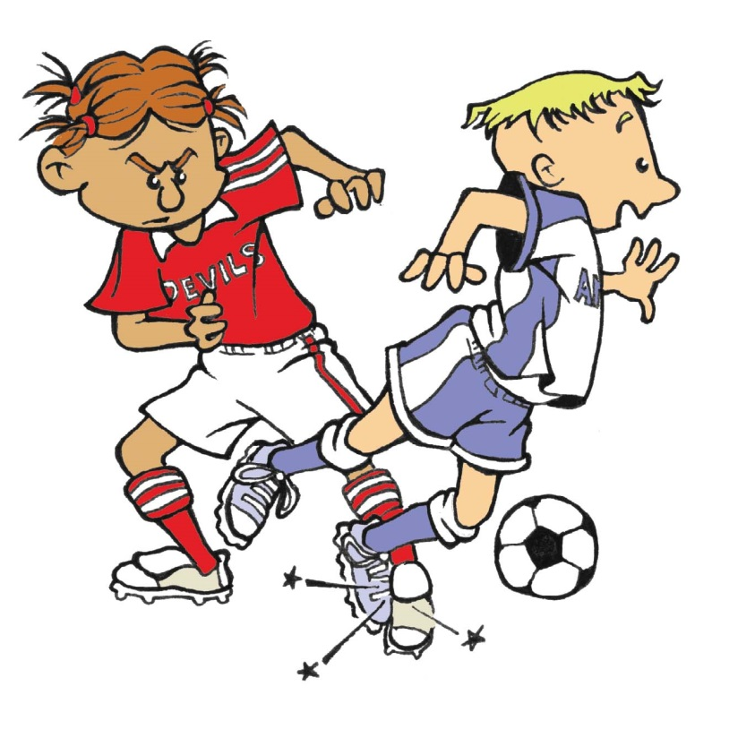
(2) Tripping
Tripping or Attempting to Trip.
Notes:
Online Training Script:
Tripping or attempting to trip.
Classroom Instructor Talking Points:

Slide 12
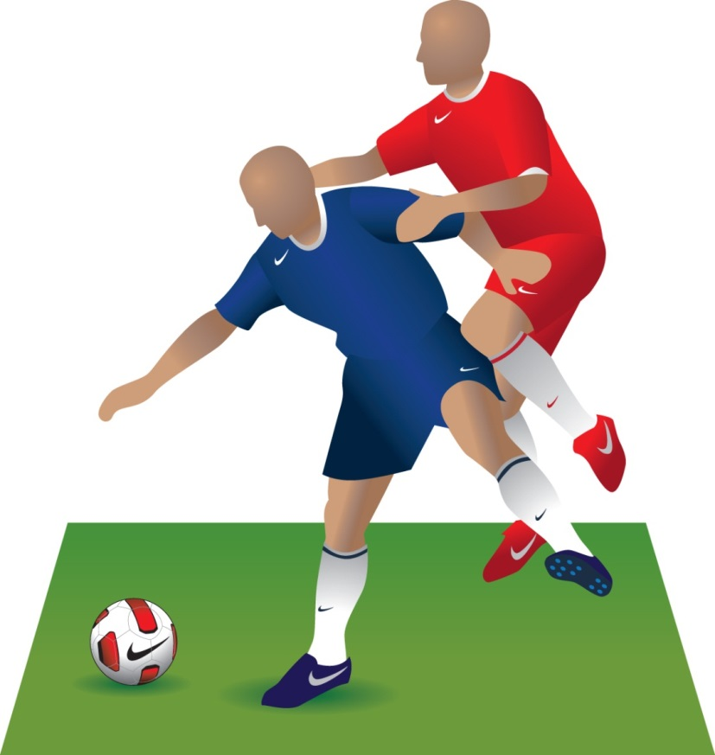
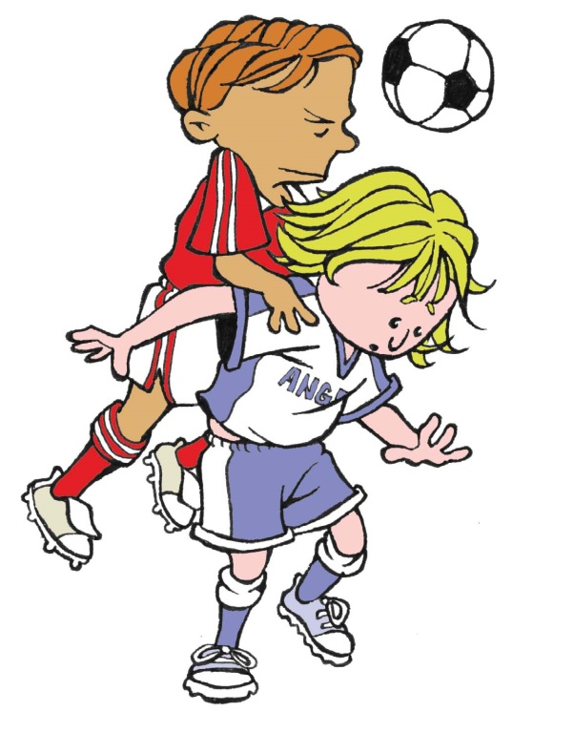
(3) Jumping At
Jumping At an Opponent.
Notes:
Online Training Script:
Jumping at an opponent.
Classroom Instructor Talking Points:

Slide 13
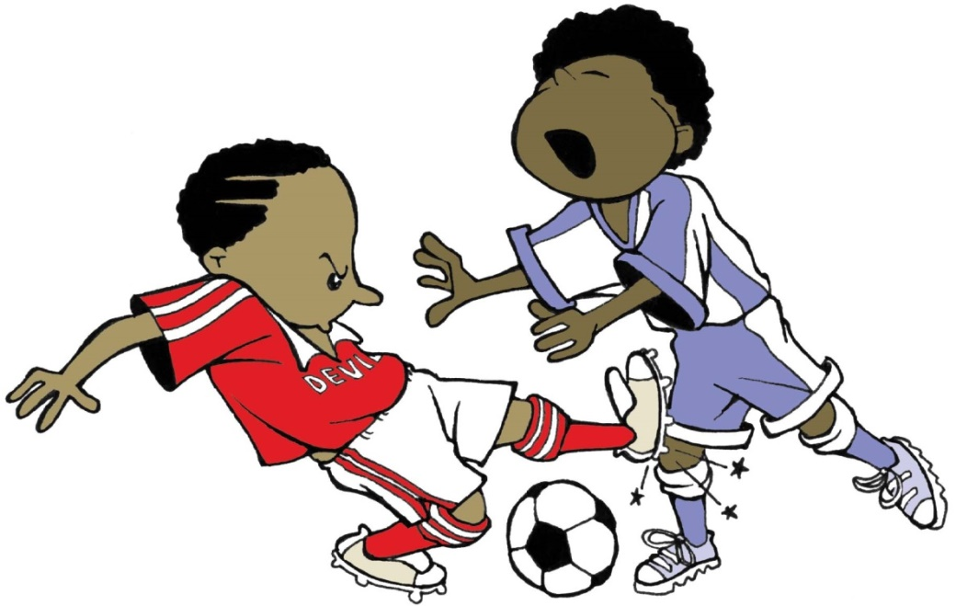
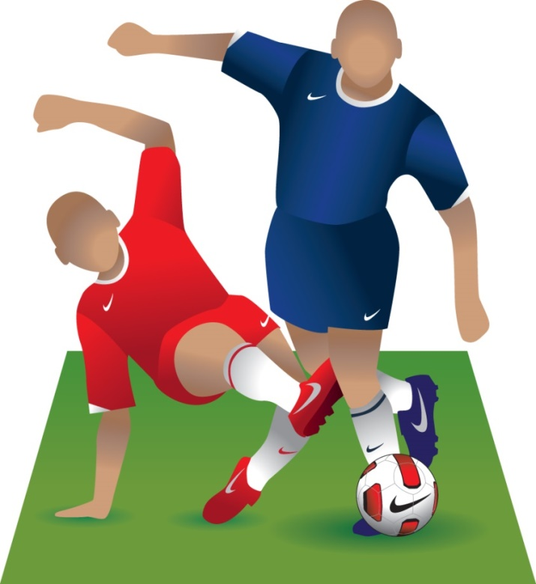
(4) Tackles or Challenges
Tackling or Challenging an opponent … when contact is made with the player before the ball.
Notes:
Online Training Script:
And tackling.
Classroom Instructor Talking Points:

Slide 14
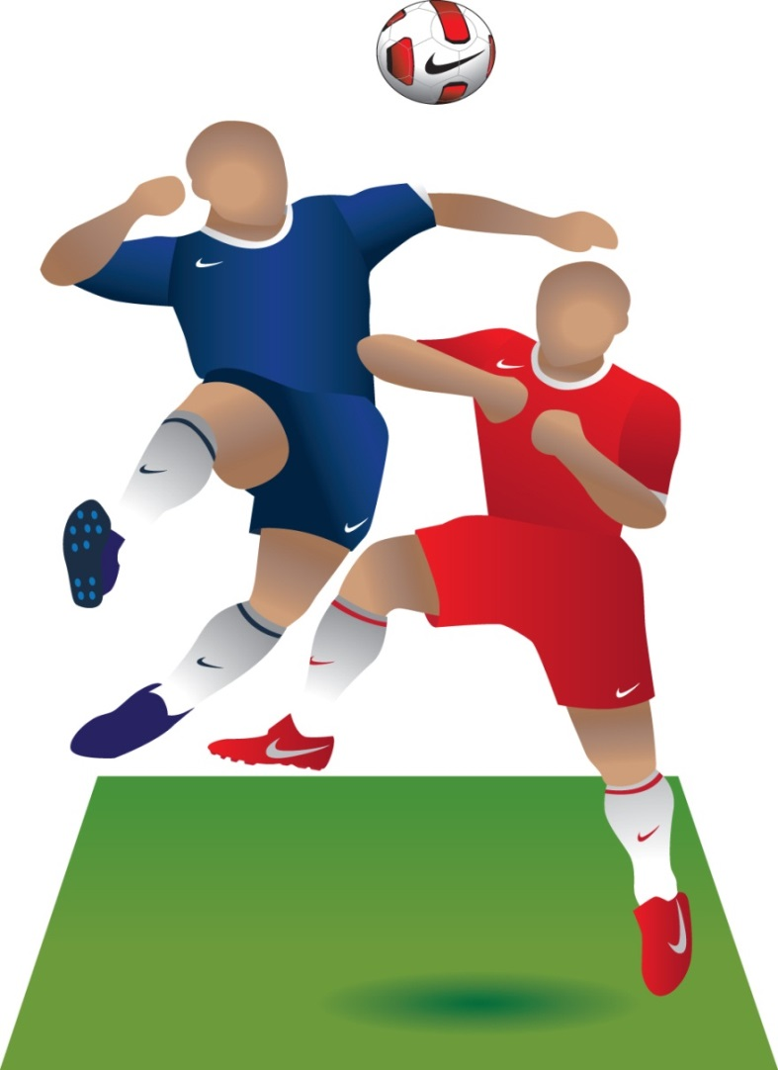
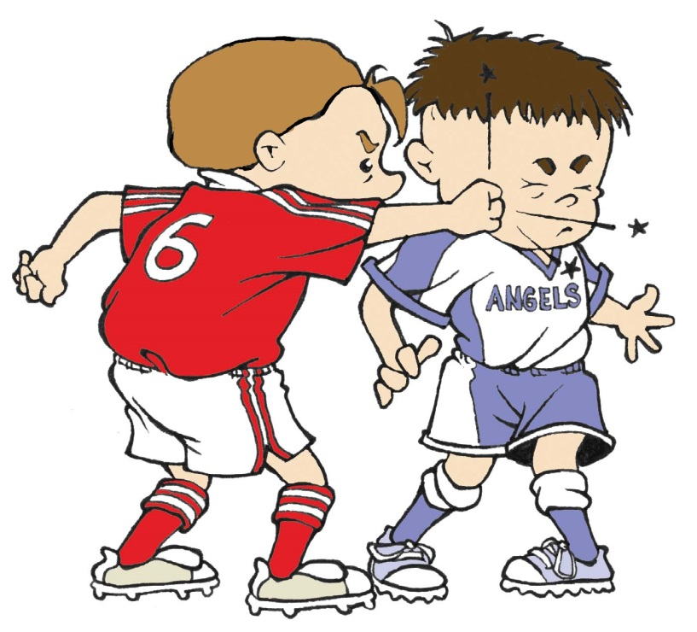
(5) Striking
Striking or Attempting to Strike
Notes:
Online Training Script:
Striking or attempting to strike.
Striking can be performed by direct contact using hands, arms, elbows, head, or knees, or by throwing any object, including the ball.
Striking as a foul occurs where contact is made with the opponent or where contact would have been made if the attempt to strike is unsuccessful.
Classroom Instructor Talking Points:

Slide 15
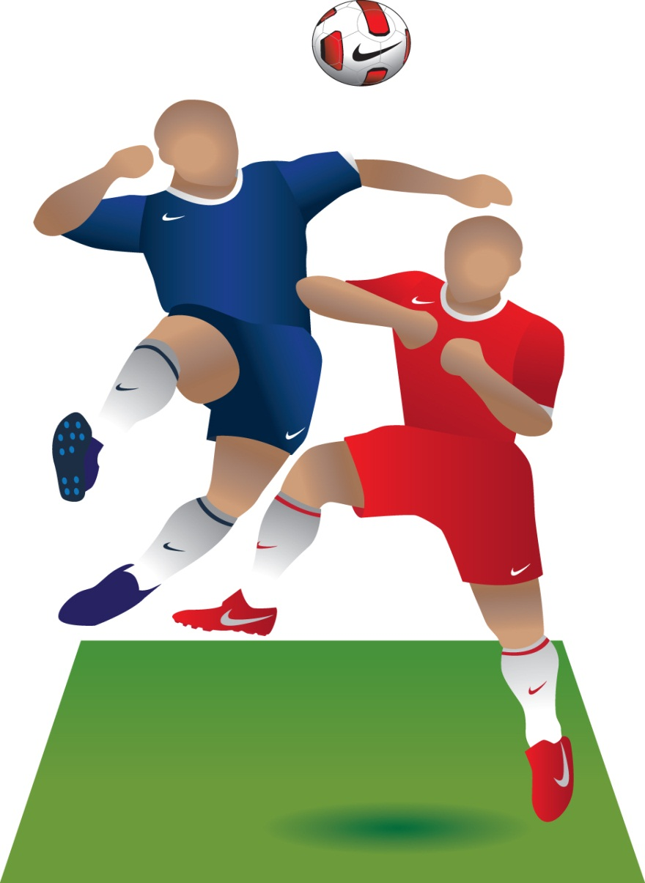
(5) Striking
Striking or Attempting to Strike.
Striking can be performed by direct contact using hands, arms, elbows, head, or knees, or by throwing any object, including the ball.

Slide 16
(5) Striking
Striking or Attempting to Strike.
A striking foul occurs where contact is made with the opponent or where contact would have been made if the attempt to strike is unsuccessful.

Slide 17
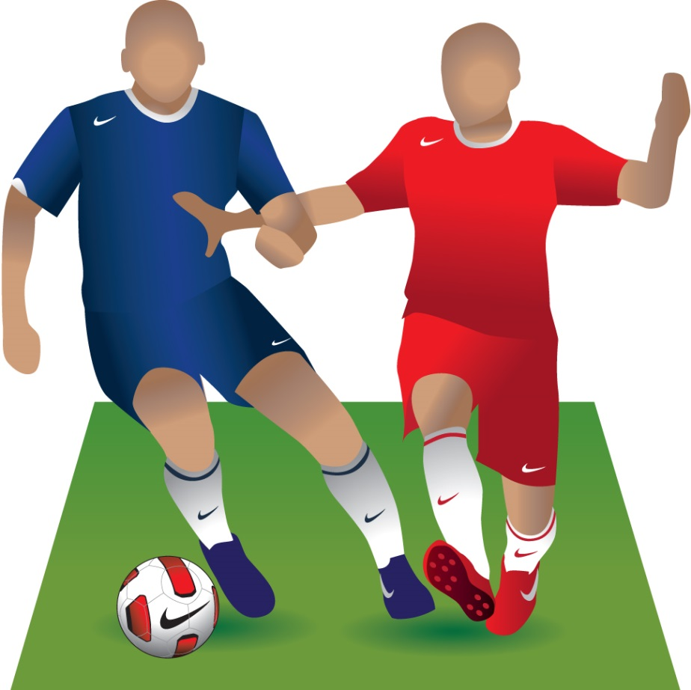
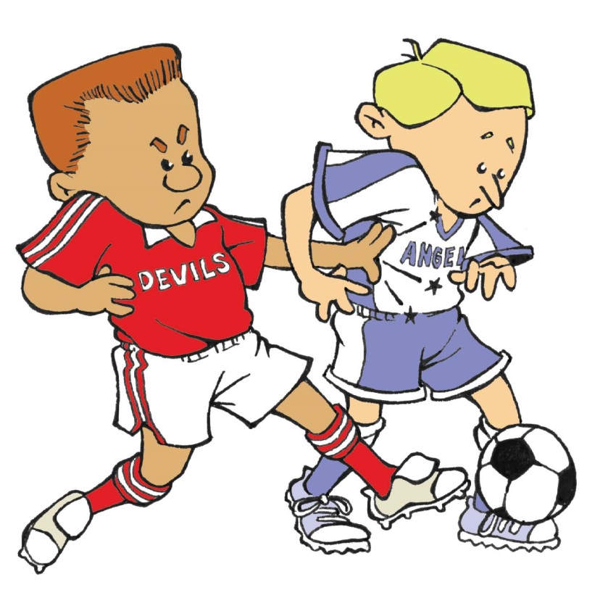
(6) Pushing
Pushing … with hands, body or arms
Notes:
Online Training Script:
Pushing.
Classroom Instructor Talking Points:

Slide 18
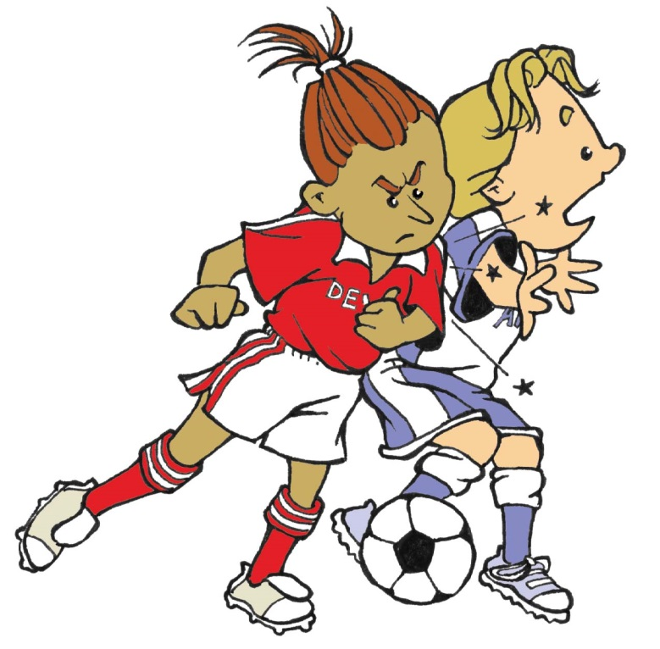
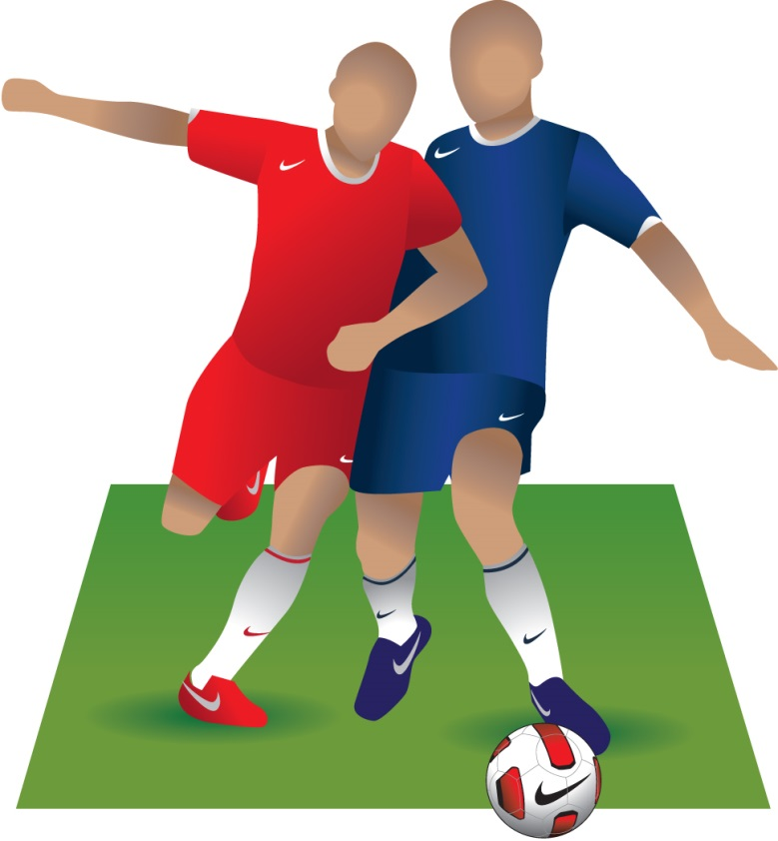
(7) Charging
Charging … not shoulder to shoulder
Notes:
Online Training Script:
Charging.
The act of charging is a challenge for space using physical contact within playing distance of the ball without using arms or elbows.
Classroom Instructor Talking Points:

Slide 19
(7) Charging
Charging is a challenge for space using physical contact within playing distance of the ball without using arms or elbows.
Charging is a foul when it is not shoulder to shoulder.

Slide 20
Careless
It is important to distinguish between the terms careless, reckless, and excessive force when discussing the first seven (7) direct free kick (DFK) fouls.
Careless means that the player has shown a lack of attention or consideration when making a challenge or that they acted without precaution.
No further disciplinary sanction is needed if a foul is judged to be careless.

Slide 21
Careless
Note that all instances of kicking, striking or attempting to do either, should be considered as careless at a minimum.
Kicking and striking fouls are more likely to be reckless or using excessive force, than careless, so referees should be mindful of this when dealing with fouls of this nature.

Slide 22
Reckless
Reckless means that the player has acted with disregard to the danger to, or consequences for, their opponent when making a challenge for the ball.
A player who plays in a reckless manner must be cautioned and shown a yellow card.

Slide 23
Excessive Force
Using excessive force means that the player has far exceeded the necessary use of force, is in danger of injuring their opponent, or has acted without regard for the opponent’s safety when challenging for the ball.
A player who uses excessive force must be sent off and shown a red card.

Slide 24
Direct Free Kick
Most direct free kick (DFK) fouls committed during small-sided and recreational youth games will qualify as careless. They are typically the byproduct of players who are still developing and learning the game.
When a player commits one of these seven (7) direct free kick (DFK) fouls carelessly, referees should not hesitate to stop play to promote a safe environment for the players.

Slide 25
Direct Free Kick
Referees must also be aware that certain actions and behaviors should be punished more severely when appropriate. Typical level of fouls in a small-sided or recreational youth game are:
Careless … Most common
Reckless … Less common
Excessive force … Rarely seen

Slide 26
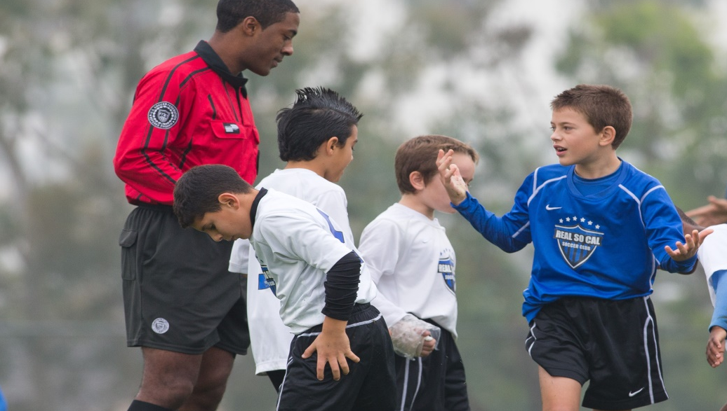
Direct Free Kick
For the final three direct free kick (DFK) fouls, the referee does not have to determine if the actions were committed carelessly, recklessly or with excessive force
These three (3) fouls need only to happen for the referee to take action.

Slide 27
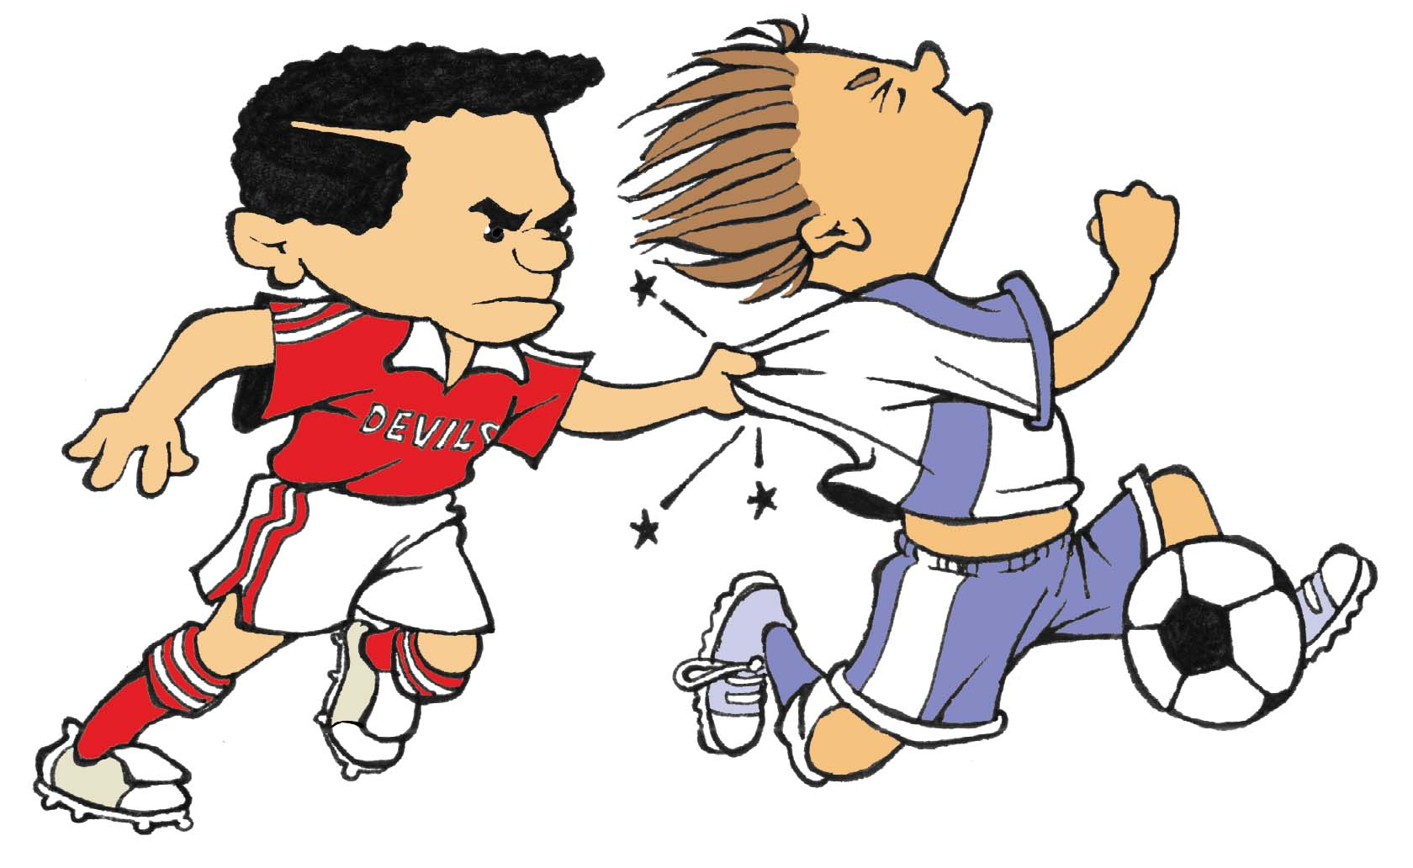
(8) Holding
Holding … Includes holding any part of an opponent’s body or uniform.

Slide 28
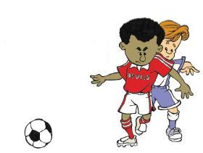
(8) Holding
Holding … Includes impeding an opponent with contact (sometimes referred to as blocking)

Slide 29
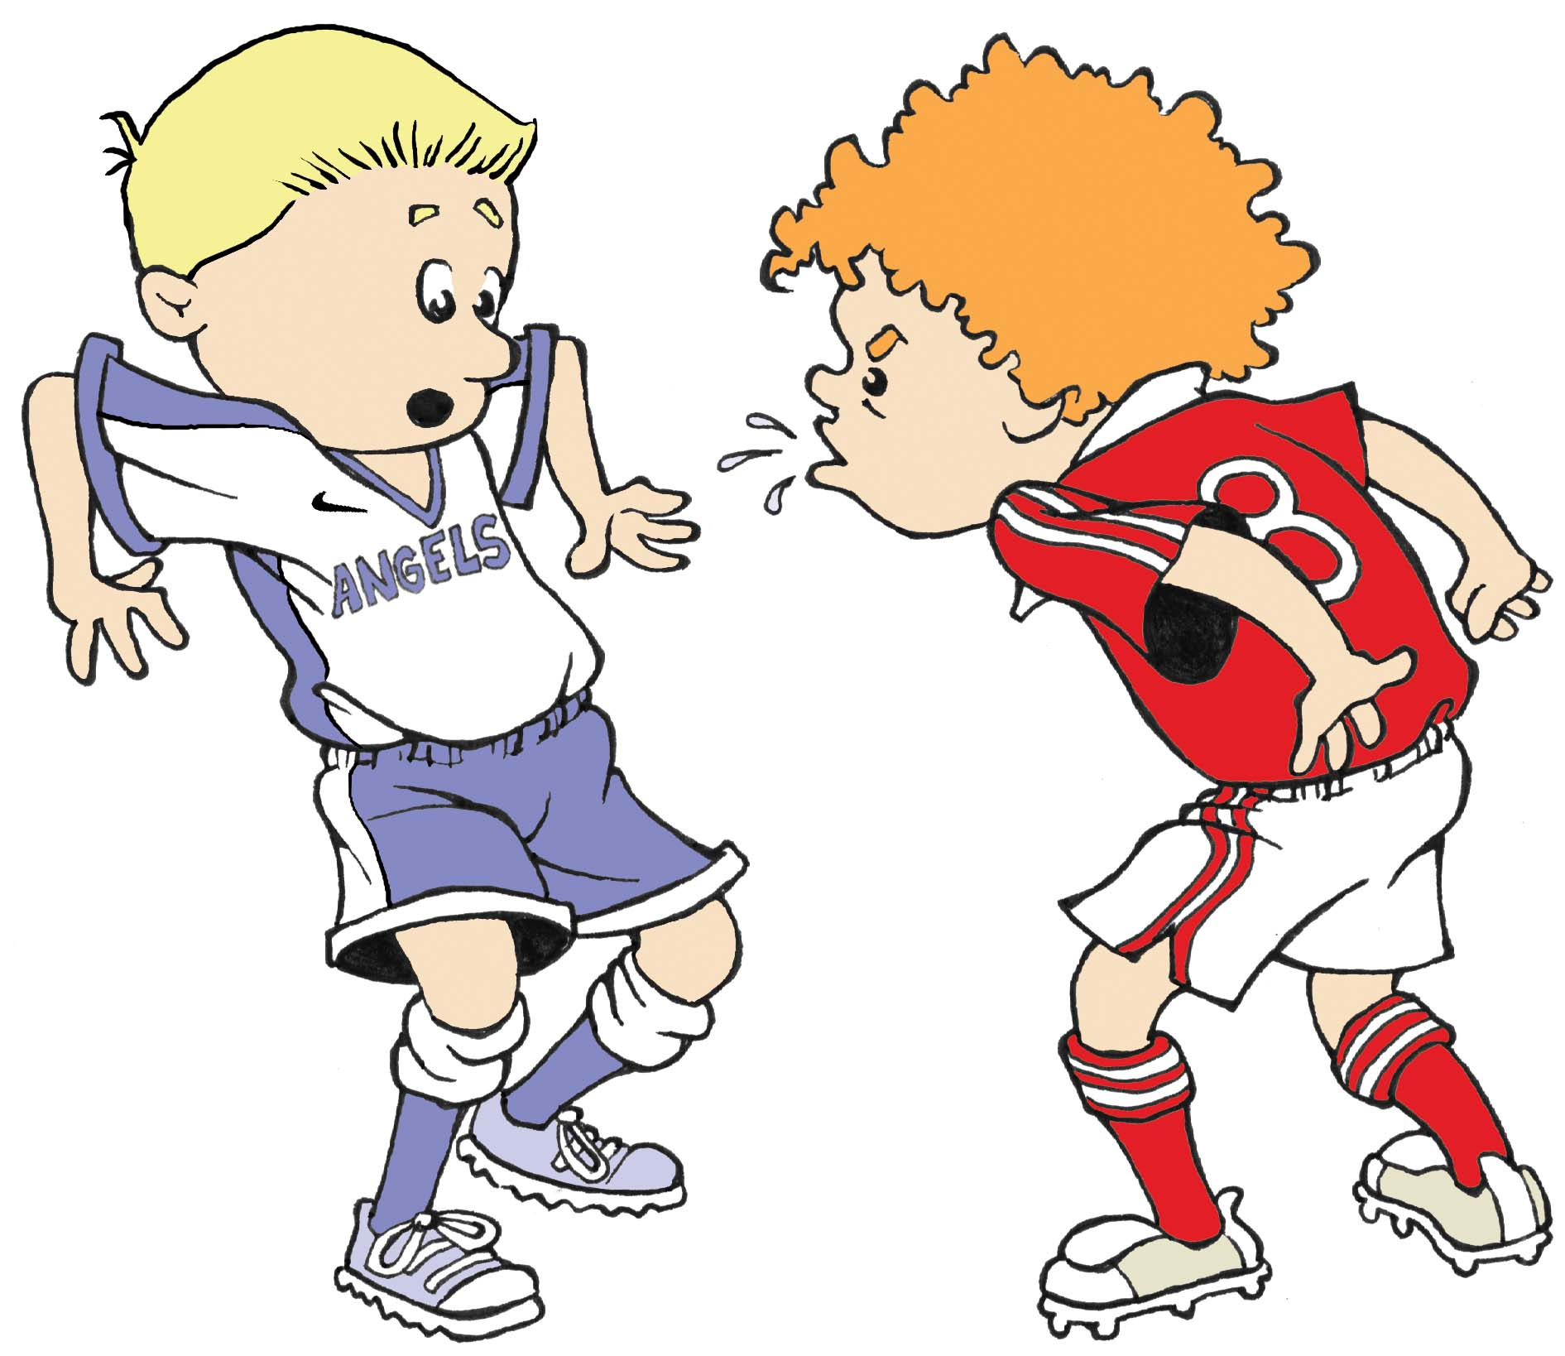
(9) Spitting At
Spitting At an Opponent

Slide 30
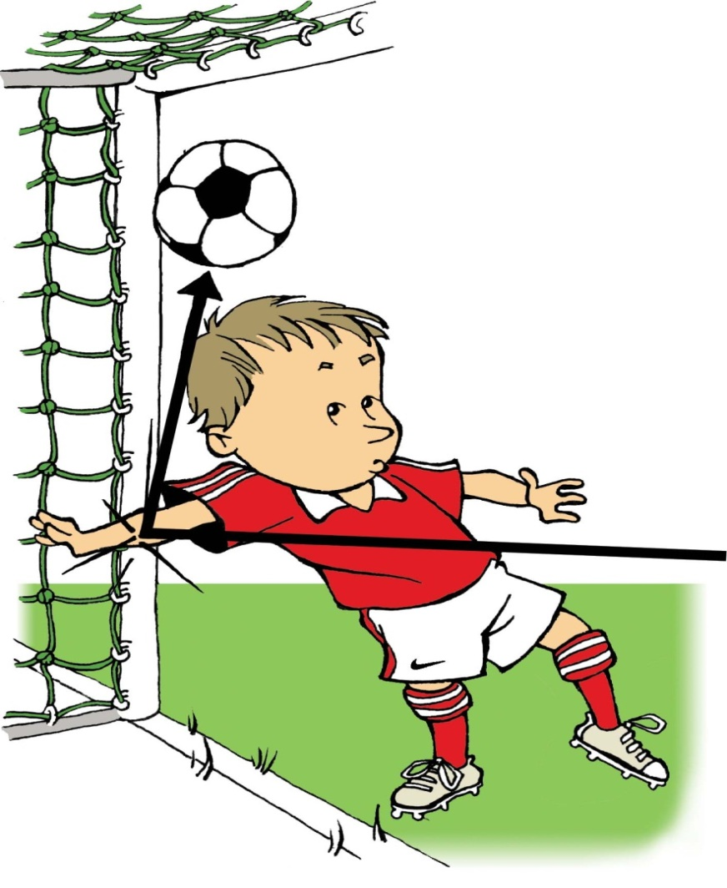
(10) Deliberate Handling
Unlike all the other direct free kick (DFK) fouls, note that deliberate handling is committed against the opposing team, not against a specific opposing player.
Deliberate Handling … with hand or arm

Slide 31
(10) Deliberate Handling
Handling the ball is the deliberate act of a player making contact with the ball with their hand or arm.
The referee should look at the following factors to help them decide if the handling offense was deliberate:
The movement of the hand towards the ball, not the ball towards the hand.
The distance between the opponent and the ball.

Slide 32
(10) Deliberate Handling
Additional things the referee should look at are:
  The position of the hand does not necessarily mean that there is an infringement.
  Touching the ball with an object held in hand is an infringement
  Hitting the ball with a thrown object also counts as an infringement

Slide 33
DFK Restart Location
In most matches, the restart (free kick) is taken where the offense occurred (with the exceptions described later).
However, the local rules of competition may specify different types and locations of the restart.
The referee must know the rules of competition for the match they are officiating.

Slide 34
DFK Restart Location
If a DFK is awarded, it is taken from the place where the offense occurred with two exceptions:
  When a DFK is awarded inside a team’s own goal area, the kick may be taken from any point inside the goal area.
  When a DFK is awarded for player committing one of the ten (10) DFK fouls within their own penalty area, the kick is taken from the penalty mark (a Penalty Kick – Law 14).

Slide 35
DFK Restart Location
A penalty kick is the result of a DFK offense in a team’s own penalty area. It doesn’t matter where the ball was when the offense was committed (as long as the ball is in play).
Note, if a player strikes (or attempts to strike) someone by throwing an object, the location of the offense is where the person was struck (or would have been struck), not the location of the person who threw the object.

Slide 36
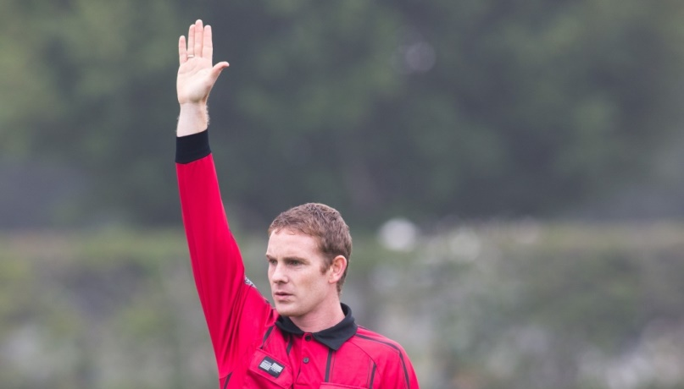
Indirect Free Kick
An IFK is awarded to the opposing team if, in the opinion of the referee, a player does the following:
Plays in a dangerous manner
Impedes the progress of an opponent without making contact
Prevents the goalkeeper from releasing the ball from their hands

Slide 37

Indirect Free Kick
The indirect free kick (IFK) fouls are also separated into two groups.
There are four (4) fouls committed by field players and four (4) fouls specifically committed by a goalkeeper.

Slide 38
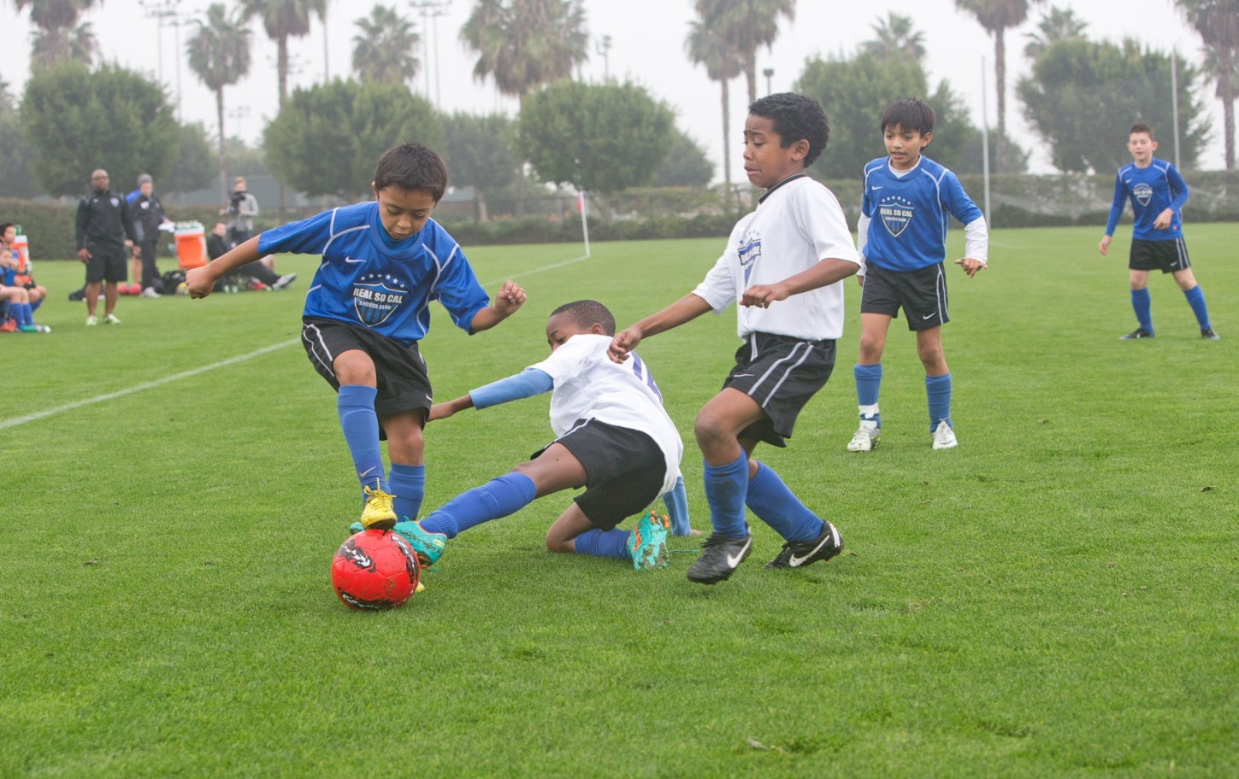
Indirect Free Kick
The first group of four (4) indirect free kick (IFK) fouls can be committed by any field player including the goalkeeper

Slide 39
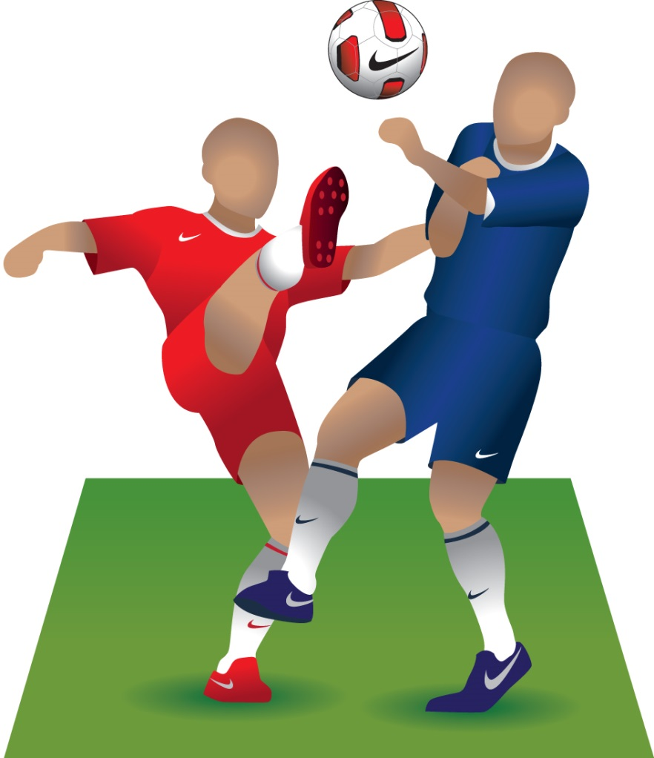
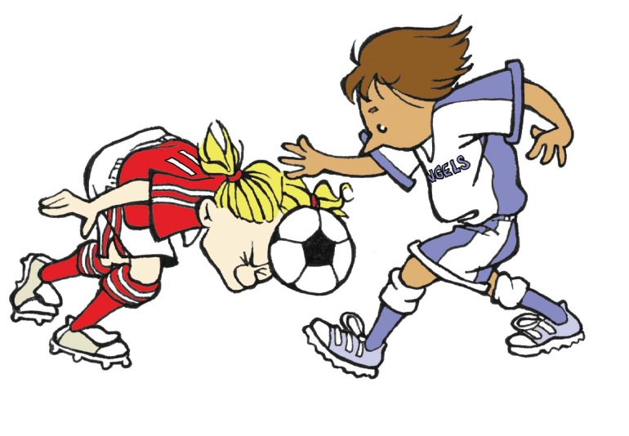
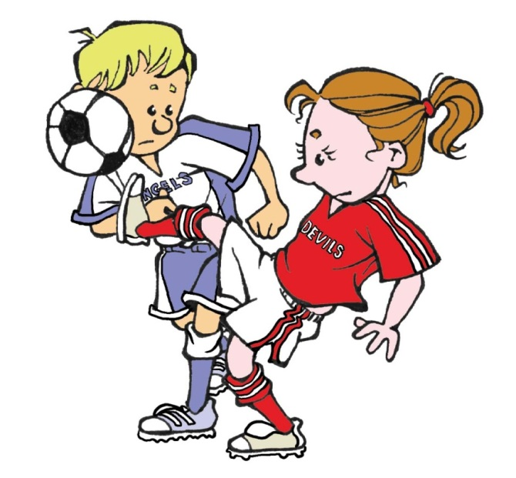
(1) Dangerous Play
Playing in a dangerous or unsafe manner.
Notes:
Online Training Script:
Playing dangerously.
An action is considered dangerous play when an opponent is adversely or unfairly affected, usually by the opponent ceasing to challenge for the ball in order to avoid receiving or causing injury as a result of the action.
When determining dangerous play, referees should also take into account the experience and skill level of the players.
Competitive youth players who are more skilled and experienced may be more likely to accept the danger of an act and continue playing compared to younger players at the small sided and recreational level.
Classroom Instructor Talking Points:

Slide 40
(1) Dangerous Play
Play should be considered dangerous
when:
the referee feels a player might be
injured because of the way they
or their opponent is playing;
an opponent is unfairly affected
by stopping their challenge for the
ball to avoid causing or getting injured.
The referee should also consider player experience/skill level when looking at dangerous play.
More skilled and experienced players, may wish to accept the danger of an act and continue playing compared to less skilled and experienced players.

Slide 41
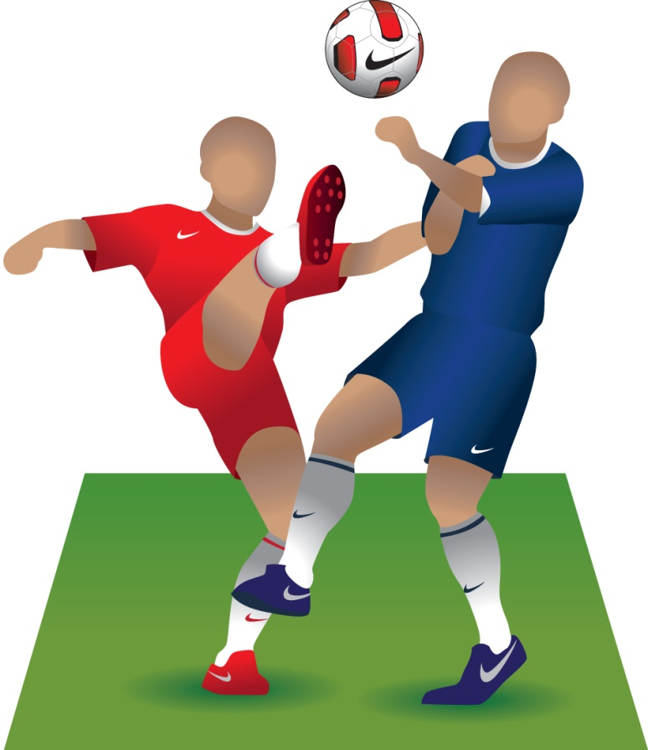
Dangerous Play
Playing Dangerously.
An action is considered dangerous play when an opponent is adversely or unfairly affected, usually by the opponent ceasing to challenge for the ball in order to avoid receiving or causing injury as a result of the action.

Slide 42
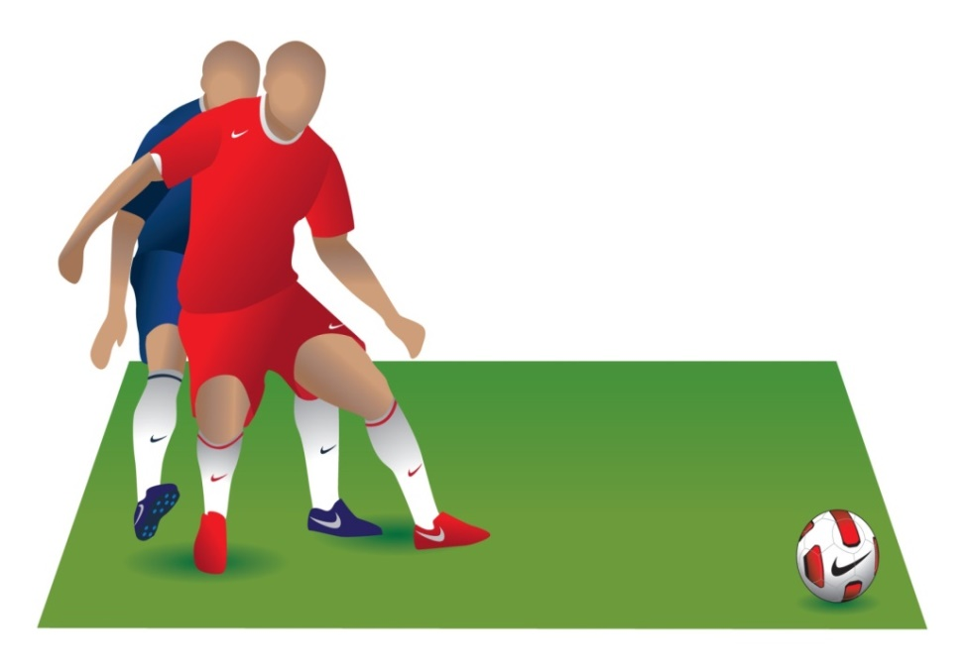
(2) Impeding
Impeding the progress of an opponent.
Impeding the progress of an opponent means moving into their path to obstruct, block, slow down or force a change in direction when the ball is not within playing distance of either player.
Notes:
Online Training Script:
Impeding the progress of an opponent.
This means that a player has moved to obstruct or interfere the path of an opponent.
Impeding also requires that the ball not be within playing distance and physical contact between the players is normally absent.
In these cases, physical contact often results in a offense punishable by a direct free kick being committed by one of the players.
Impeding refers to when a player, who is not attempting to play the ball, moves into the path of an opponent to stop or slow him or her down.

Slide 43
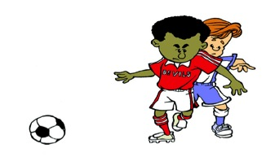
(2) Impeding
  Impeding requires the ball not be within playing distance AND that there is no physical contact between the players.
  When there is physical contact between the players, the offense is punishable by a direct free kick (DFK) being committed by one of the players.

Slide 44
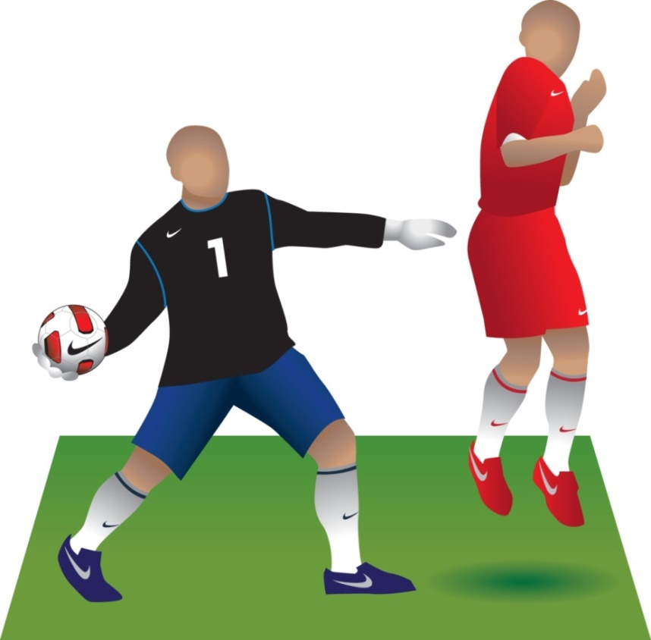
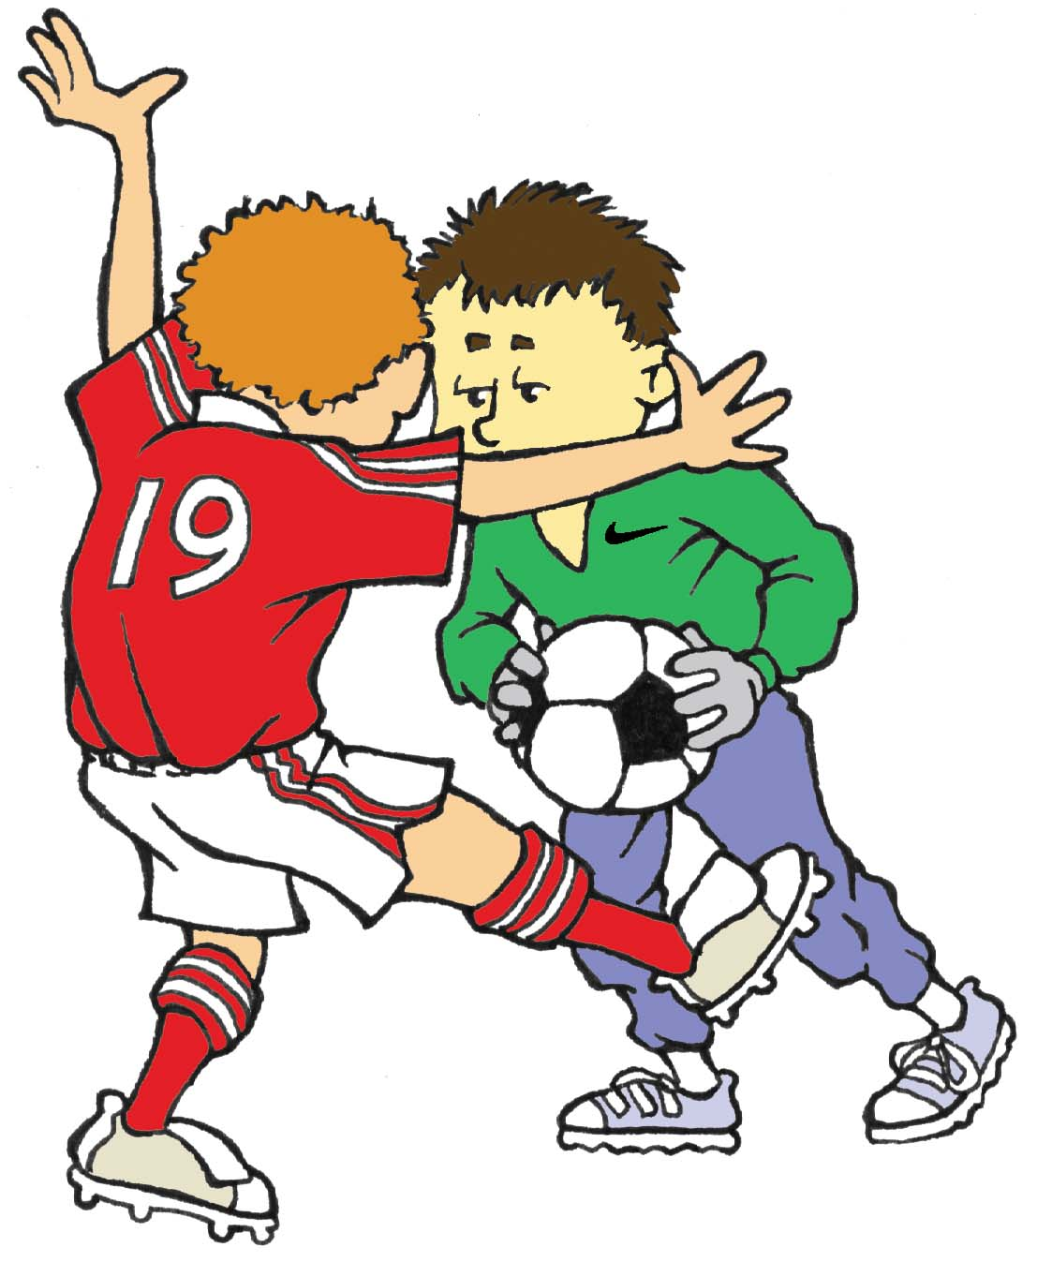
(3) Preventing
Preventing or hindering the goalkeeper from releasing the ball back into play
Notes:
Online Training Script:
Preventing the goalkeeper from releasing the ball with his or her hands.
This also includes interfering with a goalkeeper who is punting or drop kicking the ball.
Classroom Instructor Talking Points:

Slide 45

(3) Preventing
Preventing the goalkeeper from releasing the ball with their hands.
This also includes if an opponent kicks or attempts to kick the ball when the goalkeeper is in the process of releasing the ball.

Slide 46
(3) Preventing
This also includes interfering with a goalkeeper who is punting or attempting to punt the ball into play.

Slide 47
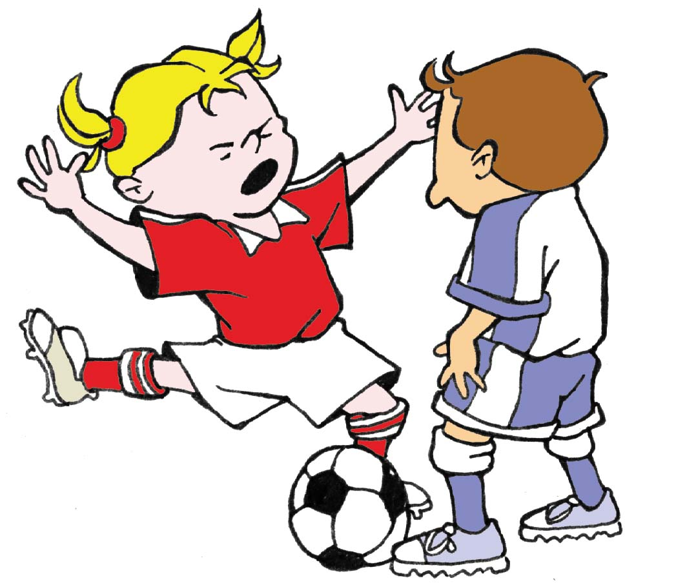
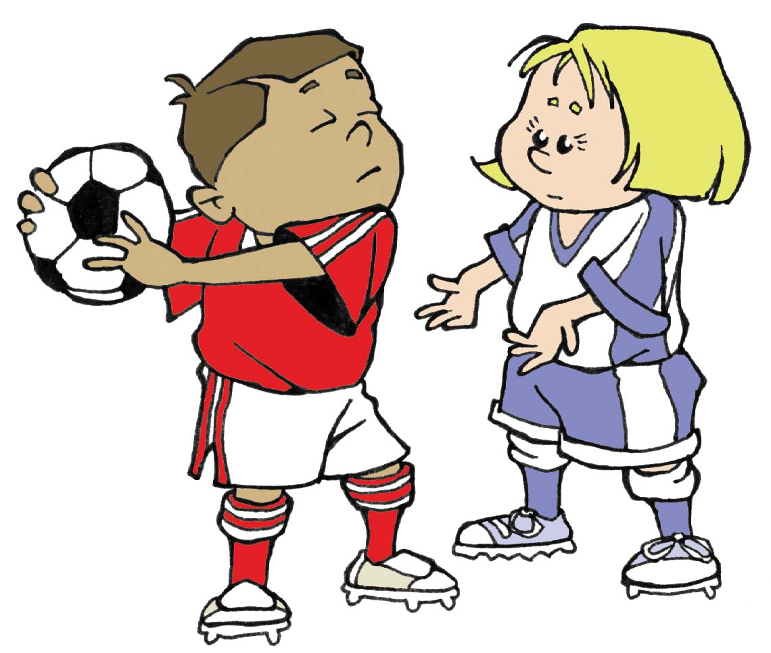
(4) Other Offenses
Committing any offense not specifically listed in Law 12.

Slide 48
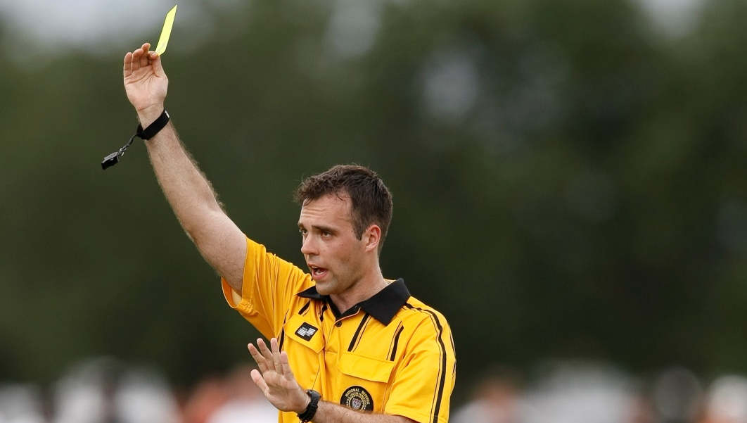
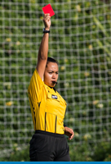
(4 ) Other Offenses
If play is stopped solely for misconduct (no foul committed) for which a yellow or red card will be given, the restart is an IFK provided the misconduct was committed by a player on the field during play.

Slide 49
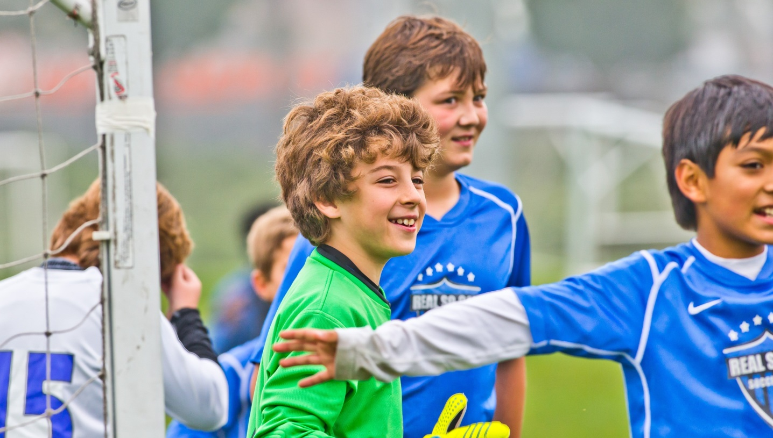
Indirect Free Kick
The second group of four (4) indirect free kick (IFK) fouls are specific to the goalkeeper

Slide 50
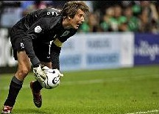
Goalkeeper Possession
A goalkeeper cannot be challenged for the ball by an opponent when in control of the ball with their hands.
Note: In this context the goalkeeper’s hand is defined as any part of the hand (this may be the entire hand or just a single finger) or any part of the arm.

Slide 51
Goalkeeper Possession
A goalkeeper is considered to be in control of the ball when:
the ball is between their hands or between the hand and any surface. Examples of this would be between a single hand and the ground or between a single hand and any part of their body;
holding the ball in the outstretched hand;
bouncing the ball on the ground or throwing it in the air to themselves.

Slide 52
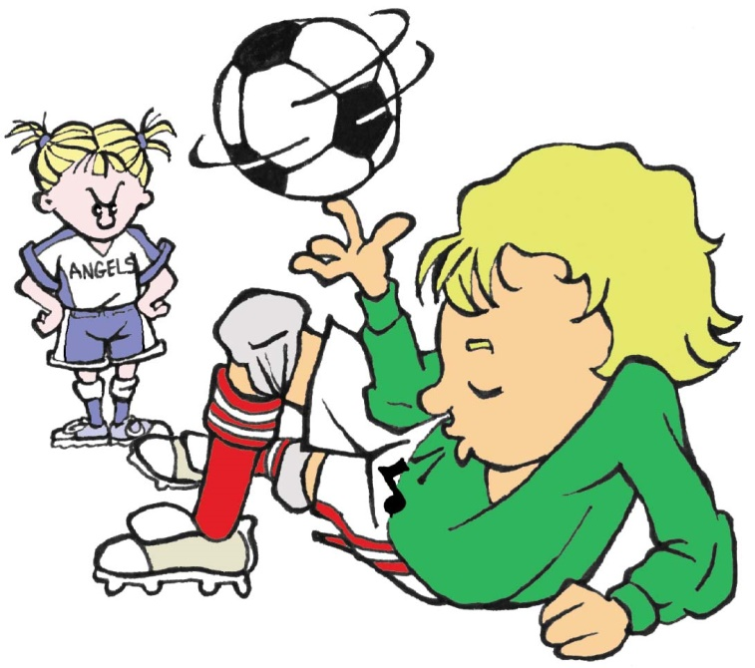
(5) 6 Seconds
The Goalkeeper holding onto the ball with their hands longer than 6 seconds before releasing it.
Note that because many small-sided and recreational games may not have goalkeepers or have players with specific goalkeeper training, referees should only enforce this in instances of blatant time wasting.

Slide 53
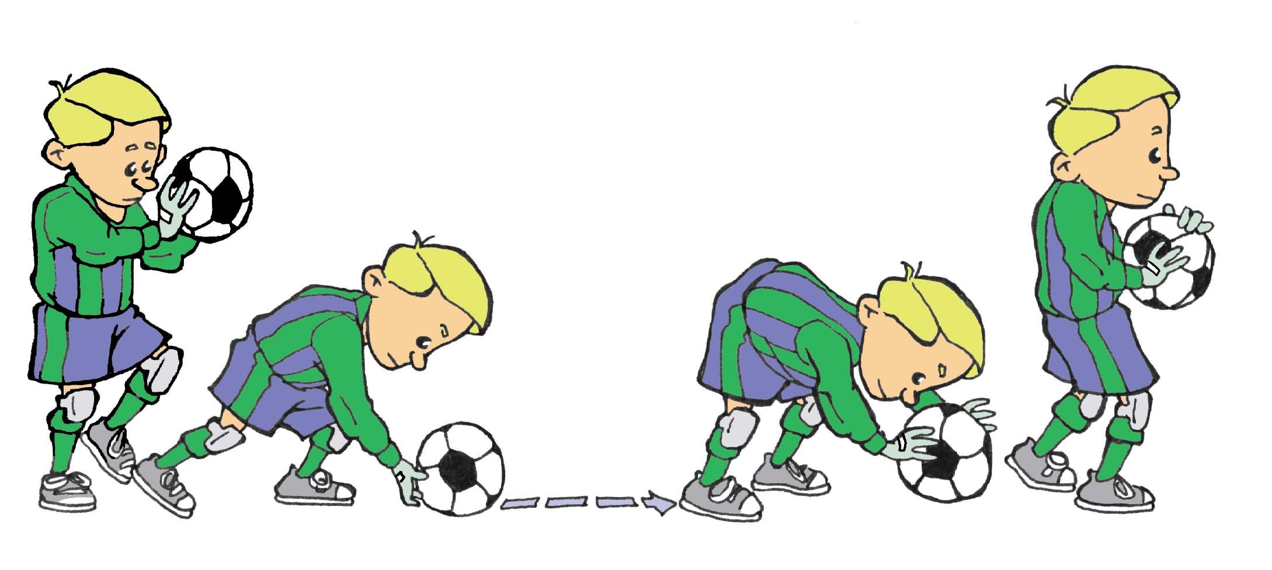
(6) Release and Handle
Goalkeeper touching the ball again with their hands after having deliberately released it into play and before it has touched another player.

Slide 54
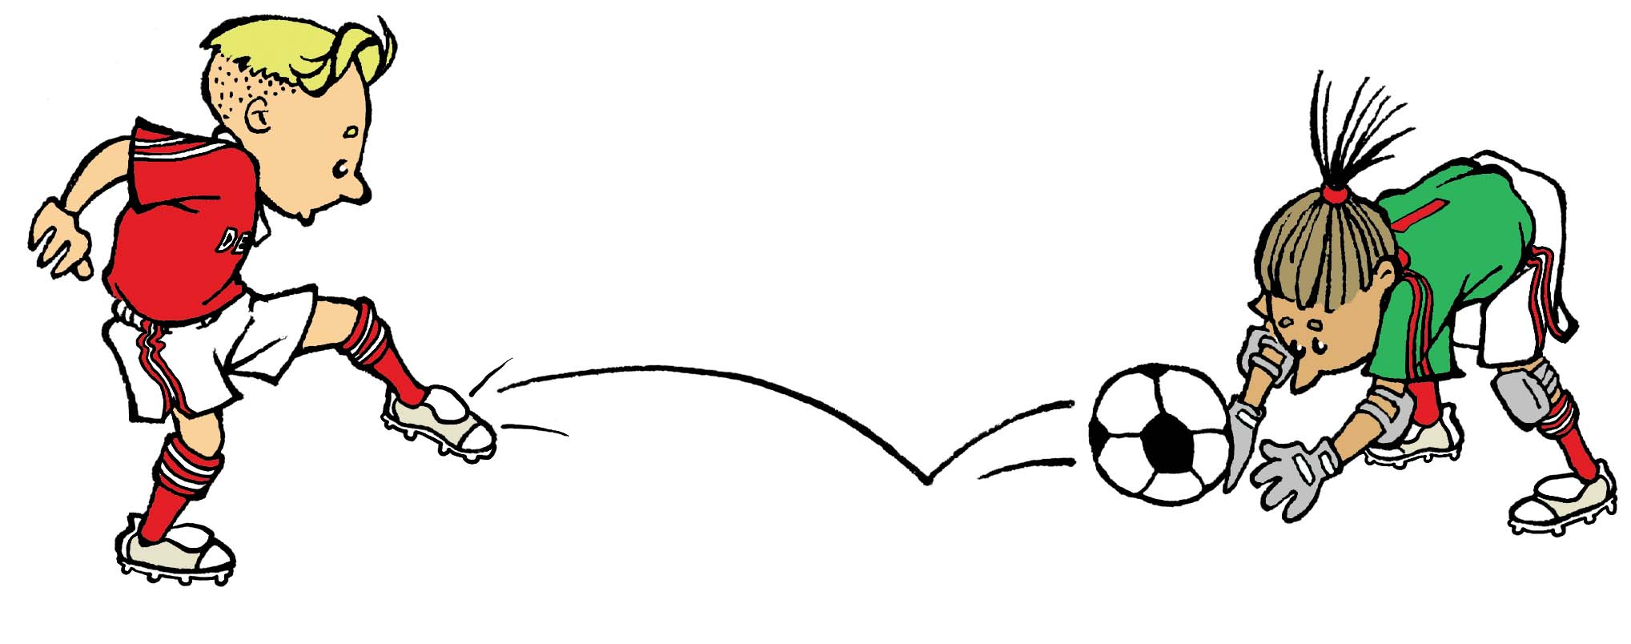
(7) Kick by Teammate
  Goalkeeper touching the ball with their hands after it has been deliberately kicked to them by a teammate.

Slide 55
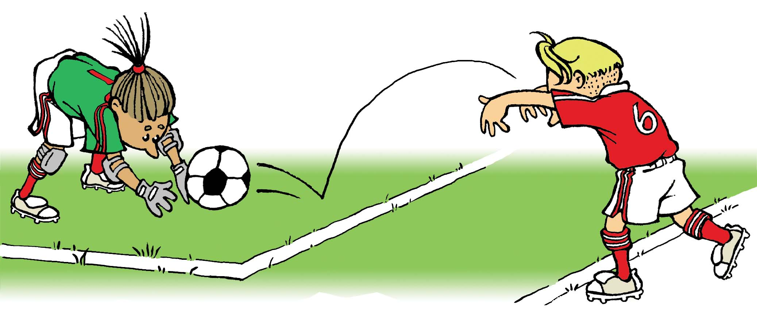
(8)Throw-in by Teammate
Goalkeeper touching the ball with their hands after receiving it directly from a thrown-in taken by a teammate.

Slide 56
IFK Restart Location
The IFK is taken from the place where the offense occurred except for the following two exceptions:
An IFK awarded in the defensive goal area may be taken from any point inside the goal area.
An IFK awarded to the attackers inside the opposing team’s goal area must be taken on the goal area line parallel to the goal line at the point nearest to where the infraction occurred.

Slide 57
Deliberate Heading
(1) If the ball makes contact with a player’s head and the player has not deliberately played or attempted to play the ball, then play should continue as no offense has occurred.
(2) A player shall not be cautioned nor sent-off for persistent infringement or denying an obvious goal scoring opportunity, as a result of a heading infraction.
Heading of the ball is allowed in U12 (11 years old) and older games without limitations.

Slide 58
Deliberate Heading
Deliberate heading of the ball is NOT allowed in U11 (10 years old) and younger games.
If a player deliberately heads the ball in a game with any portion of their head, an indirect free kick (IFK) is to be awarded to the opposing team from the spot of the offense.
If the deliberate header occurs within the goal area, the IFK should be taken on the goal area line at nearest point to where the infringement occurred.

Slide 59
Review Question
64. What are the requirements of a foul?
  Action committed by a player against an opponent or opposing team
  Action committed on the field of play
  Action committed while the ball is in play
  All of the above

Slide 60
Review Question
65. What is the correct restart if a player trips an opponent?
    Indirect free kick
    Direct free kick

Slide 61
Review Question
66. What is the correct restart if a player accidentally kicks an opponent?
    Indirect free kick
    Direct free kick
    No restart, allow play to continue

Slide 62
Review Question
67. What is the correct restart if a player pushes an opponent?
    Indirect free kick
    Direct free kick

Slide 63
Review Question
68. What is the correct restart if a player commits dangerous play?
    Indirect free kick
    Direct free kick

Slide 64
Review Question
69. How should the referee proceed if a player deliberately kicks at, but misses, an opponent in the center circle?
    Stop play and restart with a dropped ball
    Stop play and restart with an IFK
    Stop play and restart with a DFK
    Stop play and restart with a PK
    Allow play to continue

Slide 65
Review Question
70. How should the referee restart play if a player commits a careless tackle on his own penalty area line?
      Dropped ball
      Indirect free kick
      Direct free kick
      Penalty kick

Slide 66
Review Question
71. How should the referee restart play if a goalkeeper plays the ball her hands in the penalty area after it has been deliberately kicked to her by a teammate?
      Dropped ball
      Indirect free kick
      Direct free kick
      Penalty kick

Slide 67
Review Question
72. How should the referee restart play if a goalkeeper’s hands cross the penalty area line into the penalty arc while holding the ball?
      Dropped ball
      Indirect free kick
      Direct free kick
      Penalty kick

Slide 68
Review Question
73. How should the referee restart play if a player commits an impeding offense inside their own penalty area?
        Dropped ball
        Indirect free kick
        Direct free kick
        Penalty kick

