Slide 1
Mod “A” Brain Teasers
Ohio South 2016
Intermediate Referee Recertification
Mod “A” Training

Slide 2
Brain Teaser #1

Slide 3
Referee Positioning
Brain Teaser #2

Slide 4
Referee Positioning
Brain Teaser #3

Slide 5
Handling
Brain Teaser #4

Slide 6
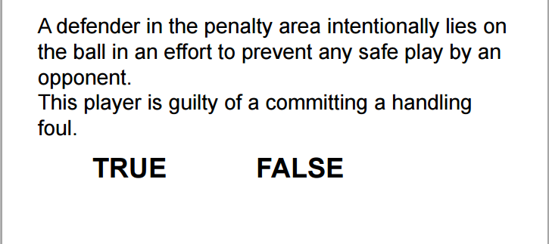
Handling
Brain Teaser #5

Slide 7
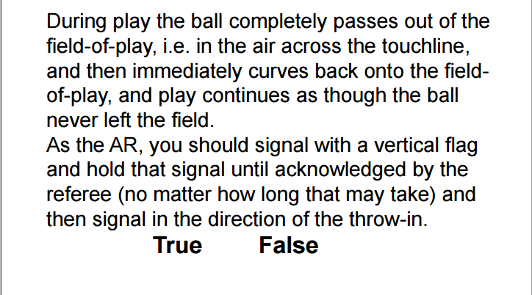
AR Involvement
Brain Teaser #6

Slide 8
AR Involvement
Brain Teaser #7

Slide 9
Kicks from the Mark
Brain Teaser #8

Slide 10
Kicks from the Mark
Brain Teaser #9
Red Player
Blue Player

Slide 11
Referee Ethics
Brain Teaser #10

Slide 12
GK Incident #1
An attacker is directly in front of the GK who has the ball in his arms. The GK takes 3 steps around the attacker, to distribute the ball. The attacker moves with the GK, preventing him from releasing the ball.
GK Incident #2
A teammate of the GK panics and kicks the ball toward the GK, but outside their Penalty Area. The GK collects the ball with her feet, dribbles it back into the Penalty Area and then kicks it to another teammate who is up field.

Slide 13
Brain Teaser #11 - Goalkeeper Incident Worksheet
Incident Number | No Stoppage | Stoppage Restart | Stoppage & Caution | Stoppage & Send-off
1 | YES | IFK | YES
2 | NO
Notes:
In the group discussion – classify what you should do with the incident using the following tale of actions.

Slide 14
GK Incident #3
On a corner kick, the GK jumps between two attackers to punch the ball away. In the process of clearing the ball, the GK then accidentally strikes the attacker in the head with his follow through.
GK Incident #4
A teammate of the GK kicks the ball towards the GK outside their Penalty Area. The GK then collects the ball with her feet, dribbles it back into the Penalty Area, and then picks the ball up with her hands and throws it to another teammate who is up field.

Slide 15
Brain Teaser #11 - Goalkeeper Incident Worksheet
Incident Number | No Stoppage | Stoppage Restart | Stoppage & Caution | Stoppage & Send-off
3 | YES | PK
4 | YES | IFK
Notes:
In the group discussion – classify what you should do with the incident using the following tale of actions.

Slide 16
GK Incident #5
A teammate of the GK is able to deliberately play the ball off his shin directly to his GK inside the Penalty Area. The GK then collects the ball with his hands and clears the ball up-field with a punt.
GK Incident #6
A GK catching a high-flying ball jumps straight up in the air with his knee raised. No attacker is within playing distance of the ball.

Slide 17
Brain Teaser #11 - Goalkeeper Incident Worksheet
Incident Number | No Stoppage | Stoppage Restart | Stoppage & Caution | Stoppage & Send-off
5 | NO
6 | NO
Notes:
In the group discussion – classify what you should do with the incident using the following tale of actions.

Slide 18
GK Incident #7
A ball deflects off an attacker into the GK’s hands. The GK collects the ball and prepares to make a punt. The attacker, who has turned and starting to move back toward midfield, is accidentally hit in the head by the punt from the GK. The attacker collapses on the ground.
GK Incident #8
A goalkeeper who is in the process of moving to attempt to collect a loose ball within her own goal area is fair charged by an opponent.

Slide 19
Brain Teaser #11 - Goalkeeper Incident Worksheet
Incident Number | No Stoppage | Stoppage Restart | Stoppage & Caution | Stoppage & Send-off
7 | YES | DROP BALL
8 | YES | DFK
Notes:
In the group discussion – classify what you should do with the incident using the following tale of actions.

Slide 20
GK Incident #9
A GK challenges an attacker heading for the goal. During the challenge, with no other defenders between him and the goal, the goalkeeper trips the attacker inside the Penalty Arc.
GK Incident #10
After the GK makes a save, the attacker who took the shot accidentally (through normal momentum) brushes by the GK. After the attacker leaves the Penalty Area, the GK, while standing in the Penalty Area, throws the ball at the attacker’s head.

Slide 21
Brain Teaser #11 - Goalkeeper Incident Worksheet
Incident Number | No Stoppage | Stoppage Restart | Stoppage & Caution | Stoppage & Send-off
9 | YES | PK |  | YES
10 | YES | DFK |  | YES
Notes:
In the group discussion – classify what you should do with the incident using the following tale of actions.

