Slide 1
Kicks from the Mark
Ohio South 2016
Intermediate Referee Recertification Training
Notes:
New screen shots

Slide 2
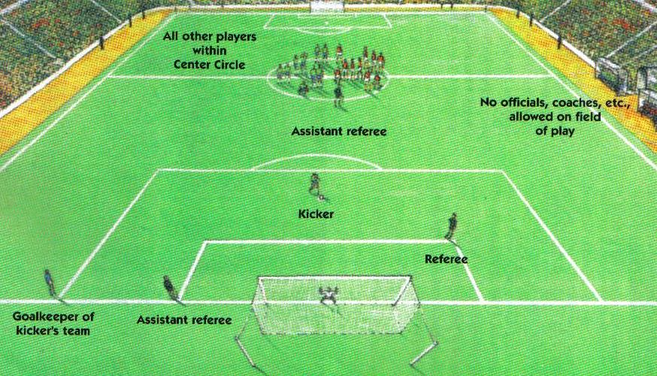
Taking of Kicks from the Penalty Mark
pg. 56, FIFA LOG

Slide 3
Taking of Kicks from the Mark
Coin Toss – Winner decides which team will kick first
Goal - The referee selects goal to be used
Kickers – Only players on the field at the end of the game are eligible to kick … initial set of 5 kickers for each team
Alternate Kicks – Conducted in pairs, one from each team, for an initial round of five pairs

Slide 4
Taking of Kicks from the Mark
Goalkeeper – Any eligible player may change places with the GK at any time
Winner - Team with most goals after each team has taken 5 kicks
Tie-Breaker – Kicks will continue to be taken one pair at a time until winner is determined

Slide 5
Taking of Kicks from the Mark
Different Kicker – All eligible players (including GK) must take a kick before any player can take a second kick
Reduce to Equate – Before beginning the kicks each team will have an equal number of kickers
No Substitutions - Only an injured goalkeeper may be substituted

Slide 6
Taking of Kicks from the Mark
Kicker Violation – If the kicker violates Law 14 and a goal is scored, the kick must be retaken
Goalkeeper Violation – If the goalkeeper violates Law 14 and a goal is not scored, the kick must be retaken
Kicker – May not play the ball a second time

Slide 7
Kicks from the Mark
Brain Teaser #8

Slide 8
Kicks from the Mark
Brain Teaser #9

