Slide 1
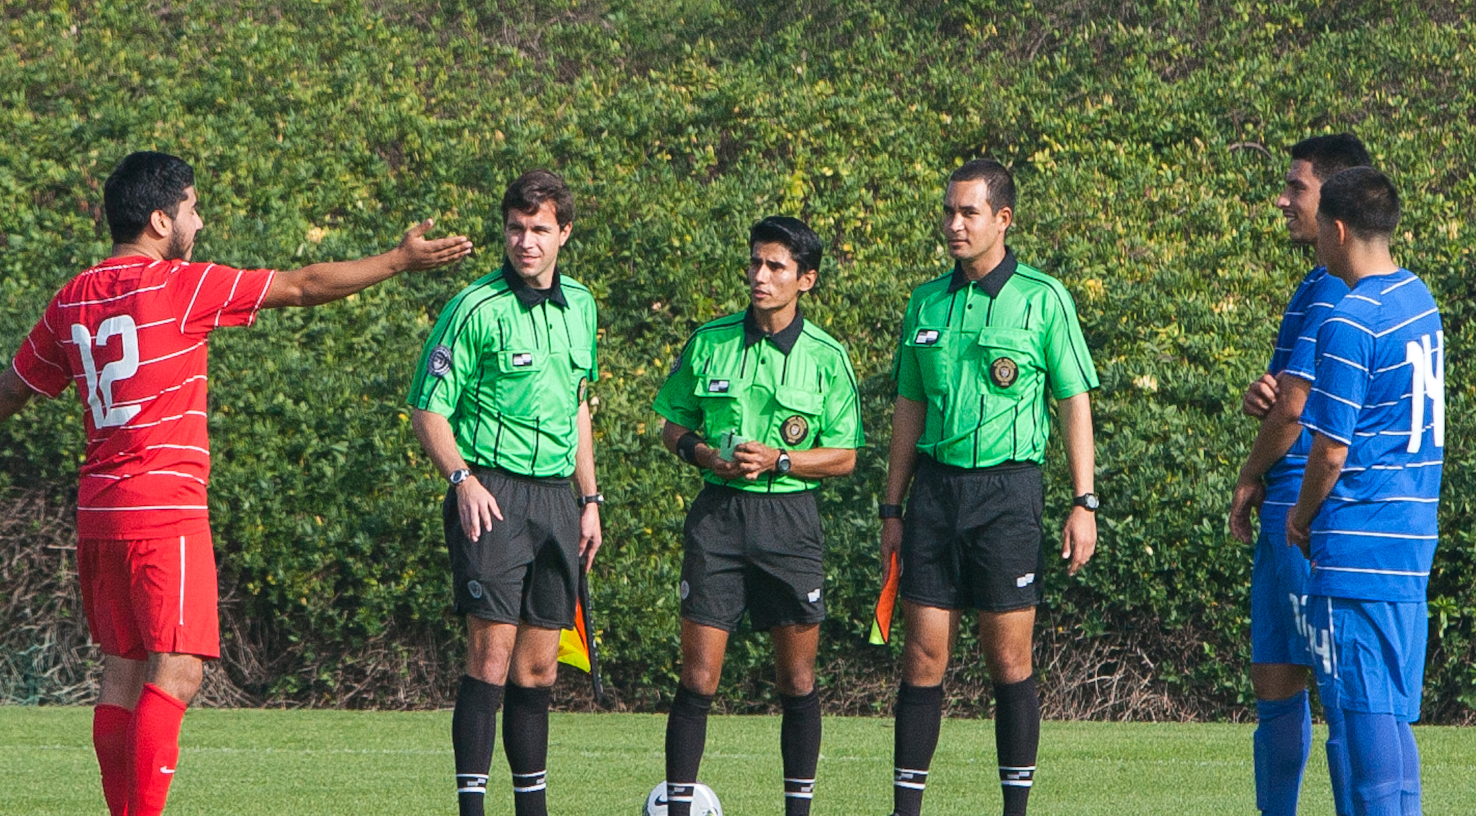
OSSRC Grade 7 Brain Teaser
Questions & Answers
Notes:
Online Training Script:

Slide 2
BT1 - LIGHTNING
You are refereeing a game. Midway through the second half, the sky gets cloudy with angry, dark gray clouds and you hear distant thunder. You stop the game.
After 10 minutes, it is still cloudy but no further sounds of thunder were heard.
The coach of the Red team sends his players back out onto the field to restart play. The other team does the same.
As the Referee, you must go out onto the field and restart the match.
A. TRUE B. FALSE
Notes:
Online Training Script:
Classroom Instructor Talking Points:

Slide 3
BT2 - Foul Recognition
In a girls U15 state cup match, an attacker A10 makes a run with the ball towards her opponent's goal. Just after entering the penalty area she is dribbling the ball heading directly towards the next-to-last defender D6, who is standing relatively motionless. As A10 approaches, D6 instinctively reaches out with her foot in an attempt to tackle the ball away. But just before D6 is able to touch the ball, A10 deftly pushes the ball past D6 and then collides with her causing both players to fall to the ground. The goalkeeper, who is the only other player in the vicinity of the play, runs up and collects the ball. As the referee you should (more than one correct answer may be possible):
Allow play to continue, no foul has been committed
Blow the whistle and stop play for a careless foul
Restart with a DFK for D6’s team
Restart with a Penalty Kick
Send-off D6 for denying an obvious goal scoring opportunity
Not issue any cards
Caution D6 for impeding
Caution A10 for reckless play
Notes:
Online Training Script:
Classroom Instructor Talking Points:

Slide 4
BT3 - Foul Recognition
During play, a sole defender D12 possesses the ball near the top of her own penalty area. She senses an oncoming attacker, panics and attempts to clear the ball away by kicking it across her own goal-line, but the ball is kicked hard toward her own goal. The goalkeeper D6 makes a diving save of the ball with her hands and deflects the ball over the goal-line wide of the goal. What should the referee do? (more than one correct answer may be possible).
Caution D12 for unsporting behavior
Caution the goalkeeper D6 for touching the ball with her hands from pass-back by D12
Restart with a corner kick
Send-off the goalkeeper D6 for denying an obvious goal
Allow the sure goal and restart with a kick-off
Restart with an IFK for the attacking team
Restart with a penalty kick
Notes:
Online Training Script:
Classroom Instructor Talking Points:

Slide 5
BT4 - Foul Recognition
A player, A7, outside the opponent’s penalty area has possession of the ball and is dribbling it in an attacking run on goal. A defender, D5, recklessly runs in and is able to step between A7 and the ball, which results in a violent collision between the two players and D5 falls to the ground injured. After play is stopped D5 is attended to by the team’s trainer.
The referee then: (more than one correct answer may be possible).
A. Should restart play with an IFK
B. Should restart play with a dropped ball
C. Should restart play with a DFK for D5’s team
D. Should restart play with a DFK for A7’s team
E. Must issue a yellow card to D5
F. Must issue a yellow card to A7
G. Should not issue any cards
H. Must have D5 leave the game (may be substituted and may return later)
I. Must have D5 leave the game (may be substituted, but would not be allowed to return later)
Notes:
Online Training Script:
Classroom Instructor Talking Points:

Slide 6
BT5 - Foul Recognition
A hard kicked ball is coming right toward a player A6's head. Reflectively, the player A6 raises both hands to protect his face and the ball then hits A6's forearm and falls to the ground at his feet.
A6 immediately collects the ball with his feet and dribbles the ball around a defender D2 and kicks the ball into the goal.
The referee should (more than one correct answer may be possible):
Allow the goal, since no foul has occurred
Do not allow the goal and call the foul on A6 for deliberately handling the ball
Do not allow the goal and call a foul on A6 because he gained an unfair advantage from the ball to hand contact.
Restart with a kick-off
Restart with a DFK for D2’s team
Restart with an IFK for D2’s team
Notes:
Online Training Script:
Classroom Instructor Talking Points:

Slide 7
BT6 - MISCONDUCT
Player A4 is running with the ball and has only the goalkeeper, D3, between him and the goal. About 30-yards from the goal a defender, D7, is able to grab the back of A4’s shirt with just enough force to make him lose control of the ball, which allows another defender, D9, to be able to catch up and kick the ball away.
In every game and for every situation that occurs as described above, which of the answers below is always an incorrect action by the referee (more than one answer is possible).
A. allowing play to continue
B. blowing the whistle to stop play
C. restarting play with a DFK
D. restarting play with an IFK
E. issuing a yellow card to player D7 for a tactical foul
F. issuing a red card to player D7 for DOGSO
G. not issuing any cards
Notes:
Online Training Script:
Classroom Instructor Talking Points:

Slide 8
BT7 - MISCONDUCT
A defender, D6, is taking a DFK from a point about 25-yards from her own goal. She attempts to kick the ball back to her GK, who is standing off to the side of the goal. Instead, D6 inadvertently kicks the ball directly at her own goal. Just before the ball enters the goal another defender, D5, knocks the ball wide of the goal and over the goal-line with her forearm.
The referee should: (more than one answer is possible)
A. Restart with a penalty kick
B. Restart with a corner kick
C. Retake the original DFK
D. Issue a yellow card to player D5 for a tactical foul
E. Issue a red card to player D5 for denying a sure goal
F. Not issue any cards
Notes:
Online Training Script:
Classroom Instructor Talking Points:

Slide 9
BT8 – Proper Uniforms
In a GU12 match the Referee determines that one of the teams has only Gold shirts to wear in the game.
The Referee decides to have the officiating crew change to Blue jerseys, but the two young ARs only have Gold shirts.
To avoid problems the Referee decides to wear a Blue jersey, while allowing the ARs to wear their Gold shirts.
Is this acceptable and something the Referee should do?
A. Yes
B. No
Notes:
Online Training Script:
Classroom Instructor Talking Points:

Slide 10
BT9 – Proper Uniforms
An adult AR comes to a match wearing black ankle socks, green shoes and long shorts hanging below the knee.
The Referee decides to dismiss the AR for not wearing a proper uniform and then appoints a Club Linesman in his place.
The AR expects to be paid, since he was scheduled by the assignor, traveled 20 miles and he was at the field well prior to game time.
The Referee is obligated to give this AR his game fee, even though the Referee chose not to use him.
A. True
B. False
Notes:
Online Training Script:
Classroom Instructor Talking Points:

Slide 11
BT10 – Referee Systems
Three adults have been assigned to a officiate a U14 boys game using the diagonal system. One official fails to show up and no one is available to serve as a Club Linesman.
Both coaches, who are familiar with both officials, agree that using two-whistles would provide a better officiated match and insist that the match be officiated using two whistles.
In this situation it would then be acceptable for the two referees to officiate the game using two whistles.
A. True
B. False
Notes:
Online Training Script:
Classroom Instructor Talking Points:

Slide 12
BT11 – Persistent Infringement
In a U17 upper level boys match a defender D6 has been marking the center striker A7 from the beginning of the game. D6 has constantly ( 7 different times) committed little ticky-tacky, but annoying, fouls that the referee considers to be trifling and does not whistle or acknowledge any of them.
In the 35th minute of the game D6 grabs A7’s shirt just enough to knock him off the ball. The referee blows his whistle to stop play and awards a DFK to A7 for the holding foul committed by D6.
Even though this is the first foul called by the referee against D6 in the game, the referee should still issue a caution to D6 for persistent infringement.
A. TRUE B. FALSE
Notes:
Online Training Script:
Classroom Instructor Talking Points:

Slide 13
BT12 - Offside
A3 has kicked the ball deep into the attacking half of the field and a teammate A7, who is in an offside position at the time of the kick, is the only attacking player near the ball.
A7 sprints towards the ball, but because he has not yet touched the ball, the AR does not signal the offside offense.
Is this a correct decision?
A. Yes
B. No
Notes:
Online Training Script:
Classroom Instructor Talking Points:

Slide 14
BT13 - Offside
A player A9 in an offside position sprints towards the ball that has been kicked ahead by a teammate.
The nearest defender, D5, then also starts to sprint to the ball, but well before either player is able to touch it, the ball passes over the goal line and out of play.
Should the AR signal for the offside offense?
A. Yes
B. No
Notes:
Online Training Script:
Classroom Instructor Talking Points:

Slide 15
BT14 - Offside
A player A12 in an offside position sprints towards the ball that has been kicked ahead by a teammate.
The nearest defender, D4, then also starts to sprint to the ball, and is able to kick the ball over the goal line and out of play just before A12 is able to reach the ball.
Should the AR signal for the offside offense?
A. Yes
B. No
Notes:
Online Training Script:
Classroom Instructor Talking Points:

Slide 16
BT15 - Reading Play
Will having a general understanding of the teams’ tactics better prepare referees to position themselves effectively during the game?
Yes
No
Notes:
Online Training Script:
Classroom Instructor Talking Points:

Slide 17
BT16 - Reading Play
Being able to recognize the tactical changes that result from substitutions will allow officials to be which of the following?
Less involved and more patient
Less reactive and more proactive
Notes:
Online Training Script:
Classroom Instructor Talking Points:

Slide 18
BT17 - Reading Play
What are some general tactics that referees working the amateur adult game should be familiar with?
Set pieces
Marking
Off the ball
All of the above
Notes:
Online Training Script:
Classroom Instructor Talking Points:

Slide 19
BT18 - Reading Play
Which of the following is not associated with reading play?
Positioning
Use of the tool box
Being proactive
Professional appearance
Notes:
Online Training Script:
Classroom Instructor Talking Points:

Slide 20
BT19 - Reading Play
What should a referee be looking for with regard to how or why players are committing fouls?
Frustration
Intimidation
Retaliation
All of the above
Notes:
Online Training Script:
Classroom Instructor Talking Points:

Slide 21
BT20 - Dissent
If not dealt with by the referee, dissent can do which of the following?
Undermine the authority of the referee
Negatively impact game flow
Lead to game disrepute or mass confrontation
All of the above
Notes:
Online Training Script:
Classroom Instructor Talking Points:

Slide 22
BT21 - Dissent
What factors should the referee consider when dealing with dissent?
Loud, personal, offensive
Public, targeted, provocative
Public, personal, provocative
Offensive, inflammatory, detailed
Notes:
Online Training Script:
Classroom Instructor Talking Points:

Slide 23
BT22 - Dissent
Is using presence and personality a way for referees to set the tone early in the match when managing dissent?
Yes
No
Notes:
Online Training Script:
Classroom Instructor Talking Points:

Slide 24
BT23 - Dissent
Which should the referee do to effectively manage dissent?
Completely ignore the first signs of dissent until it becomes a major problem
Be proactive and take action early in the game to put a stop to dissent before it leads to bigger problems
Notes:
Online Training Script:
Classroom Instructor Talking Points:

Slide 25
BT24 - Dissent
Dissent directed at an AR or 4th official should be addressed by the Referee only when indicated or signaled as such by the AR or 4th official.
True
False
Notes:
Online Training Script:
Classroom Instructor Talking Points:

Slide 26
BT25 - Foul Recognition
When evaluating fouls, what factors should the referee consider?
Temperature of the match
Speed and distance of the player
Nature of the contact made
All of the above
Notes:
Online Training Script:
Classroom Instructor Talking Points:

Slide 27
BT26 - Foul Recognition
Are trifling fouls those that are simple in nature and don’t have a significant impact on the game?
Yes
No
Notes:
Online Training Script:
Classroom Instructor Talking Points:

Slide 28
BT27 - Foul Recognition
What are the requirements for a foul?
The action is committed by a player
The action if committed on the field of play
The action is committed while the ball is in play
All of the above
Notes:
Online Training Script:
Classroom Instructor Talking Points:

Slide 29
BT28 - Foul Recognition
What are fouls that break up promising attacks referred to as?
Trifling
Tactical
Ticktack
All of the above
Notes:
Online Training Script:
Classroom Instructor Talking Points:

Slide 30
BT29 - Foul Recognition
Is proper positioning important for accurate foul recognition?
Yes
No
Notes:
Online Training Script:
Classroom Instructor Talking Points:

Slide 31
BT30 - Above the Shoulder
What type of challenges most frequently involve contact above the shoulder?
Aerial
Tactical
Excessive force
Tackles from behind
Notes:
Online Training Script:
Classroom Instructor Talking Points:

Slide 32
BT31 - Above the Shoulder
Is the arm considered being used as a weapon if a player jumps up and into an opponent or leads with an extended arm?
Yes
No
Notes:
Online Training Script:
Classroom Instructor Talking Points:

Slide 33
BT32 - Above the Shoulder
Does using the arm as a tool mean that the player should always receive a yellow card?
Yes
No
Notes:
Online Training Script:
Classroom Instructor Talking Points:

Slide 34
BT33 - Above the Shoulder
Does using the arm as a weapon mean that the player should always be issued a red card?
Yes
No
Notes:
Online Training Script:
Classroom Instructor Talking Points:

Slide 35
BT34 - Above the Shoulder
Whenever an extended arm makes contact with an opponent’s face or neck region, that must always be considered as an endangerment of that player’s safety.
True
False
Notes:
Online Training Script:
Classroom Instructor Talking Points:

Slide 36
BT35 - Mass Confrontation
Which of the following best describes game disrepute?
At least one player from each team adopting an aggressive attitude towards each other or the match officials
At least three players from each team adopting an aggressive attitude towards each other or the match officials
Notes:
Online Training Script:
Classroom Instructor Talking Points:

Slide 37
BT36 - Mass Confrontation
How many players are involved when describing mass confrontation?
At least one from each team
At least three regardless of which team they are from
Notes:
Online Training Script:
Classroom Instructor Talking Points:

Slide 38
BT37 - Mass Confrontation
Should referees avoid discussing game disrepute and mass confrontation in the pre-game conference?
Yes
No
Notes:
Online Training Script:
Classroom Instructor Talking Points:

Slide 39
BT38 - Mass Confrontation
Should officials recognize the warning signs of game disrepute and mass confrontation and attempt to deal with these proactively?
Yes
No
Notes:
Online Training Script:
Classroom Instructor Talking Points:

Slide 40
BT39 - Mass Confrontation
When mass confrontation breaks out among the players, what approach should the referee team use to manage the situation?
Circle of trust
Triangle of control
Iron triangle
Referee rhombus
Notes:
Online Training Script:
Classroom Instructor Talking Points:

